Slide 1
Research and Scientific method
prepared by
V.Kalyani
Assistant Professor of Geography
Govt.College for Women (A), Kumbakonam.

Slide 2
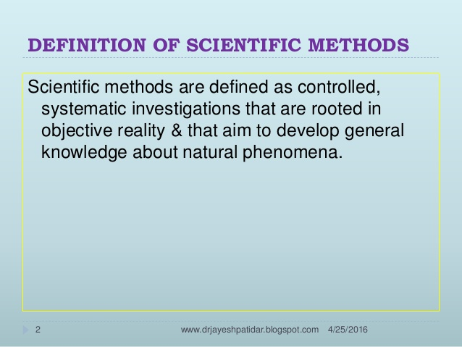

Slide 3
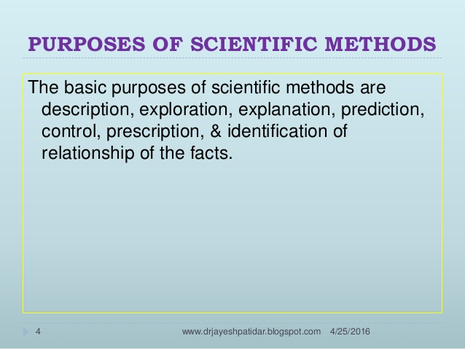

Slide 4
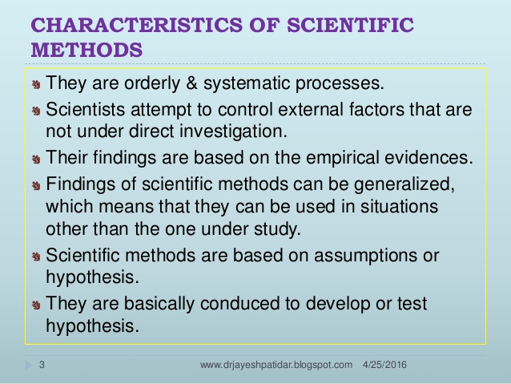

Slide 5
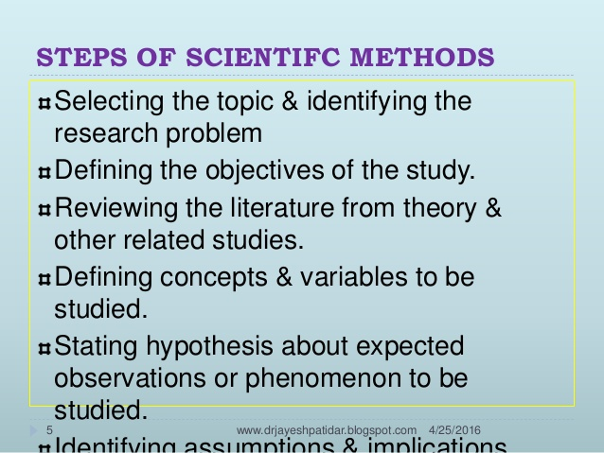

Slide 6
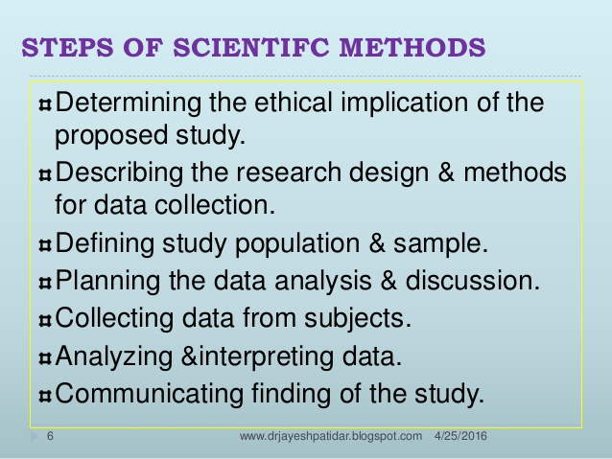

Slide 7
Thank you.

