Slide 1
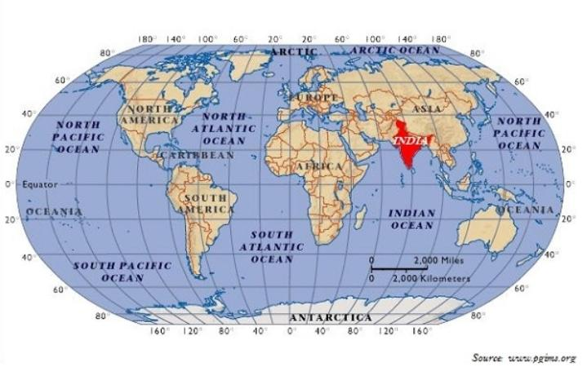
INDIA - LOCATION

Slide 2
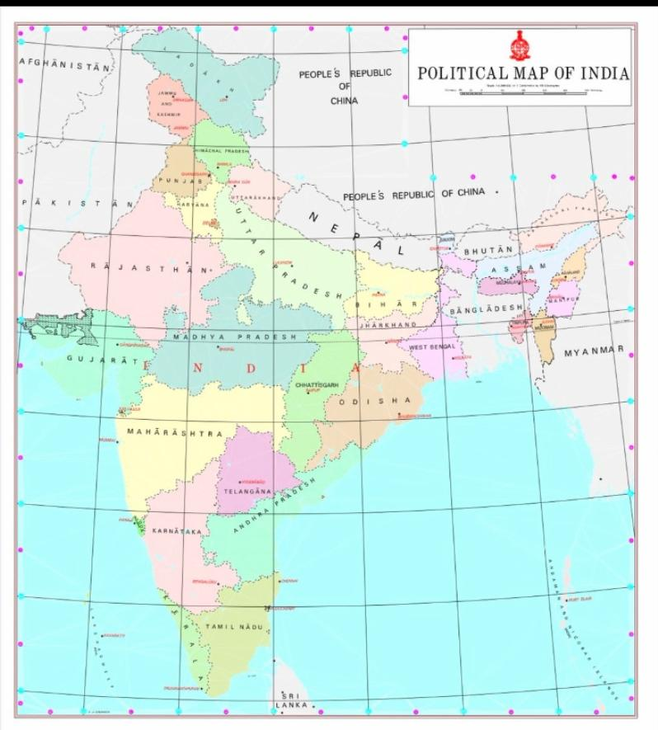
INDIA - LATITUDINAL & LONGITUDINAL MAP
http://meet.google.com/ver-rbrz-mii

Slide 3
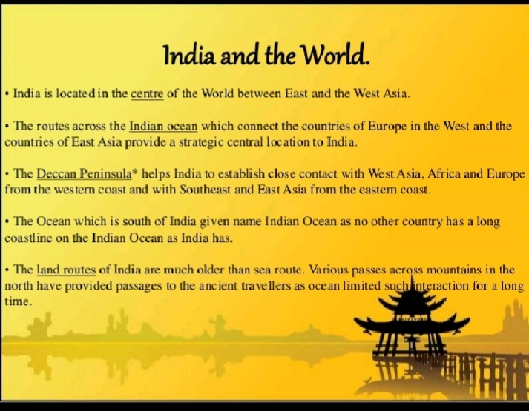

Slide 4
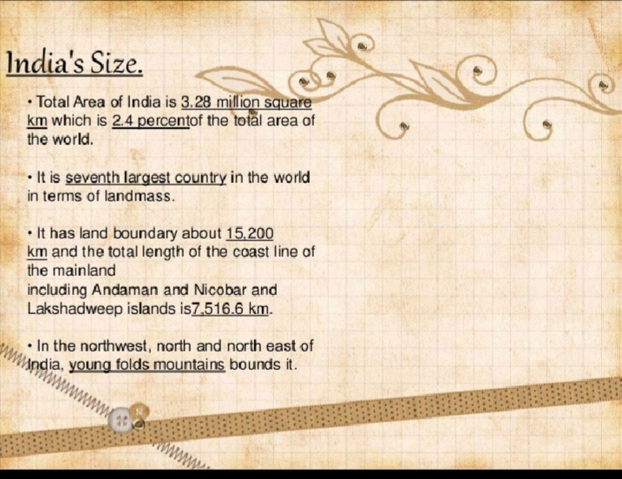

Slide 5
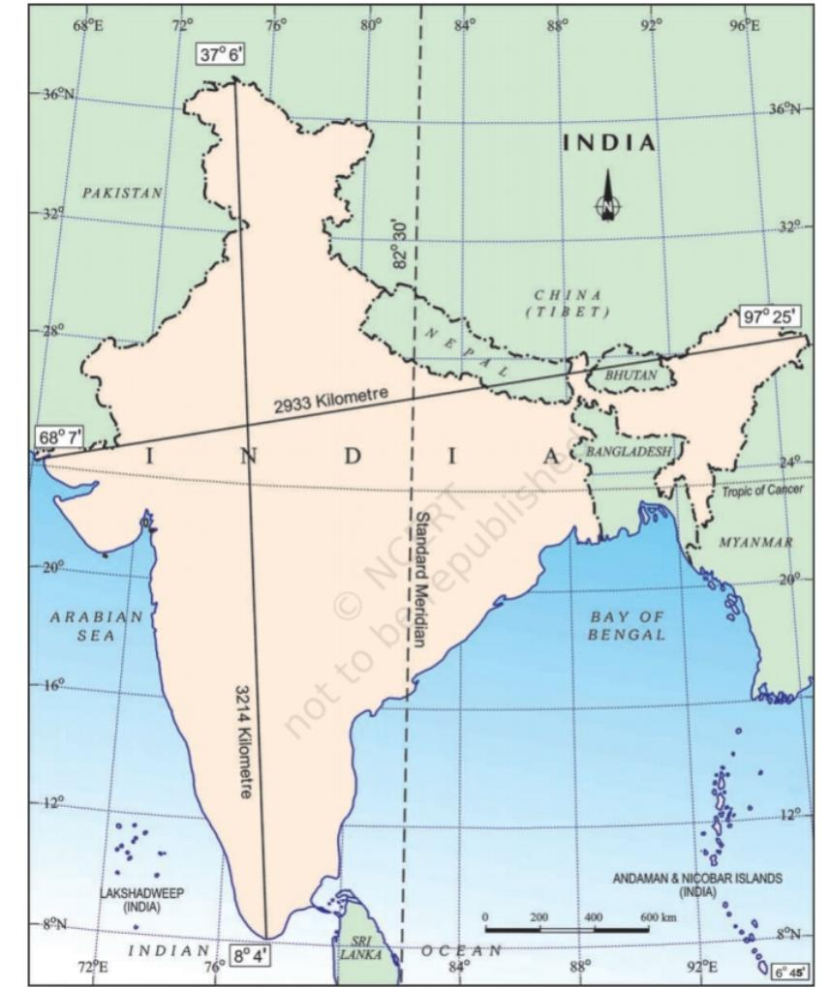

Slide 6
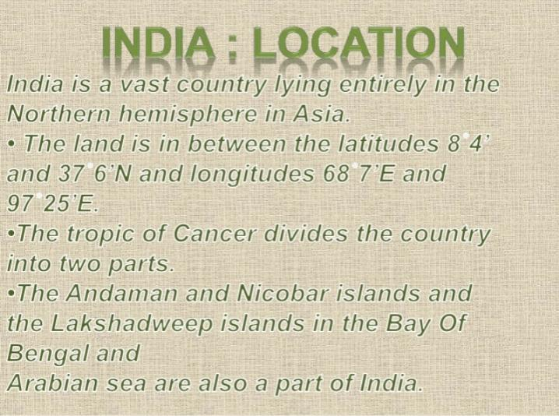

Slide 8
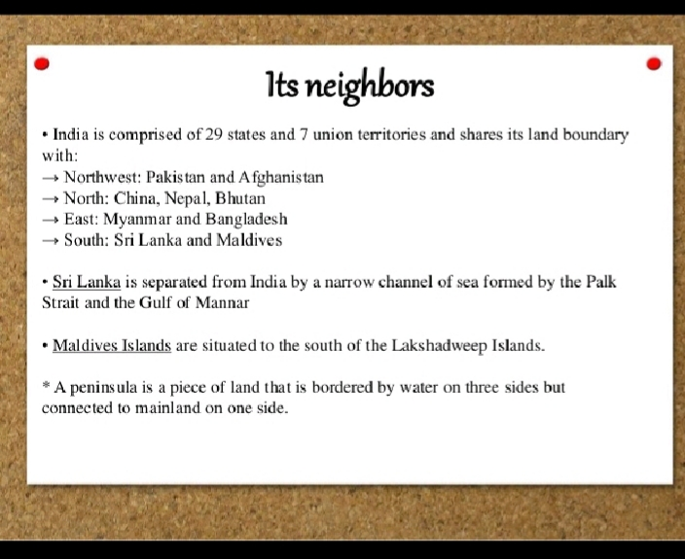

Slide 9
