Slide 1
S. MAHESWARI
Guest Lecturer in Geography
GCW(A)K
Geography of india
Drainage system in india
Part 1 [04.08.2020]

Slide 2
Drainage system in india
Indian Drainage consists of a large number of small and big rivers.
The rivers in India have been more or less adjusted to her physical conditions.
In fact, the rivers are the manifestations of the landscape and climatic conditions of the country.

Slide 3
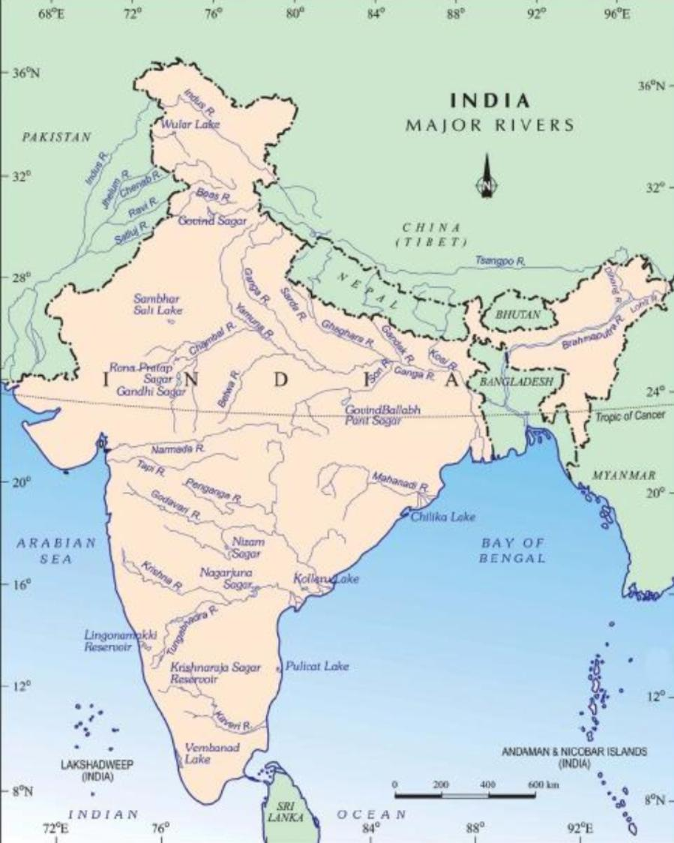
MAJOR RIVERS IN INDIA

Slide 4
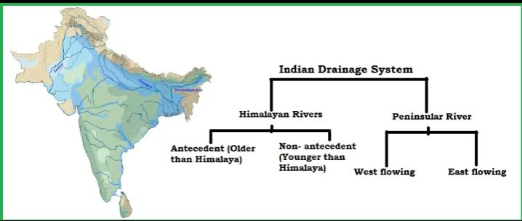
INDIAN RIVERS

Slide 5
RIVER SYSTEM OF HIMALAYAN DRAINAGE
The Hemalayan drainage consists of three major river systems. They are
The Indus River System
The Ganga System
The Brahmaputra River System

Slide 6
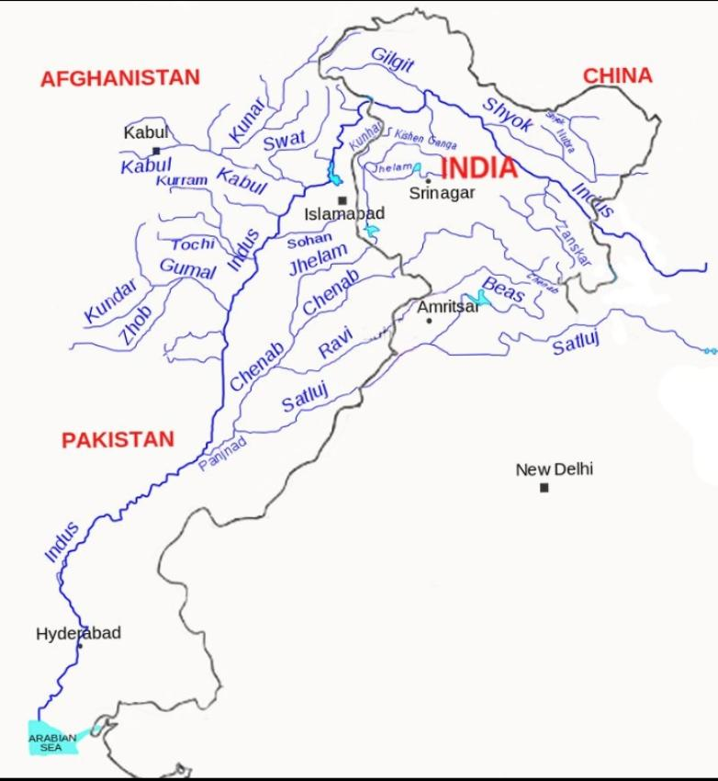
The Indus River System

Slide 7
The Indus River System
Its one of the largest river basins of the world.
Its also called as Sindhu river system.
Its the most westernmost of the Himalayan river in India.
Its tributaries the Jhelum, Chenab, Ravi, Beas, Sutlej, Zasker, Dras, Shyok, Shigar and Gilgit.

Slide 8
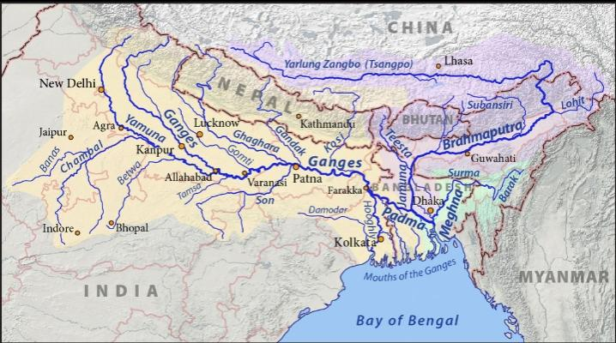
The Ganga River System

Slide 9
The Ganga River System
Its largest and most important river system of India
Its 26.3% catchment area of the country
Its area shared on Ten number of states in our country
Its main tributaries of the Yamuna, Ramganga, Chamba, Gandak and Kosi

Slide 10
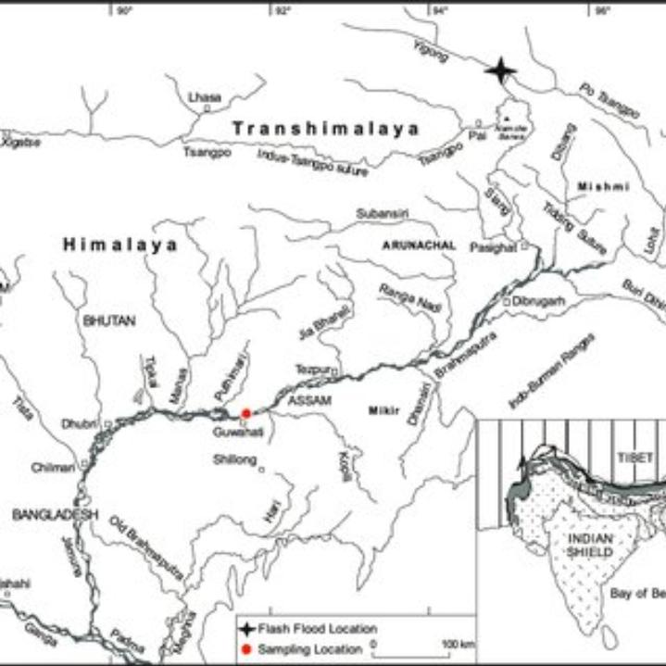
The Brahmaputra River System

Slide 11
The Brahmaputra River System
Its catchment area of 258008 km in India
Its flows eastward and parallal to the main Himalayan range
Its major tributaries are yhe Subansiri, Kameng, Tista, Manas, Burhi, Disang, Dhansiri and Disang

Slide 12
Thank you

