Slide 1
S. Maheswari guest lecturer in geography gcw(a)K geography of india
Topic: drainage system iN india
08.08.2020 [part 2]

Slide 2
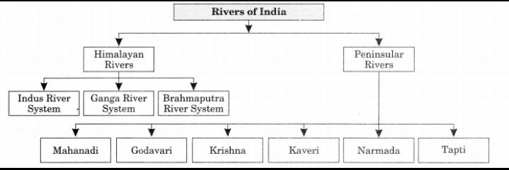
Drainage system in india

Slide 3
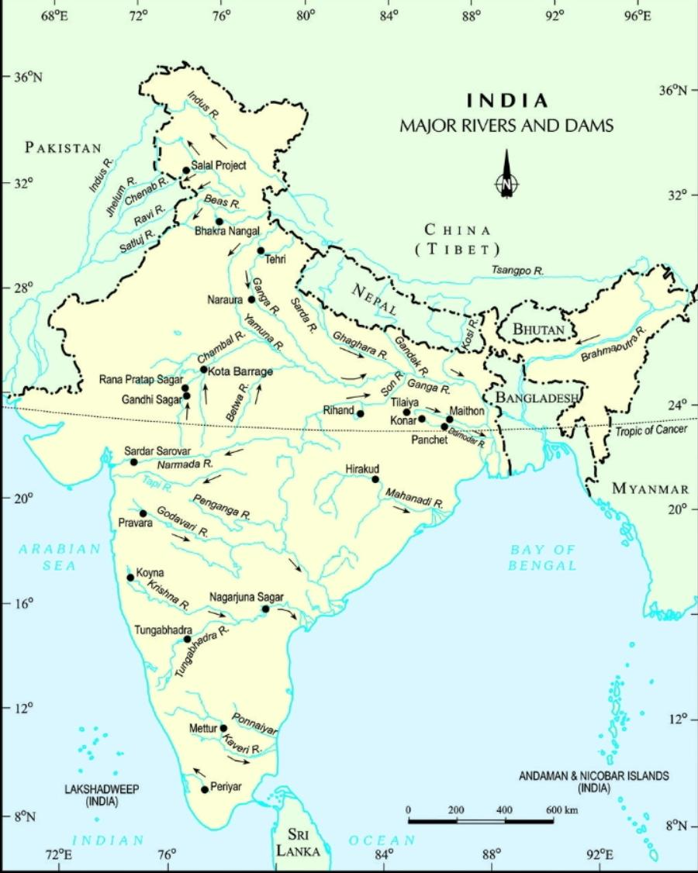
Indian rivers

Slide 4
PENINSULAR RIVERS
EAST WARD RIVERS
WEST WARD RIVERS

Slide 5
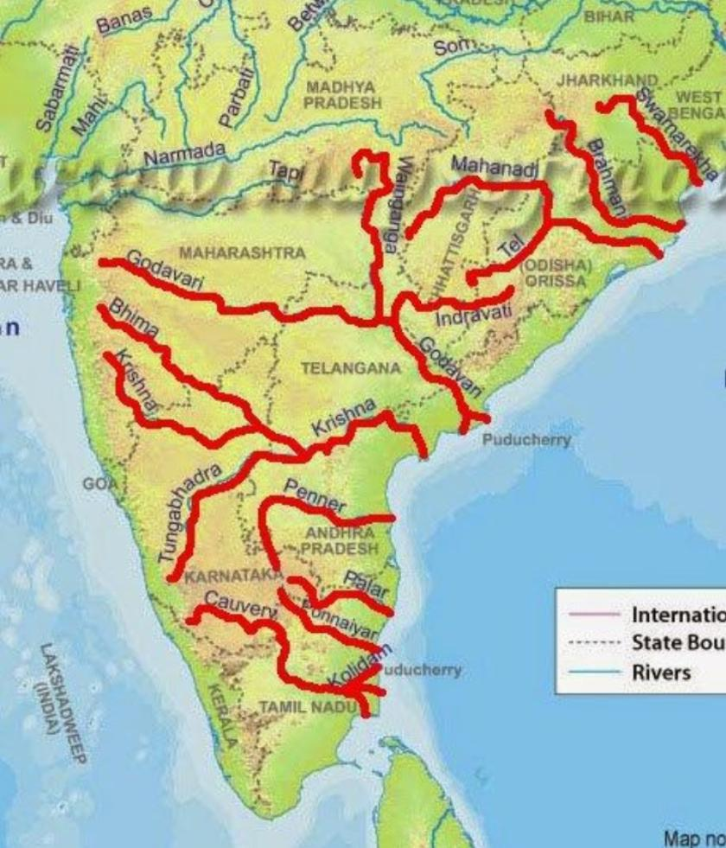
EASTWARD RIVERS

Slide 6
East ward flowing rivers
FOLLOWING IN THE MAIN RIVERS OF EAST WARD FLOWING:
The Mahanathi
The Brahmani
The Subernarekha
The Godavari
The Krishna
The Pennar
The Kaveri
The Tambraparni

Slide 7
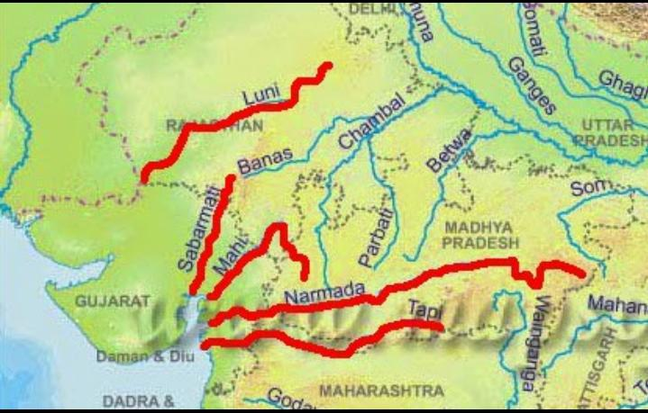
Westward flowing rivers

Slide 8
Westward flowing river
Following is the main rivers of eastward flowing:
The Narmadha
The Tapti
The Sabarmati
The Luni
The Mahi

Slide 9
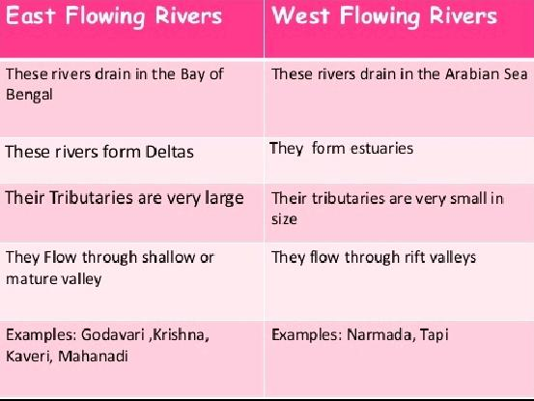

Slide 10
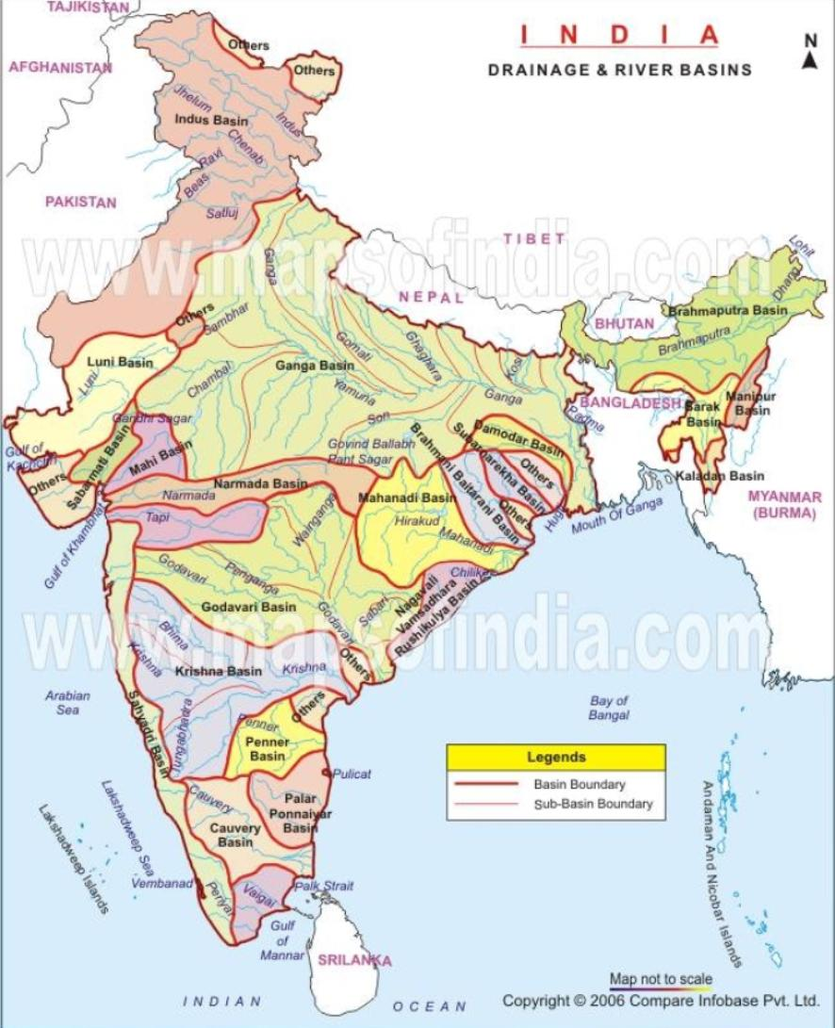

Slide 11
Comparison between himalayan and peninsular rivers
HIMALAYAN RIVERS
These rivers originate from the Himalayan mountain ramges.
They are longer and larger than the peninsular rivers.
They have larger basins and catchment area.
The bedrocks of these rivers are soft, sedimentary and easily erodible.
They are perennial in nature, flow throughout the year.
PENIMSULAR RIVERS
These river originate from the peninsular plateaus in India.
They are comparatively smaller and shorter than the Himalayan rivers.
They have smaller basins and catchment areas.
The bedrocks of these rivers are hard and not easily erodible.
They are seasonal and non-pernnial so may not flow throughout the year.

Slide 12
HIMALAYAN RIVERS
They are fed by the meltwater from glaciers and rains.
They form V-shaped valleys.
They form meanders.
They form big deltas at their mouths where they meet the sea.
They are antecedent rivers, i.e. They maintain tjeir original course and pattern in spite of the changes in the rock topography.
PENINSULAR RIVERS
They are fed only rains.
They form U-shaped valleys.
They may not form meanders.
They form small rivers and estuaries.
They are consequent rivers i.e. They flow in the direction of the slope

Slide 13


