Slide 1
S. MaheSwari guest lecturer in geography government college for women (a) kumbakonam
Iii b.sc. Geography geography of india
Title : natural vegetation and
wildlife sanctury in india
Date : 18.08.2020 & 19.08.2020

Slide 2
Natural vegetation
INTRODUCTION
The natural vegetation is the endowments of nature.
They grow naturally by following the climatic variables. The types of natural vegetation differ according to precipitation, soil, climate, and topography.
The cultivated crops and fruits, orchards form part of vegetation, but not naturally vegetation.

Slide 3
Natural vegetation in india
India is bestowed with a wide range of flora and fauna. Due to a diverse geographical and climatic condition, an extensive range of natural vegetation grows in India.
The main climatic factors are rainfall and temperature.
The amount of annual rainfall has a great bearing on the type of vegetation.
Annual Rainfall | Type of Vegetation
200 cm or more | Evergreen Rain Forests
100 to 200 cm | Monsoon Deciduous Forests
50 to 100 cm | Drier Deciduous or Tropical Savanna
25 to 50 cm | Dry Thorny Scrub (Semi-arid)
Below 25 cm | Desert (Arid)

Slide 4
Temperature is the major factor in Himalayas and other hilly regions with an elevation of more than 900 metres.
As the temperature falls with altitude in the Himalayan region the vegetal cover changes with altitude from tropical to sub-tropical, temperate and finally alpine.
Soil is an equally determining factor in few regions. Mangrove forests, swamp forests are some of the examples where soil is the major factor.
Topography is responsible for certain minor types e.g. alpine flora, tidal forests, etc..

Slide 5
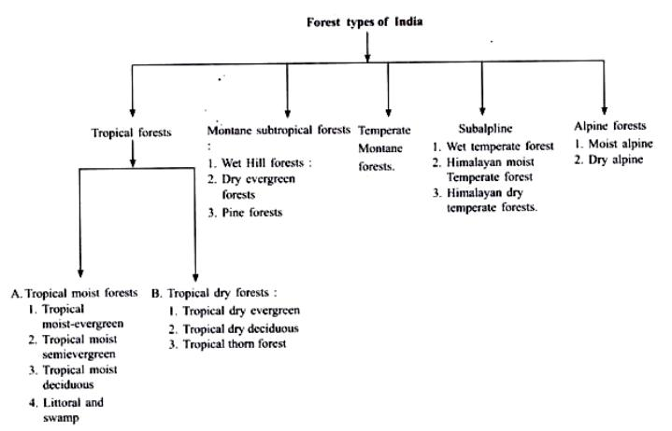

Slide 6
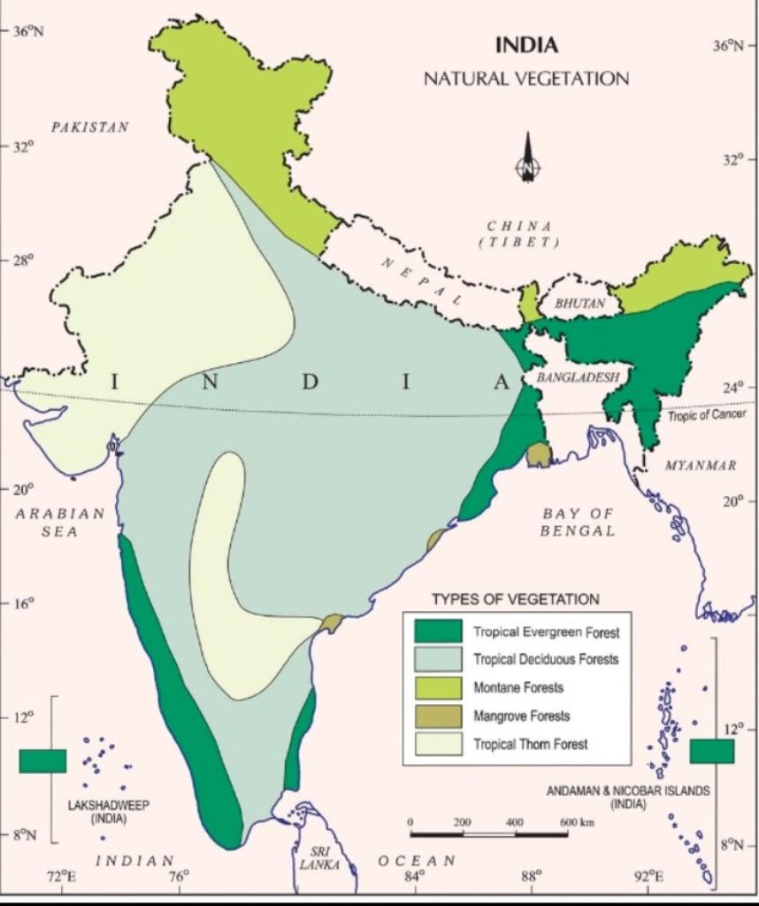
Types of natural vegetation in india

Slide 7
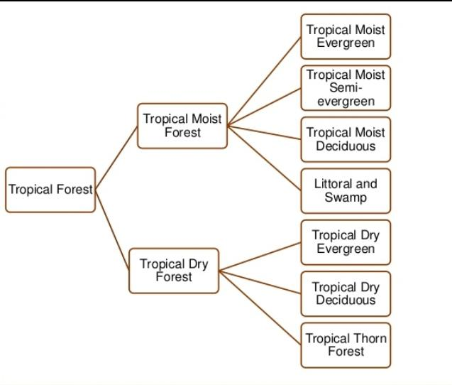

Slide 8
Moist tropical forests
Tropical Wet Evergreen Forests or Rain Forests
Climatic Conditions:
Annual rainfall exceeds 250 cm
The annual temperature is about 25°-27°C
The average annual humidity exceeds 77 percent and
The dry season is distinctly short.
Characteristics:
• Evergreen: Due to high heat and high humidity, the trees of these forests do not shed their leaves together.
• Mesosphytic: Plants adopted to neither too dry nor too wet type climate.
Lofty: The trees often reach 45 – 60 metres in height.
Thick Canopy: From the air, the tropical rain forest appears like a thick canopy of foliage, broken only where it is crossed by large rivers or cleared for cultivation.
All plants struggle upwards (most ephiphytes) for sunlight resulting in a peculiar layer arrangement. The entire morphology looks like a green carpet when viewed from above.

Slide 9
Less undergrowth: The sun light cannot reach the ground due to thick canopy. The undergrowth is formed mainly of bamboos, ferns, climbers, orchids, etc.
Distribution
Western side of the Western Ghats (500 to 1370 metres above sea level).
Some regions in the Purvanchal hills.
In the Andaman and Nicobar Islands.
Timber
Hardwood: The timber of these forests is fine-grained, hard and durable.
It has high commercial value but it is highly challenging to exploit due to dense undergrowth, absence of pure stands and lack of transport facilities [Read previous posts on Climatic regions to understand how lumbering industry works in Equatorial Rainforests (hardwood) and Taiga Climatic (softwood) conditions].
The important species of these forests are mahogany, mesua, white cedar, jamun, canes, bamboo etc.

Slide 10
Tropical Moist Semi-Evergreen Forests
They are transitional forests between tropical wet evergreen forests and tropical deciduous forests.
They are comparatively drier areas compared to tropical wet evergreen forests.
Climatic Conditions
Annual rainfall is 200-250 cm
Mean annual temperature varies from 24°C to 27°C
The relative humidity is about 75 per cent
The dry season is not short like in tropical evergreen forests.
Distribution
Western coast
Assam
Lower slopes of the Eastern Himalayas
Odisha and
Andamans.

Slide 11
Characteristics
The semi-evergreen forests are less dense.
They are more gregarious [living in flocks or colonies – more pure stands] than the wet evergreen forests.
These forests are characterized by many species.
Trees usually have buttressed trunks with abundant epiphytes.
The important species are laurel, rosewood, mesua, thorny bamboo – Western Ghats, white cedar, Indian chestnut, champa, mango, etc. – Himalayan region.
Timber
Hardwood: Similar to that in tropical evergreen forests except that these forests are less dense with more pure stands (timber industry here is better than in evergreen forests).

Slide 12
Tropical Moist Deciduous Forests
Climatic Conditions
Annual rainfall 100 to 200 cm.
Mean annual temperature of about 27°C
The average annual relative humidity of 60 to 75 per cent.
Spring (between winter and summer) and summer are dry.
Characteristics
The trees drop their leaves during the spring and early summer when sufficient moisture is not available.
The general appearance is bare in extreme summers (April-May).
Tropical moist deciduous forests present irregular top storey [25 to 60 m].
Heavily buttressed trees and fairly complete undergrowth.
These forests occupy a much larger area than the evergreen forests but large tracts under these forests have been cleared for cultivation.

Slide 13
Distribution
Belt running along the Western Ghats surrounding the belt of evergreen forests.
A strip along the Shiwalik range including terai and bhabar from 77° E to 88° E.
Manipur and Mizoram.
Hills of eastern Madhya Pradesh and Chhattisgarh.
Chota Nagpur Plateau.
Most of Odisha.
Parts of West Bengal and
Andaman and Nicobar islands.
Timber
These provide valuable timer like Teak.
The main species found in these forests are teak, sal, laurel, rosewood, amla, jamun, bamboo, etc.
It is comparatively easy to exploit these forests due to their high degree of gregariousness (more pure stands).

Slide 14
Sal and tidal forests
They can survive and grow both in fresh as well as brackish water (The mixture of seawater and fresh water in estuaries is called brackish water and its salinity can range from 0.5 to 35 ppt).
Occur in and around the deltas, estuaries and creeks prone to tidal influences (delta or tidal forests).
Littoral (relating to or on the shore of the sea or a lake) forests occur at several places along the coast.
Swamp forests are confined to the deltas of the Ganga, the Mahanadi, the Godavari, the Krishna and the Cauvery.
Dense mangroves occur all along the coastline in sheltered estuaries, tidal creeks, backwaters, salt marshes and mudflats. It provides useful fuel wood.
The most pronounced and the densest is the Sunderban in the Ganga delta where the predominant species is Sundri (Heriteera).
Timber
It provides hard and durable timber which is used for construction, building purposes and making boats.
The important species found in these forests are Sundri, agar, rhizophora, screw pines, canes and palms, etc.

Slide 15
Dry Tropical Forests
Tropical Dry Evergreen Forests
Distribution
Along the coasts of Tamil Nadu.
Climatic Conditions
Annual rainfall of 100 cm [mostly from the north-east monsoon winds in October – December].
Mean annual temperature is about 28°C.
The mean humidity is about 75 per cent.
The growth of evergreen forests in areas of such low rainfall is a bit strange.
Characteristics
Short statured trees, up to 12 m high, with complete canopy.
Bamboos and grasses not conspicuous.
The important species are jamun, tamarind, neem, etc.
Most of the land under these forests has been cleared for agriculture or casuarina plantations.

Slide 16
Casuarina planta
It resembles feathery conifer in general appearance.
They are rapid-growing, carefree species for sites and climates as varied as coastal sand dunes, high mountain slopes, hot humid tropics, and semi-arid regions.
They have the ability to fix atmospheric nitrogen. It grows 15 to 25 metres in height on an average
Distribution
Casuarina is the most popular farm forestry in the states of Andhra Pradesh, Tamil Nadu, West Bengal, Odisha, Maharashtra, Gujarat, and Karnataka.
Benefits
Reduces damage in the event of natural calamities.
Line planting in the coastal areas helps in controlling the wind force.
It is also used for tourism promotion in view of its ornamental appearance.
It provides top quality firewood.
The wood is suitable for paper pulp and useful raw material for the manufacture of paper for writing, printing, and wrapping.
It is got some serious medicinal values as well.
Wasteland development
The characteristics which make it a suitable species for wasteland development include adaptability to wide range of habitats, fast growth, salt tolerant, drought resistant, ability to reclaim land and stabilize sand dunes.
Intercrops such as groundnut, cucumber, watermelons, sesamum, and pulses can also be raised along with the plantation.

Slide 17
Tropical Dry Deciduous Forests
Climatic Conditions
Annual rainfall is 100-150 cm.
Characteristics
These are similar to moist deciduous forests and shed their leaves in dry season.
The major difference is that they can grow in areas of comparatively less rainfall.
They represent a transitional type – moist deciduous on the wetter side and thorn forests on the drier side.
They have closed but uneven canopy.
The forests are composed of a mixture of a few species of deciduous trees rising up to a height of 20 metres.
Undergrowth: Enough light reaches the ground to permit the growth of grass and climbers.
Distribution
They occur in an irregular wide strip running from the foot of the Himalayas to Kanniyakumari except in Rajasthan, Western Ghats and West Bengal.
The important species are teak, axlewood, rosewood, common bamboo, red sanders, laurel, satinwood, etc.
Large tracts of this forest have been cleared for agricultural purposes.
These forests have suffer from over grazing, fire, etc.

Slide 18
Tropical Dry Deciduous Forests
Climatic Conditions
Annual rainfall is 100-150 cm.
Characteristics
These are similar to moist deciduous forests and shed their leaves in dry season.
The major difference is that they can grow in areas of comparatively less rainfall.
They represent a transitional type – moist deciduous on the wetter side and thorn forests on the drier side.
They have closed but uneven canopy.
The forests are composed of a mixture of a few species of deciduous trees rising up to a height of 20 metres.
Undergrowth: Enough light reaches the ground to permit the growth of grass and climbers.
Distribution
They occur in an irregular wide strip running from the foot of the Himalayas to Kanniyakumari except in Rajasthan, Western Ghats and West Bengal.
The important species are teak, axlewood, rosewood, common bamboo, red sanders, laurel, satinwood, etc.
Large tracts of this forest have been cleared for agricultural purposes.
These forests have suffer from over grazing, fire, etc.

Slide 19
Tropical Thorn Forests
Climatic Conditions
Annual rainfall less than 75 cm.
Humidity is less than 50 per cent.
Mean temperature is 25°-30°C.
Characteristics
The trees are low (6 to 10 metres maximum) and widely scattered.
Acacias and Euphorbias are very prominent.
The Indian wild date is common. Some grasses also grow in the rainy season.
Distribution
Rajasthan, south-western Punjab, western Haryana, Kachchh and neighbouring parts of Saurashtra.
Here they degenerate into desert type in the Thar desert.
Such forests also grow on the leeside of the Western Ghats covering large areas of Maharashtra, Karnataka, Telangana, Andhra Pradesh and Tamil Nadu.
The important species are neem, babul, cactii, etc.

Slide 20
Desert vegetation
This vegetation occurs west of the Aravallies and comprises short barriers, palm, etc., in the sandy expanse of the Thar Desert.

Slide 21
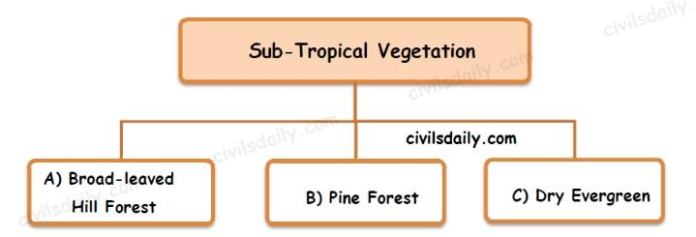

Slide 22
Montane Sub-Tropical Forests
Sub-tropical Broad-leaved Hill Forests
Climatic conditions
Mean annual rainfall is 75 cm to 125 cm.
Average annual temperature is 18°-21°C.
Humidity is 80 per cent.
Distribution
Eastern Himalayas to the east of 88°E longitude at altitudes varying from 1000 to 2000 m.
Characteristics
Forests of evergreen species.
Commonly found species are evergreen oaks, chestnuts, ash, beech, sals and pines.
Climbers and epiphytes [a plant that grows non-parasitically on a tree or other plant] are common.
These forests are not so distinct in the southern parts of the country. They occur only in the Nilgiri and Palni hills at 1070-1525 metres above sea level.
It is a “stunted rain-forest” and is not so luxuriant as the true tropical evergreen.
The higher parts of the Western Ghats such as Mahabaleshwar, the summits of the Satpura and the Maikal Range, highlands of Bastar and Mt. Abu in the Aravali Range carry sub-types of these forests.

Slide 23
Sub-tropical Moist Pine Forests
Distribution
Western Himalayas between 73°E and 88°E longitudes at elevations between 1000 to 2000 metres above sea level.
Some hilly regions of Arunachal Pradesh, Manipur, Naga Hills and Khasi Hills.
Timber
Chir or Chil is the most dominant tree which forms pure stands.
It provides valuable timber for furniture, boxes and buildings.
It is also used for producing resin and turpentine.

Slide 24
Sub-tropical Dry Evergreen Forests
Distribution
Found in the Bhabar, the Shiwaliks and the western Himalayas up to about 1000 metres above sea level.
Climatic Conditions
Annual rainfall is 50-100 cm (15 to 25 cm in December-March).
The summers are sufficiently hot and winters are very cold.
Characteristics
Low scrub forest with small evergreen stunted trees and shrubs.
Olive, acacia modesta and pistacia are the most predominant species.

Slide 25
Wet Temperate forest
TEMPERATE FORESTS
Moist Temperate forest
Dry Temperate forest

Slide 26
Montane Temperate Forests
Montane Wet Temperate Forests
Climatic Conditions
Grows at a height of 1800 to 3000 m above sea level
Mean annual rainfall is 150 cm to 300 cm
Mean annual temperature is about 11°C to 14°C and the
Average relative humidity is over 80 per cent.
Distribution
Higher hills of Tamil Nadu and Kerala, in the Eastern Himalayan region.
Characteristics
These are closed evergreen forests. Trunks have large girth.
Branches are clothed with mosses, ferns and other epiphytes.
The trees rarely achieve a height of more than 6 metres.
Deodar, Chilauni, Indian chestnut, birch, plum, machilus, cinnamomum, litsea, magnolia, blue pine, oak, hemlock, etc. are important species

Slide 27
Himalayan Moist Temperate Forests
Climatic Conditions
Annual rainfall varies from 150 cm to 250 cm
Distribution
Occurs in the temperate zone of the Himalayas between 1500 and 3300 metres.
Cover the entire length of this mountain range in Kashmir, Himachal Pradesh, Uttarakhand, Darjeeling and Sikkim.
Characteristics
Mainly composed of coniferous species.
Species occur in mostly pure strands.
Trees are 30 to 50 m high.
Pines, cedars, silver firs, spruce, etc. are most important trees.
They form high but fairly open forest with shrubby undergrowth including oaks, rhododendrons and some bamboos.
Timber
It provides fine wood which is of much use for construction, timber and railway sleepers.

Slide 28
Himalayan Dry Temperate Forests
Climatic Conditions
Precipitation is below 100 cm and is mostly in the form of snow.
Characteristics
Coniferous forests with xerophytic shrubs in which deodar, oak, ash, olive, etc are the main trees.
Distribution
Such forests are found in the inner dry ranges of the Himalayas where south-west monsoon is very feeble.
Such areas are in Ladakh, Lahul, Chamba, Kinnaur, Garhwal and Sikkim.

Slide 29
Alpine Forests
Altitudes ranging between 2,900 to 3,500.
These forests can be divided into: (1) sub-alpine; (2) moist alpine scrub and (3) dry alpine scrub.
The sub-alpine forests occur lower alpine scrub and grasslands.
It is a mixture of coniferous and broad-leaved trees in which the coniferous trees attain a height of about 30 m while the broad leaved trees reach only 10 m.
Fir, spruce, rhododendron, etc. are important species.
The moist alpine scrub is a low evergreen dense growth of rhododendron, birch etc. which occurs from 3,000 metres and extends upto snowline.
The dry alpine scrub is the uppermost limit of scrub xerophytic, dwarf shrubs, over 3,500 metres above sea level and found in dry zone. Juniper, honeysuckle, artemesia etc. are important species.

Slide 30
WILDLIFE IN INDIA

Slide 31
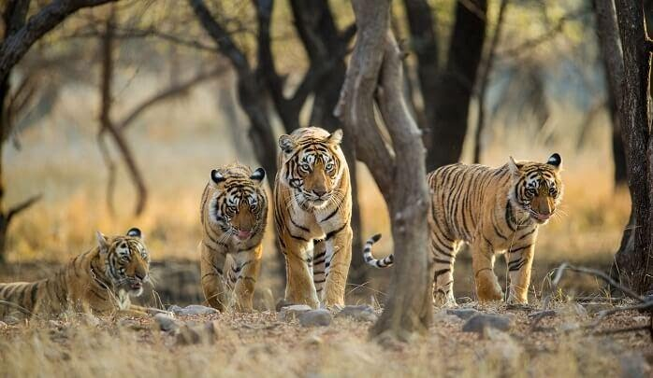
Wildlife in india
India boasts of a rich biodiversity, vast natural resources, and some very unique species of flora and fauna that roam free in the huge number of nature reserves and protected wildlife sanctuaries in this enormous country. They are a true haven for nature and wildlife lovers that flock to these green terrains and thick jungles in huge numbers every year.

Slide 32
The Indian fauna consists of over 80,000 (including 6,500 invertebrates 5,000 mollusca, 2,546 fishes, 1228 birds, 458 mammals, 204 ampjibians, 446 reptiles, 4 panthera) and 60,000 species of insects.
Prater (1934) has divided India into six Zoo-geographical regions: They are
Himalayan region,
Northern Mains,
Rajasthan Desert,
Penninsular Plateau,
Malabar Coast, and
Nilgiri .

Slide 33
The Indian Board of Wildlife was constituted in 1985 for an all-round development of wild animals and birds in the country.
Wildlife management in India has the following objectives :
Safeguarding the natural habitat of wild animals.
Maintenance of animals and birds in their protected areas.
Protecting wildlife through legislation and Acts.
Establishing biosphere reserves for plant and animals.

Slide 34
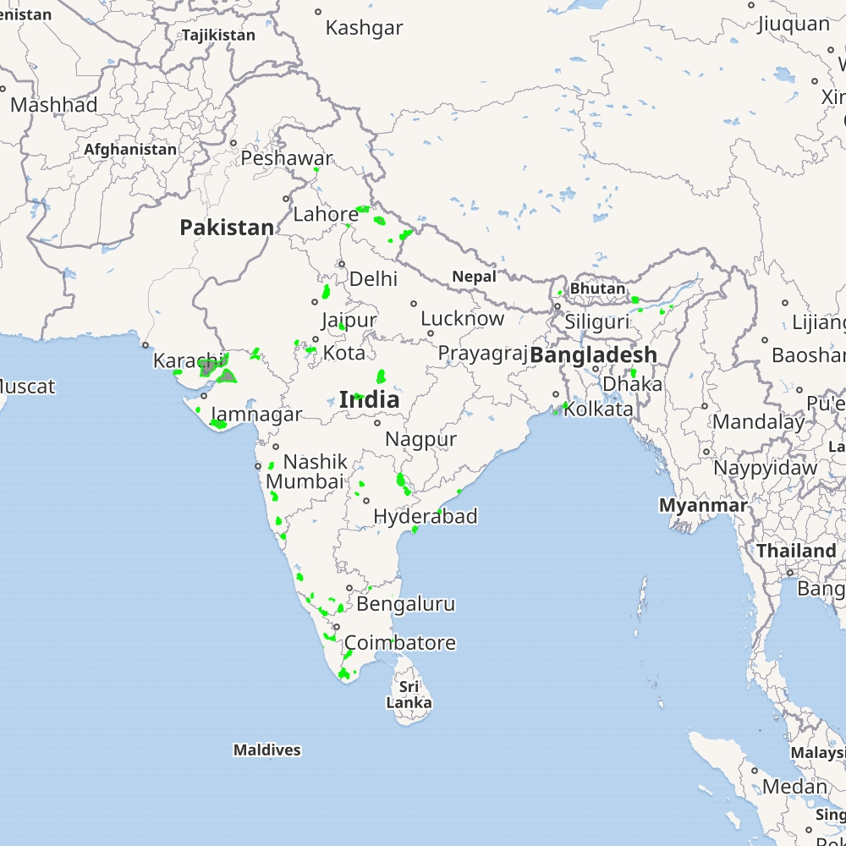
Established wildlife sancturies in India
Wildlife sanctuaries of India are classified as IUCN Category IV protected areas. Between 1936 and 2016, 543 wildlife sanctuaries were established in the country that cover 118,918 km² (45,914 sq mi) as of 2017. Among these, the 50 tiger reserves are governed by Project Tiger, and are of special significance for the conservation of the Bengal tiger.

Slide 35
25 Best Wildlife Sanctuaries In India.
Look at all these wildlife sanctuaries of India sheltering rare and exotic species of plants, animals, and birds and take your pick. Out of the 543 sanctuaries here, these are the most favorite of wildlife enthusiasts and nature fanatics who understand the true importance of wildlife sanctuaries.

Slide 36
Bhadra Wildlife Sanctuary, Karnataka
Tadoba Andhari Tiger Reserve, Maharashtra
Chinnar Wildlife Sanctuary, Kerala
Dandeli Wildlife Sanctuary, Karnataka
Bhagwan Mahavir Wildlife Sanctuary, Goa
Interview Island Wildlife Sanctuary, Andaman
Kutch Desert Wildlife Sanctuary, Gujarat
Karakoram Wildlife Sanctuary, Jammu And Kashmir
Indian Wild Ass Sanctuary, Gujarat
Dibang Wildlife Sanctuary, Arunachal Pradesh
Rollapadu Wildlife Sanctuary, Andhra Pradesh
Grizzled Squirrel Wildlife Sanctuary, Tamil Nadu
Eaglenest Wildlife Sanctuary, Arunachal Pradesh

Slide 37
Koyna Wildlife Sanctuary, Maharashtra
Tamor Pingla Wildlife Sanctuary, Chhattisgarh
Senchal Wildlife Sanctuary, West Bengal
Periyar Wildlife Sanctuary, Kerala
Govind Wildlife Sanctuary, Uttarakhand
Chilka Wildlife Sanctuary, Odisha
Nauradehi Wildlife Sanctuary, Madhya Pradesh
Manas Wildlife Sanctuary, Assam
Mundanthurai Wildlife Sanctuary, Tamil Nadu
Indira Gandhi Wildlife Sanctuary, Tamil Nadu
Landfall Island Wildlife Sanctuary, Andaman
Eturnagaram Wildlife Sanctuary, Telangana

Slide 38
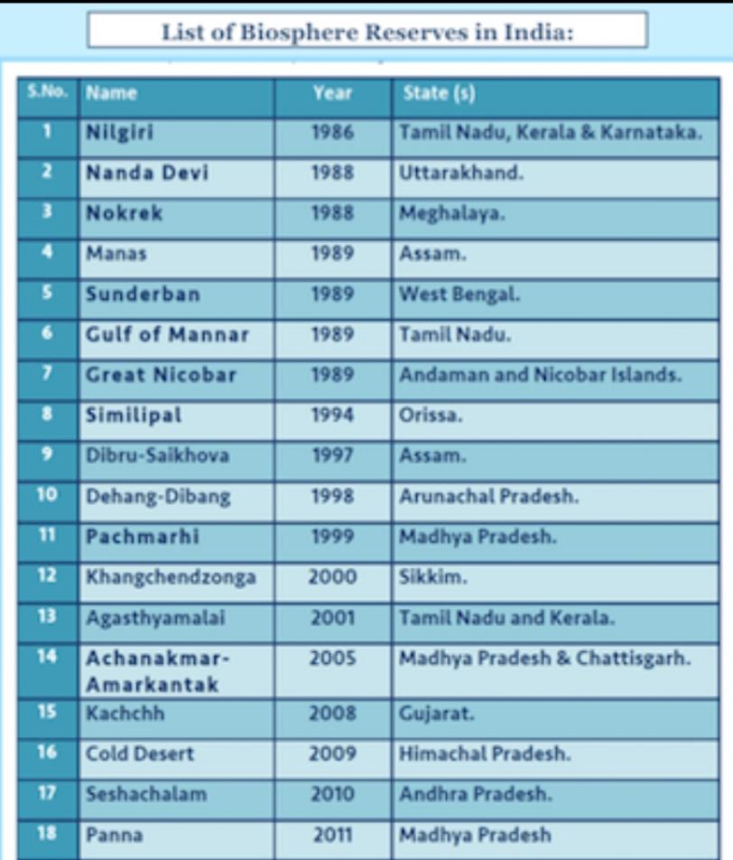

Slide 39
THANK YOU

