Slide 1
S. Maheswari guest lecturer in geography government college for women (A) kumbakonam title: geography of India
Iii b.sc. Geography
Topic :irrigation in india
Date : 20.08.2020

Slide 2
Irrigation
INTRODUCTION
Irrigation is the artificial application of water to the soil or agricultural field. It is the replacement or supplementation of rainwater with another source of water. It is used in dry areas and during periods of inadequate rainfall.
The main idea behind irrigation systems is to assist in the growth of agricultural crops and plants by maintaining with the minimum amount of water required, suppressing weed growth in grain fields, preventing soil consolidation etc

Slide 3
Irrigation in India
Irrigation in India includes a network of major and minor canals from Indian rivers, groundwater well based systems, tanks, and other rainwater harvesting projects for agricultural activities. Of these groundwater system is the largest.
In 2013-14, only about 36.7% of total agricultural land in India was reliably irrigated, and remaining 2/3rd cultivated land in India is dependent on monsoons.
65% of the irrigation in India is from groundwater.
Currently about 51% of the agricultural area cultivating food grains is covered by irrigation .
The rest of the area is dependent on rainfall.

Slide 4
Indian agriculture is largely dependent on irrigation.
The need of irrigation stems from various factors including :
Uncertainty of rainfall,
Irregularitu of rainfall,
Variability of rainfall,
Monsoon gaps,
Concentration of rainfall in a few days,
Unequall distribution of rainfall,
Dry winter season,
Requirement of excessive water for certain crops like rice, jute, sugar cane, etc., and
Application of more and frequent watering for high yielding variety seeds, etc.

Slide 5
Facilities of irrigation occur differently in different partyof India.
Northern plains have perennial rivers originating in the Himalayas, coupled with a flat and even topography, high waters table, and alluvial soils, where digging of Wells and Canals is quite easy and profitable.
In Peninsular India, on the other hand, construction of canals and digging of wells is difficult due to rough and rocky terrain.
Tanks and reservoirs are more useful for storing water for irrigation purpose.

Slide 6
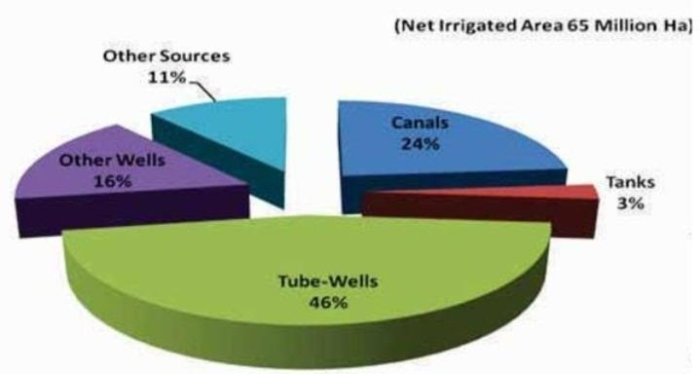
Sources of irrigation
Relief, soils, availability of surface or ground water, and the moisture requirement of crops largely determine the means of irrigation in India.
There are three major sources of irrigation in India.
SOURCES OF IRRIGATION
CANALS
TANKS
WELLS AND TUBE WELLS

Slide 7
Canal irrigation
Canal is an artificial watercourse constructed for water supply and irrigation.
There are two types of canals:
Inundation Canals – These are taken out from the rivers without any regulating system like weirs etc at their head. Such canals are useful only during the rainy season
Perennial Canals – These are those which are taken off from perennial rivers by constructing a barrage across the river. Most of the canals at present in India are perennial.

Slide 8
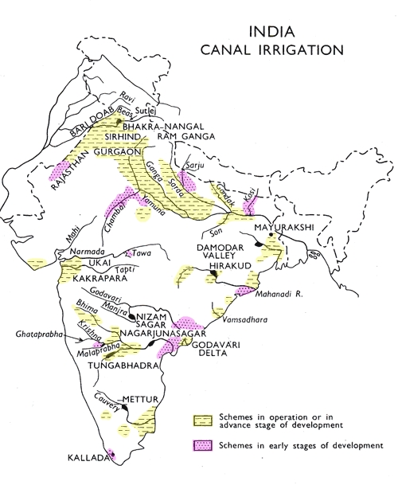
Canals can be an effective source of irrigation in areas of low relief, deep fertile soils, perennial source of water and an extensive command area. Therefore the main concentration of canal irrigation is in the northern plains.
The canals are practically absent from the peninsular plateau region because of rocky terrain. However, the coastal and the delta regions in South India have some canals for irrigation.
The percentage of canal irrigation area to total irrigated area in the country has fallen from about 40% in 1950-51 to less than 25% at present.
The states UP, Punjab, Haryana, Rajasthan and Bihar account for about 60% of the canal irrigated area in the country.

Slide 9
Merits:
  Perennial Source
  Provides safety from droughts
  Brings fertile sediments to the fields
  Economical to serve a large area
Demerits:
  Canal water soaks into the ground and leads to water logging, increases salinization, and leads to marshy conditions leading to malaria and flooding
  Wastage of water.

Slide 10
Wells and tube wells
A well is a hole dug in the ground to obtain the subsoil water. An ordinary well is about 3-5 metres deep but deeper wells up to 15 metres are also dug.
This method of irrigation has been used in India from time immemorial. Various methods are used to lift the ground water from the well. Some of the widely used methods are the persian wheel, reht, charas or mot, and dhinghly (lever) etc.
A tube well is a deeper well (generally over 15 metres deep) from which water is lifted with the help of a pumping set operated by an electric motor or a diesel engine.

Slide 11
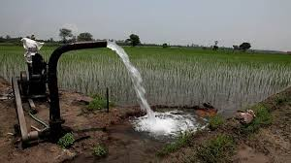
Well irrigation is gradually giving way to energized tube wells. But there are many wells still in use where electricity is not available or the farmers are too poor t0 afford diesel oil.
This method of irrigation is popular in those areas where sufficient sweet ground water is available.
It is particularly suitable in areas with permeable rock structure which allows accumulation of ground water through percolation. Therefore wells are seen more in areas with alluvial soil, regur soil, etc. and less seen in rocky terrain or mountainous regions.
These areas include a large part of the great northern plains, the deltaic regions of the Mahanadi, the Godavari, the Krishna and the Cauvery, parts of the Narmada and the Tapi valleys and the weathered layers of the Deccan trap and crystalline rocks and the sedimentary zones of the peninsula

Slide 12
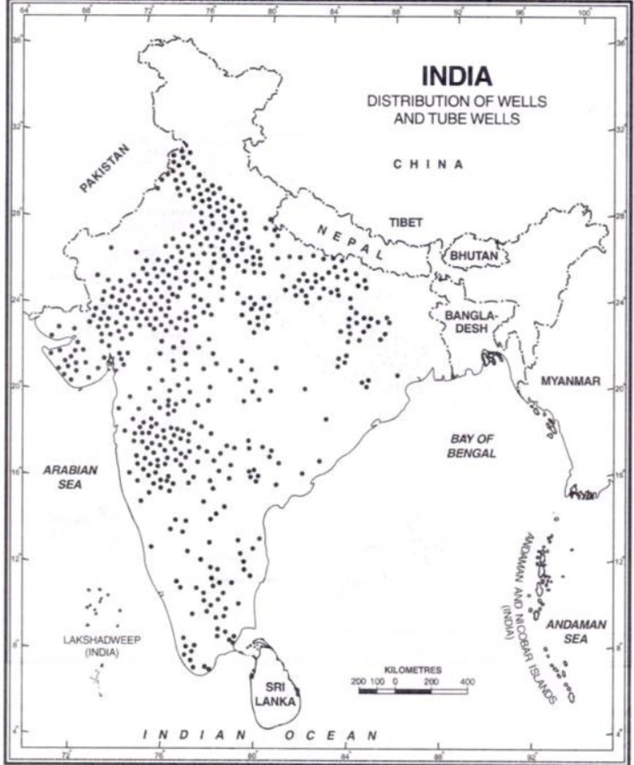
However, the greater part of peninsular India is not suitable for well irrigation due to rocky structure, uneven surface and lack of underground water.
Large dry tracts of Rajasthan, the adjoining parts of Punjab, Haryana and Gujarat and some parts of Up have brackish ground water which is not fit for irrigation and human consumption and hence unsuitable for well irrigation
At present irrigation from wells and tubewells accounts for more than 60% of the net irrigated area in the country.
UP has the largest area under well irrigation which accounts for 28% of the well irrigated area of the country. U.P., Rajasthan, Punjab, Madhya Pradesh, Gujarat, Bihar and Andhra Pradesh account for about three-fourths of the total well-irrigated area

Slide 13
Merits:
  Simplest
  Cheapest
  Well is an independent source of irrigation and can be used as and when the necessity arises. Canal irrigation, on the other hand, is controlled by other agencies and cannot be used at will.
  Some ground water salts are useful for crops
  Does not lead to salinization and flooding problems
  There is a limit to the extent of canal irrigation beyond the tail end of the canal while a well can be dug at any convenient place.
Demerits:
  Only limited area can be irrigated. Normally, a well can irrigate 1 to 8 hectares of land.
  Not suitable for dry regions
  Overuse may lead to lowering of water table

Slide 14
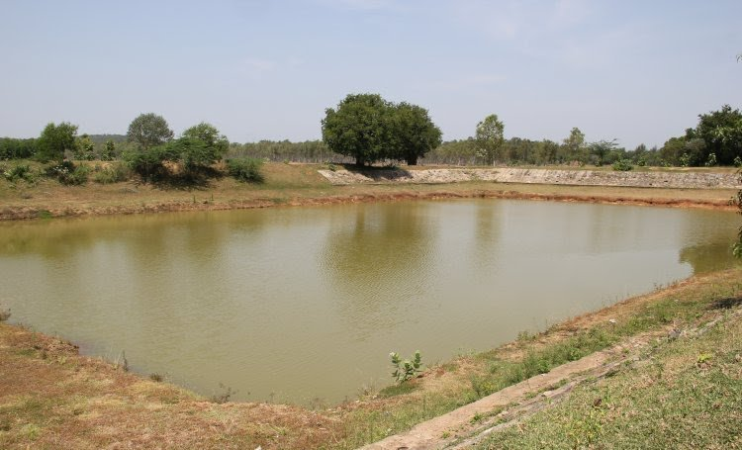
Tank irrigation
A tank is a reservoir for irrigation, a small lake or pool made by damming the valley of a stream to retain the monsoon rain for later use.
It accounts for approximately 3% of the net irrigated area in India.
Tank Irrigation is popular in the peninsular plateau area where Andhra Pradesh and Tamil Nadu are the leading states.
Andhra Pradesh has the largest area (29%) of tank irrigation in India followed by Tamil nadu (23%).

Slide 15
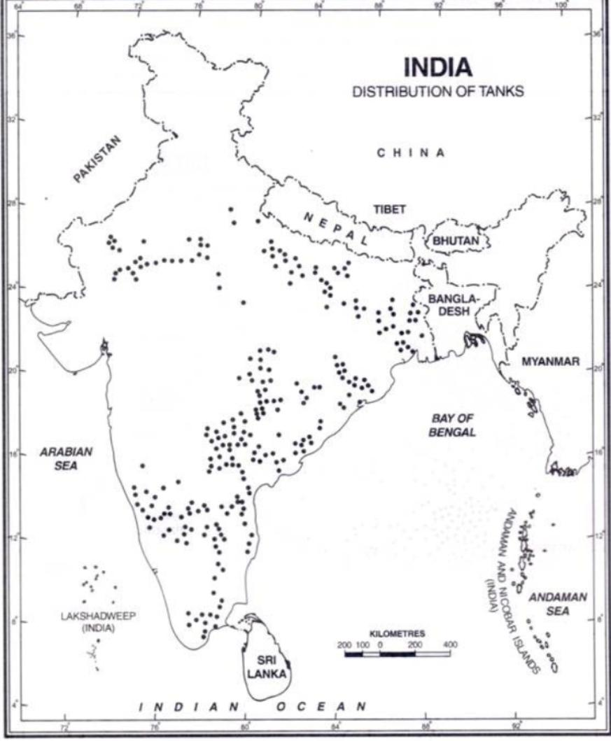
It is practised mainly in the peninsular region due to the following reasons:The undulating relief and hard rocks make it difficult to dig canals and wells
There is little percolation of water due to hard rock structure and ground water is not available in large quantities.
Most of the rivers are seasonal; there are many streams which become torrential during the rainy season – so the only way to use this water is to impound it by constructing bunds and building tanks. Also, it is easy to collect rainwater in natural or artificial pits because of impermeable rocks.
Scattered nature of agricultural fields

Slide 16
Merits
  Most of the tanks are natural and do not involve cost for their construction
  Independent source for an individual farmer or a small group of farmers
  longer life span
  can be used for fishing also
Demerits
  Depends on rain and these tanks may dry up during the dry season
  Silting of their beds
  Require large areas
  Evaporation losses
  Sometimes there might be a need to lift the water to take it to the field

Slide 17
Irrigation Planning in India by Planning Commission
Major Irrigation Plan: Those irrigation projects are included in it which is implemented for irrigation in cultivable command areas of 10, 000 hectare or more. Often large canals and multipurpose river valley projects are included in it.
Medium Irrigation Plan: Those irrigation projects are included in it which is implemented for irrigation in cultivable command areas of 2000 hectare or more but less than 10, 000 hectare.
Minor Irrigation Plan: Those irrigation projects are included in it which is implemented for irrigation in cultivable command areas of less than 2000 hectare.

Slide 18


