Slide 1
S. MAHESWARI
GUEST LECTURER IN GEOGRAPHY
GOVERNMENT COLLEGE FOR WOMEN(A) KUMBAKONAM
GEOGRAPHY OF INDIA
III B.Sc. GEOGRAPHY
TITLE : COTTON IN INDIA
08.09.2020

Slide 2
COTTON IN INDIA
INTRODUCTION :
Cotton is an industrial vegetable fibre.
The fibre is obtained from the bolls or opened seed pods of a tropical or sub-tropical bush.
Its quality of lightness and cheapness makes is an ideal material for clothing.
The cotton fibre is strong, durable and washable.
It is used all over the world for making clothes, carpets, threads, etc.

Slide 3
Conditions of Growth:
Cotton is the crop of tropical and sub-tropical areas and requires uniformly high temperature varying between 21°C and 30°C. The growth of cotton is retarded when the temperature falls below 20°C. Frost is enemy number one of the cotton plant and it is grown in areas having at least 210 frost free days in a year.
The modest requirement of water can be met by an average annual rainfall of 50- 100 cm. However, it is successfully grown in areas of lesser rainfall with the help of irrigation. About one-third of the total area under cotton cultivation is irrigated.
Moist weather and heavy rainfall at the time of boll-opening and picking are detrimental to cotton as the plant becomes vulnerable to pests and diseases. High amount of rainfall in beginning and sunny and dry weather at ripening time are very useful for a good crop.

Slide 4
Cotton is a kharif crop which requires 6 to 8 months to mature. Its time of sowing and harvesting differs in different parts of the country depending upon the climatic conditions. In Punjab and Haryana it is sown in April-May and is harvested in December-January that is before the winter frost can damage the crop.
In the peninsular part of India, it is sown upto October and harvested between January and May because there is no danger of winter frost in these areas. In Tamil Nadu, it is grown both as a kharif and as a rabi crop.
Here the rainfall occurs after September and cotton is sown in October. The irrigated crop is sown in January-February. Most of the crop is grown mixed with other kharif crops such as maize, jowar, ragi, sesamum, castor, groundnut and some vegetables.

Slide 5
Cotton cultivation is closely related to deep black soils (regur) of the Deccan and the Malwa Plateaus and those of Gujarat. It also grows well in alluvial soils of the Satluj-Ganga Plain and red and laterite soils of the peninsular regions. Cotton quickly exhausts the fertility of soil. Therefore, regular application of manures and fertilizers to the soils is very necessary.
Picking is a crucial period from the labour point of view. Since picking of cotton is not yet mechanized, a lot of cheap and efficient labour is required at this time. Normally the picking season is spread over a period of about three months.

Slide 6
Types of Cotton
Three broad types of cotton are generally recognised on the basis of the length, strength and structure of its fibre.
Long staple cotton,
Medium staple cotton,
Short staple cotton.
1. Long staple cotton:
It has the longest fibre whose length varies from 24 to 27 mm. The fibre is long, fine and shining. It is used for making fine and superior quality cloth. Obviously, it fetches the best price. There has been rapid progress in the production of long staple cotton since Independence. About half of the total cotton produced in India is a long staple. It is largely grown in Punjab, Haryana, Maharashtra, Tamil Nadu, Madhya Pradesh, Gujarat and Andhra Pradesh.

Slide 7
2. Medium staple cotton:
The length of its fibre is between 20 mm and 24 mm. About 44 per cent of the total cotton production in India is of medium staple. Rajasthan, Punjab, Tamil Nadu, Madhya Pradesh, Uttar Pradesh, Karnataka and Maharashtra are its main producers.
3. Short staple cotton:
This is inferior cotton with fibre less than 20 mm long. It is used for manufacturing inferior cloth and fetches less price. About 6 per cent of the total production is of short staple cotton. U.P., Andhra Pradesh, Rajasthan, Haryana and Punjab are its main producers.

Slide 8
Production and Distribution of Cotton in India
India has the largest area under cotton cultivation in the world though she is the world’s third largest producer of cotton after China and the USA. Currently it is grown over 6 per cent of the net sown area
This has been made possible due to large scale commercial cultivation of high yielding hybrid varieties in long and extra long staples. In spite of the three fold increase in the yield; our yield of 307 kg/hectare is just half of the world average and far below the yield of 731 kg/hectare in the USA, 756 kg/hectare in Pakistan and 816 kg/hectare in Egypt.
Almost 65 per cent of the area under cotton is rainfed with erratic and poorly distributed rains during the cropping season. It is subjected to severe attack of pests and diseases.
Despite the increase in production, cotton for quite some time is experiencing a plateau in productivity which needs to be broken.

Slide 9
Distribution:
India has the sole distinction of growing all the four cultivated species of cotton and their intra- and inter-specific hybrids. In India, cotton is grown in three distinct agro-ecological zones, viz., Northern (Punjab, Haryana and Rajasthan), Central (Gujarat, Maharashtra and Madhya Pradesh) and Southern zone (Andhra Pradesh, Tamil Nadu and Karnataka).
1. Maharashtra:
Maharashtra is the second largest producer and produces 29.78 per cent of the total cotton production of India. Maharashtra is a traditional producer of cotton. The lava soil of deccan plateau is world renowned for cotton production and is popularly known as the black cotton soil. Over 80 per cent of the production comes from Khandesh, Vidarbha and Marathwada regions comprising the districts of Yavatmal, Nanded, Amravati, Parbhani, Wardha, Jalgaon, Akola, Buldhana, Nagpur, Dhule, etc.

Slide 10
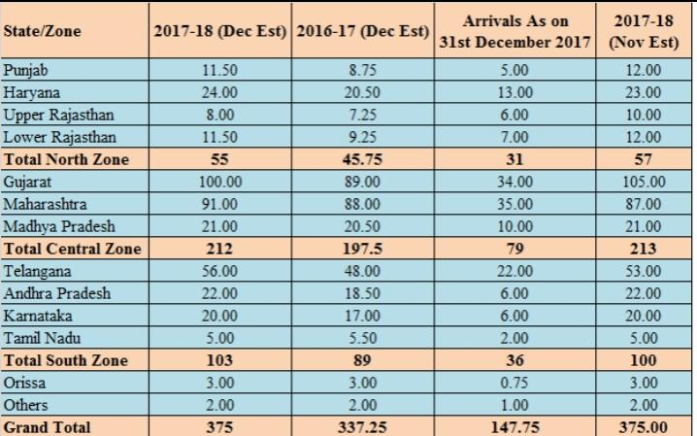
Zones of Cotton Cultivation in India

Slide 11
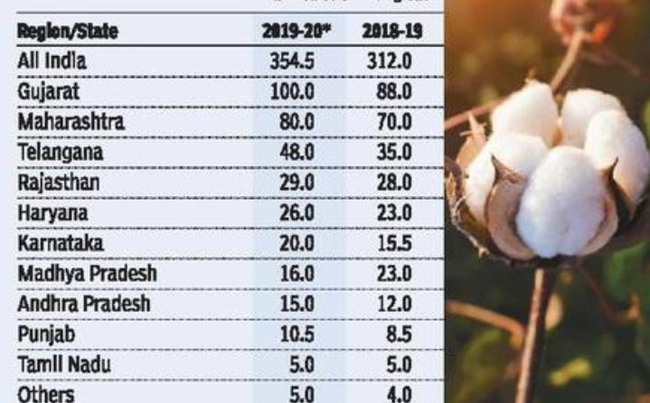
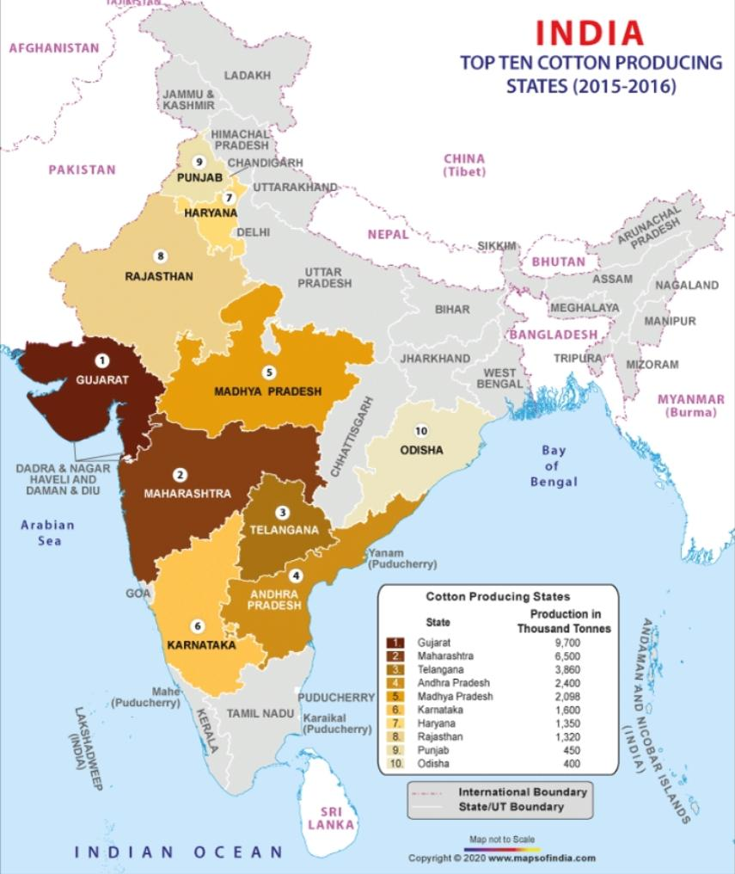
STATE WISE PRODUCTION IN INDIA

Slide 12
2. Gujarat:
Accounting for 19.33 per cent of the total production and 21.33 per cent of the cotton area of the country, Gujarat is the largest cotton producing state of India. The average yield is 1.8 quintals/hectare which is almost the same as the national average. With ‘black cotton soil’ 1.5 metre deep in some parts and with 80-100 cm annual rainfall Gujarat provides favourable conditions for cotton cultivation.
Two-thirds of the production comes from the Gujarat plains including Bharuch, Surendemagar, Vadodra and Ahmedabad districts. Mahesana, Kheda, Sabarkantha, Surat, Amreli and Panchmahals are other major producers.
3. Andhra Pradesh:
Andhra Pradesh accounts for 12.46 per cent of production and 10.47 per cent of hectarage of India. Two-thirds of the production of Andhra Pradesh comes from two districts, namely Guntur and Prakasam. Adilabad, Kumool and Anantapur contribute the rest. Its 8th largest produce in the country.

Slide 13
4. Punjab:
Punjab has also the distinction of producing some of the best qualities of cotton in India. All this has been made possible due to fertile alluvial soils, a close network of irrigation facilities, heavy dose of fertilizers and pesticides and above all the enterprising spirit of the farmers.
Seeds of ВТ cotton, which were introduced in some parts of the state, are showing good results. This variety of seeds has the advantage over other hybrid seeds as it needs less use of pesticides. It requires just three to five applications while other varieties had to be sprayed around 15-20 times—resulting in savings of around Rs. 2,500-3,000 per acre. Punjab produced 10.83 lakh bales (each bale of 170 kg).
Most of the cotton production comes from the Malwa region of the state. This region contributes nearly 95 per cent of Punjab’s cotton. Cotton is known as “white gold” in this region. Bhatinda, Faridkot, Firozepur and Sangrur are the major producing districts and account for over three fourths of Punjab’s total production of cotton. Ludhiana, Muktsar, Moga, Mansa and Fatehgarh Sahib are other cotton producing districts.

Slide 14
5. Haryana:
Accounting for 11.91 per cent production and 6.77 per cent of hectarage, Haryana is the fifth largest producer of cotton in India. In the year 2002-03, Haryana produced 11.38 lakh bales. The state has the second highest yield of 3.4 quintals/hectare in the country next only to that of the neighbouring Punjab.
About 80 per cent of the production comes from Hissar, Sirsa and Fatehabad districts which are contiguous to the major cotton producing districts of Punjab. Like Punjab, most of the production is from the American long staple varieties. Bhiwani, Jind and Rohtak and Ambala are other producing districts.
6. Madhya Pradesh:
This state suffers from low yields (only 1.2 quintals/hectare). More than 80 per cent of the production comes from Malwa where there are vast tracts of lava soil. East Nimar, West Nimar, Ujjain, Shajapur, Dewas, Dhar, Ratlam, Rajgarh, Indore, and Bhopal are the main producers. Its 7th largest producer in the country.

Slide 15
7. Karnataka:
This state produces 4.22 per cent cotton of India from 5.13 per cent of India’s area under cotton cultivation. The North Karnataka plateau is the main area of cotton cultivation. Dharwad, Raichur, Bellary and Gulbarga are the main producing districts. 6th place occupied in the production of cotton cultivation in India.
8. Rajasthan:
Rajasthan accounts for about 2.9 per cent of the production and 5 per cent of the area of the country. The state has the lowest yield of only 1.1 quintals/hectare. Ganganagar is the most important cotton producing district of Rajasthan and accounts for over 80 per cent of the state’s production.
This district is contiguous to the cotton producing areas of Punjab and Haryana and enjoys the same advantages. The remaining cotton of Rajasthan comes from Bhilwara, Ajmer, Chittaurgarh, Jhalawar, Pali and Hanumangarh.
Its one of the 4th largest cotton producer in the country.

Slide 16
9. Telungana:
Telangana regions and stands in the 3rd position in cotton production. Cotton is popularly called as “White Gold” and is grown in most of the parts of Telangana. Each year cotton is cultivated in about 12.5 lakh hectares with a production of 48 lakh bales.
10. Tamil Nadu:
Tamil Nadu contributes about 1.55 per cent of the total production with about 1.11 per cent of the total area of the country. Coimbatore, Salem, Madurai, Tiruchirapalli, Ramnathapuram, South Arcot, Vallalur, Chengalpattu and Tirunelveli K. Bomman are the main producing districts.
Uttar Pradesh, Kerala, Orissa, Meghalaya and Mizoram also produce cotton in small quantities.

Slide 17
Trade
India is an exporter as well as importer of cotton. India exports inferior quality cotton mainly to U.K., where it is mixed with superior quality cotton. India has been a big importer of superior quality long staple cotton mainly from the USA, Russia, UAR, Sudan and Kenya.
Considering the major provisions of World Trade Organisation (WTO) vis-a-vis India’s position, the points that emerge to be of immediate concern in enhancing the productivity and quality of Indian cotton and making it competitive globally are:
(i) bringing down the cost of cultivation and enhancing its productivity and quality,
(ii) rendering our cotton globally attractive,
(iii) keeping Indian cotton free of trash content.

Slide 18
Cotton yarn and fabrics exports accounts for about 23 per cent of India's total textiles and apparel exports. In 2018-19, India's cotton production was 28.70 million bales of 170 Kg each. During 2018-19, total textile and clothing exports stood at US$ 36.62 billion.

Slide 19
THANK YOU

