Slide 1
S. MAHESWARI
GUEST LECTURER IN GEOGRAPHY
GOVERNMENT COLLEGE FOR WOMEN(A) KUMBAKONAM
GEOGRAPHY OF INDIA
III B.Sc. GEOGRAPHY
TITLE : COFFEE IN INDIA
30.09.2020

Slide 2
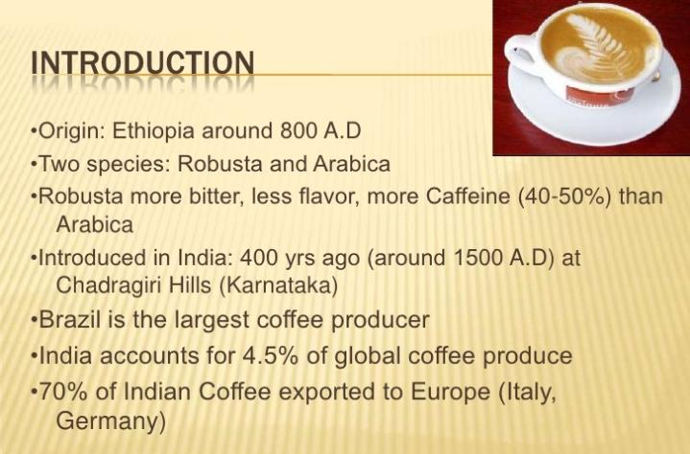
COFFEE IN INDIA

Slide 3
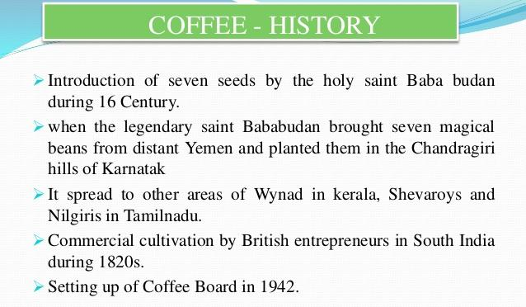

Slide 4


Slide 5


Slide 6
Conditions of Growth:
Coffee plant requires hot and humid climate with temperature varying between 15°C and 28 °C and rainfall from 150 to 250 cm. It does not tolerate frost, snowfall, high temperature above 30°C and strong sun shine and is generally grown under shady trees. Prolonged drought is also injurious to coffee. Dry weather is necessary at the time of ripening of the berries.
Stagnant water is harmful and this crop is grown on hill slopes at elevations from 600 to 1,600 metres above sea level. Northern and eastern aspects of slopes are preferred as they are less exposed to strong afternoon sun and the south- west monsoon winds. Well drained, rich friable loams containing good deal of humus and minerals like iron and calcium are ideal for coffee cultivation.

Slide 7
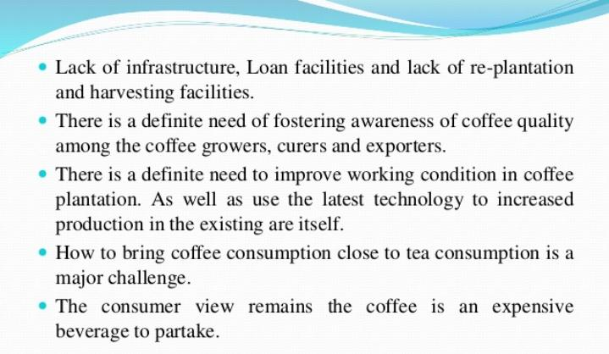

Slide 8
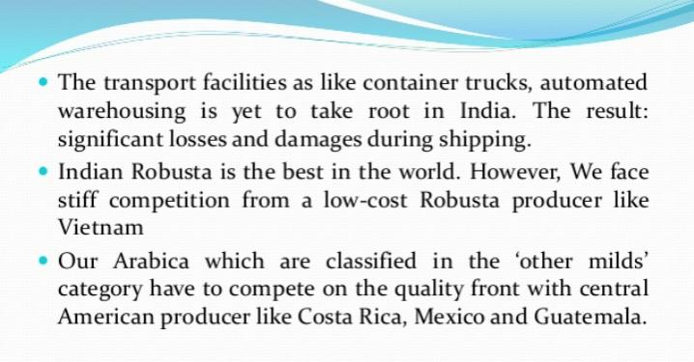

Slide 9


Slide 10


Slide 11


Slide 12
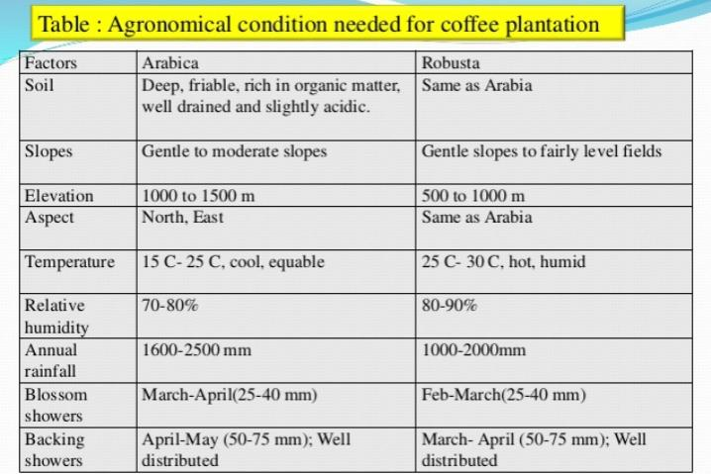

Slide 13
Coffee Production in India
KARNATAKA
Among all coffee producing states in India, Karnataka is the indisputable leader and produces more than 70% of the total coffee produced in the country. Karnataka produced 2.33 Lakh Metric Tonnes of coffee in the last financial year, which is the highest coffee production by any state in India.
In 2.33 Lakh Metric Tonnes of coffee, the production of Robusta Coffee formed the major part, which was more than 1.58 Lakh Metric Tonnes. Arabica is an another type of coffee produced in Karnataka, whose production was 74,755 Metric Tonnes.

Slide 14
Coffee is planted in a large area in Karnataka and account for more than 60% of the total area under coffee cultivation in India. There are more than 4,500 coffee plantations in India, which is generally on high altitude of about 1,300 metre above sea level.
Kodagu, Chikmagalur and Hassan are the main coffee producing regions in Karnataka. Kodagu is the largest coffee producing region in Karnataka with more than 50% share in the total coffee produced in the state. Mysore and Shimoga are the other coffee producing regions in the state.
Apart from the highest coffee production, Karnataka also has the highest yield, which is more than 1,000 Kilograms per hectare. The main reason for coffee production in a large quantity in Karnataka is the suitable temperature, climate and rainfall.
Production: 2,33,230 Metric Tonnes

Slide 15
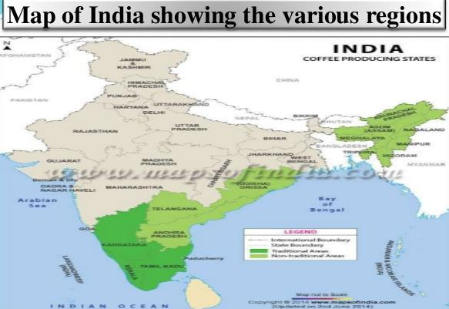

Slide 16
KERALA
Kerala with a total production of 67,700 Metric Tonnes stand at 2nd position in the list of top 5 largest coffee producing states in India. Kerala account for more than 20% of the total coffee produced in India.
Like Karnataka, Robusta Coffee form the major part of the total coffee produced in the state with a production of more than 65,000 Metric Tonnes. Arabica Coffee is produced in a small quantity as compared to Robust and in the last financial year, its production was 2,055 Metric Tonnes.

Slide 17
Wayanad and Travancore are the main coffee producing regions in Kerala and account for more than 95% of the total coffee produced in the state. Nelliampathies, Kozhikode, Palakkad and Malappuram are other coffee producing regions in the state.
Like Karnataka, coffee in Kerala is planted on high altitude of about 1,200 metres above sea level. Kerala also has a good yield, which is 790 kilograms per hectare.
Production: 67,700 Metric Tonnes

Slide 18
TAMIL NADU
Tamil Nadu is next on this list, which produced 17,875 Metric Tonnes of coffee in the last financial year. Tamil Nadu is a major coffee producing state and account for more than 5% of the total coffee produced in the country.
Arabica Coffee form the major part of the total coffee produced in the state and in the last financial year, the production of Arabica Coffee was 13,150 Metric Tonnes. Robusta Coffee is also produced by the state, whose production was 4,725 Metric Tonnes in the last year.
Pulneys, Nilgris, Salem and Coimbatore are the main coffee growing region in Tamil Nadu. Pulneys is the largest coffee producing region in the state with a production of more than 7,600 Metric Tonnes.
Production: 17,875 Metric Tonnes

Slide 19
ANDHRA PRADESH
Andhra Pradesh with a production of 7,425 Metric Tonnes has occupied 4th position in the list of top 5 coffee producing states in India. Andhra Pradesh produces Arabica and Robusta Coffee, whose total production was 7,425 Metric Tonnes.
The production of Arabica Coffee and Robusta Coffee was 7,370 Metric Tonnes and 550 Metric Tonnes respetively in the last financial year. The total production of coffee in the next financial year is expected to cross the mark of 9,500 Metric Tonnes.
Production: 7,425 Metric Tonnes

Slide 20
ODISHA
Odisha is the fifth largest coffee producing state in India with a production of 550 Metric Tonnes. Arabica is the type of coffee grown in Odisha, which need moderate temperature and high rainfall to grow.
Koraput, Rayagada, Phulbani and Keonjhar are the main coffee producing regions in Odisha.
Production: 550 Metric Tonnes

Slide 21
Tripura
Tripura is one of the largest producer of coffee in North East India along with rubber and tea gardens. The state is an alternative plantation region of coffee and rubber in India.
Nagaland
Nagaland is the second largest coffee producing states in the North East and a favourable land for coffee farming in India.
Assam
Assam is best known for tea gardens but there are few places in the state where coffee are grown too. Monsoon places of Assam are idea place for monsoon varieties of coffee.
Meghalaya
The rollicking hills and cascading waterfalls of Meghalaya are the best coffee grown regions. East Khasi Hills dotted with coffee plants and a serious business in Meghalaya.

Slide 22
Mizoram
Mid hill ranges of Mizoram are best place for coffee plantation the crop is practically introduced in the state. Mizoram is home to list of endemic species of birds and wildlife such as Phayre’s leaf monkey and Capped langur.
Manipur
Districts of Manipur are now taking drives for coffee plantation, geography of Manipur is best suited for coffee beans both Arabica and Robusta.
Arunachal Pradesh
Namsang Tehsil of Tirap district is one of the small village where coffee plantations take place in Arunachal Pradesh.

Slide 23
TRADE
Exports
India exports coffee to over 45 countries. The total coffee exports from the country stood at 277,696 MT in 2015-16 (provisional based on export permits from April 1, 2015, to February 29, 2016) against the target of 265,000 MT, fetching the value of Rs 164,187/tonne. Export earnings have increased from Rs 1050.36 crore (US$ 177.26 million) in 2001-02 to Rs 4,559.42 crore (US$ 699.67 million) in 2015-16 (provisional based on export permits from April 1, 2015, to February 29, 2016), growing at a CAGR of 11.05% during the period. Italy was the largest export market for Indian coffee, importing 59,968 MT (21.1% of India’s total exports) in 2014-15. It was followed by Germany (26,190 MT), Russian Federation (22,460 MT), Turkey (15,878 MT) and Belgium (12,209 MT). Significantly, value-added coffee exports have improved their share to reach 95,481 MT in 2014-15 (from October 1, 2014, to September 30, 2015).

Slide 24

Output of Indian Coffee

Slide 25
THANK YOU

