Slide 1
Ii M.SC. APPLIED GEOGRAPHY population and settlement geography topic : naturer and scope of settlement geography
05.08.2020
Presented by
s. Maheswari
Guest lecturer in geography
GOVT. COLLEGE FOR WOMEN (A)
KUMBAKONAM

Slide 2
Indroduction
Settlement Geography is one of the main branch of Human Geography
Its also known as Geography of Settlement
The complexity of a settlement can range from a small number of dwellings grouped together to the largest of cities with surrounding areas.

Slide 3
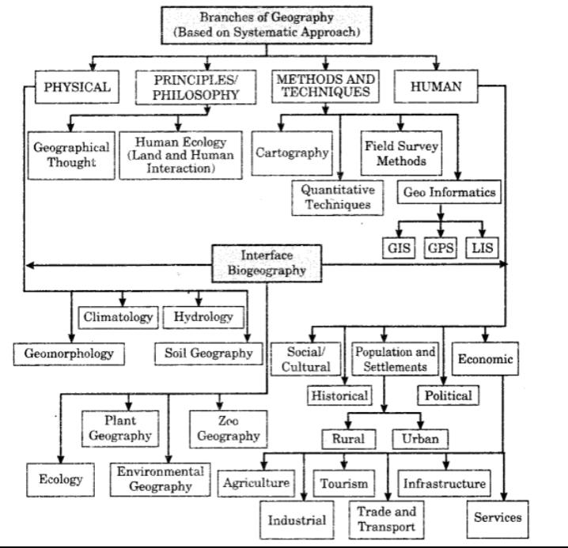

Slide 4
Meaning and definition
Settlement Geography deals with the orderly description and interpretation of origin and growth, locational patterns, morphology, function and spatial organizations of human settlements on the earth’s surface.
According to O. Schulter (1899) --- Its included location, size and growth of settlements and their relationships with the nature in the study of settlement.
According to C.F.Kohn (1954) ---- Its has to do with facilities men built in the process of occupying an area.
According to G.S.Gosal (1972) --Its concerned with spatial variation on the earth’s surface.

Slide 5
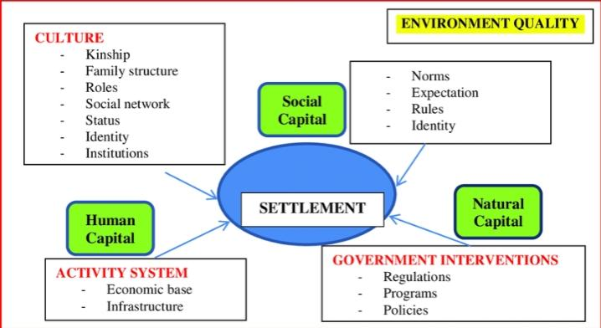
Scope of settlement geography

Slide 6
SCOPE :
Origin and growth of settlement
Morphology of Settlement.
Physical morphology
Functional morphology
Social morphology
Spatial morphology
Classification of settlement
Problems and Planning of settlements

Slide 7
Nature of settlement geography
Following is a main account of the nature of settlement geography:
Settlement geography is settlement centred geography
Settlement geography is a systematic science
Settlement geography is a spatial science
Settlement geography is a social science
Settlement geography is also treated as rural settlement geography

Slide 8
THANK YOU

