Slide 1
Government college for women (a) kumbakonam department of geography ii m.sc. Applied geography
17.08.2020 population and settlement geography topic : site and situation of rural settlement
Presented By
S. MAHESWARI
GUEST LECTURER IN GEOGRAPHY

Slide 2
MEANING AND DEFINITION OF SETTLEMENT
Settlement is a permanently occupied human dwelling place which indicates a community of dwellings and associated buildings ranging from a hamlet to a metropolitan or megalopolis.
Any form of human habitation even a single dwelling may be called settlement although the term is usually applied to a group of dwellings.
Some definitions of settlement are given :
Settlement is a space-bound social organization, varying from an isolated farmstead or a rural hamlet to a city or a metropolis and responding variously to environment, economic, cultural, technological and historical conditions – Singh, L.R
Any permanently occupied human dwelling place although an isolated occupied, may be described as settlement. The word more usually indicates a community of dwellings and associated building ranging from a hamlet to a conurbation – Jackie Smith

Slide 3
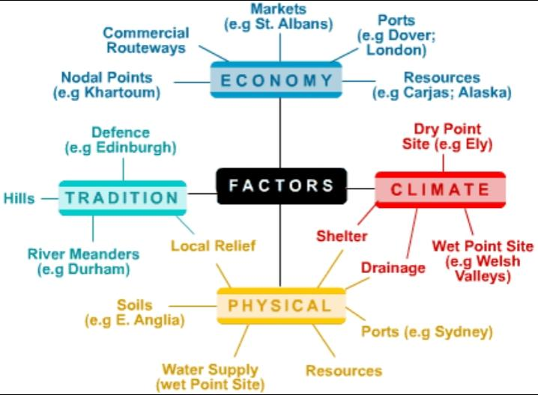
FACTORS AFFECTING ORIGIN AND EVOLUTION OF SETTLEMENTS

Slide 4
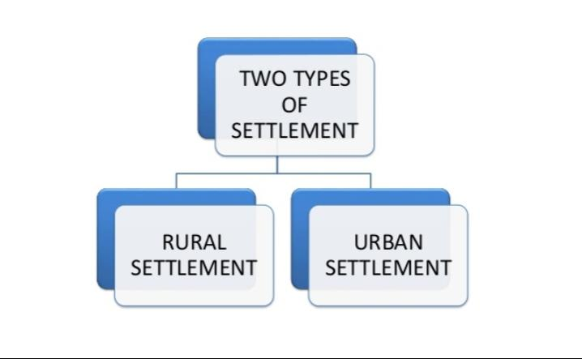
TYPES OF SETTLEMENT

Slide 5
RURAL SETTLEMENT
Definition:
The rural settlements are concerned with the degree of dispersion of the dwellings and the life is supported by land based primarily economic acitivities like agricultural, livestock farming, forestry, mining and quarrying, gardening, fishing etc.
Farms, hamlets and villages are also called rural settlement.

Slide 6
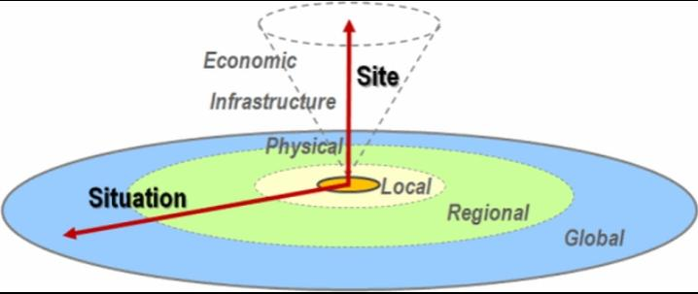
SITE AND SITUATION OF RURAL SETTLEMENT
SITE:
Drscribe the point at which a settlement is located, it describes the land it is build on.
SITUATION:
Describe where settlement is located in relation to the surrounding features such as other settlements mountains, rivers and communication. It is the situation of a settlement that determine whether it will grow from a small hamlet into a village

Slide 7
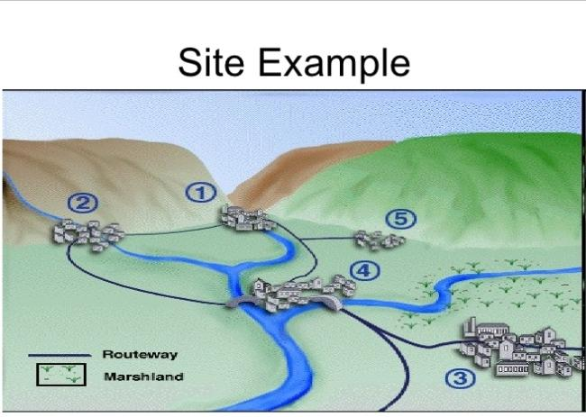
SITE OF RURAL SETTLEMENT
Sites favourable for rural settlements include the following:
Water supply
Land
Dry land
Housing
Defence
Planned settlement

Slide 8
WATER SUPPLY:
Humans are largely dependent on water for life, thus, the supply os water has been a strong factor that determines the location of settlements like Tank or Lake site, Spring, Stream, River, Confluence and Canal settlements.
Water is required not only for drinking, cooking and washing, but also for economically important activities such as irrigation, transport, etc.
Water also forms a kind of natural defence to these settlements.
LAND:
Land, that is suitable for agriculture is an important factor.
Since rural settlements are predominantly agricultural in nature, level plains and fertile lands needed for traditional crops are highly preferred.
DRY LAND:
Land, not threatened by floods, is usually chosen as a site for sets.
Thus, high lying areas that provided water while being relatively dry and free floods are chosen.
Such areas include outer bends of meanders, river terraces or levees and foothills.

Slide 9
HOUSING:
Availability of materials to build houses is another factor that influences the development of a settlement.
Example: Easy availability of materials such as wood from forests, stone from surrounding rocks, mud bricks and ice blocks, etc. Serve the purpose of housing.
The type of construction of the houses is in accordance with the climatic conditions of the area.
Example: In Northern Hemisphere – South facing slopes
In Southern Hemisphere – North facing slopes
DEFENCE:
In the past, strategic positions like hills, islands, etc., were chosen to establish settlements in order to cope with the high political instability and hostility among ethic clans or tribes. Ex.: Inselberge (Nigeria)
PLANNED SETTLEMENTS:
Its nneed food, water and shelter as pre conditions.
Settlements are reorganized or restructured according to place of governments or landlords, in order to facilitate agricultural production.

Slide 10
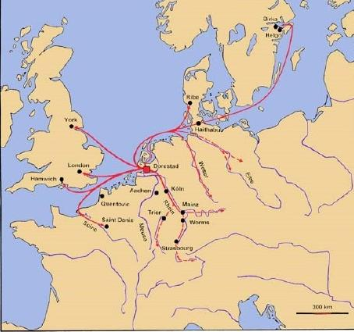
SITUATION OF RURAL SETTLEMENT
Situation favourable factors for rural settlement:
Route centre
Gap village
Lowest bridging point on a river
Port
Minerals for export

Slide 11
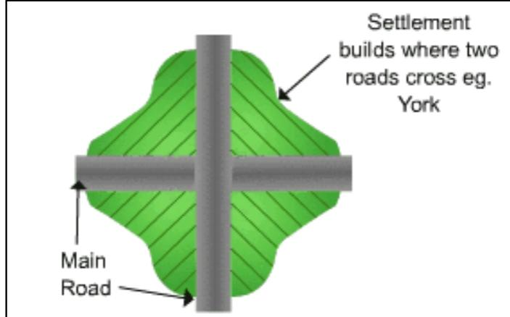
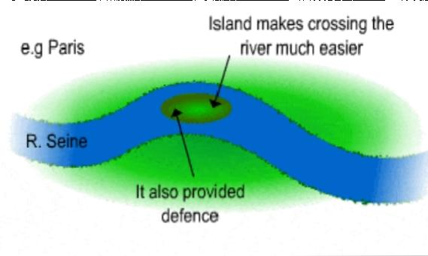
ROUTE CENTRES: Route centre are often called Nodel Points. Anywhere, where two routes meet Has great potantial for settlement.
BRIDGING POINTS: Many setttlements have built up at points where it was easiest to cross a large river.

Slide 12
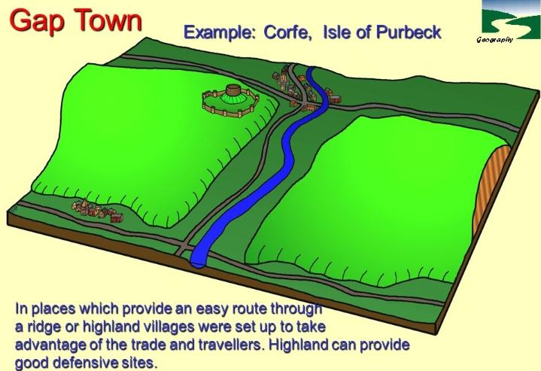
GAP TOWN:
Lincoln is found in a gap between two areas of higher ground. Resources-important for industry, eg villages such as Aberfan in Welsh village is close to coal reserve.
The location of growth of an settlement depended upon its site and situation.
The site was the actual place where people decided to locate their settlement.
The growth of that settlement then depended upon its situation in relation to accessibility and availability of natural resources.

Slide 13
Differentiation between Site and Situation
SITE
SITUATION
The Site is the exact location of a area, you can find it on map.
The Site of a area has features that are inherent to its location.
The Site is the land that the area was built upon.
The Situation of a area relates to its surrounding features, both human-made and natural.
The Situation of the area includes characteristics that are external to the settlement.
The Situation contains the surrounding areas of the land.

Slide 14


