Slide 1
Ii m.sc. Applied geography population and settlement geography topic : types of rural settlement
21.8.2020 & 25.08.2020
Presented by
S. MAHESWARI,
GUEST LECTURER IN GEOGRAPHY,
GCW(A)K

Slide 2
Types of rural settlement
The classification of rural settlement has been approached in various ways. Settlements may be classified by many authors. They are
August Meitzen (1895)
He classified the rural settlements of Europe into two broad categories :
1. Nucleated Village – closely located together giving birth to a single large village.
2. Single Homestead or Isolated dwelling – scattered widely taking different sites for their location.
Ahlman (1928)
He observed three forms of villages in Denmark :
1. The close or round village with farmstead enclosing a square or circle about an open space.
2. The long village with farmstead in two rows along a road.
3. The irregular village.

Slide 3
R.B.Hall (1913)
He studing and classifieds the rural settlements forms in Japan has recognized four main types of rural settlements:
1. Compact village
2. The Satsuma type
3. Castles and walled village
4. The Echigo type
R.E.Dickinson (1949)
He studying the rural settlements of Germany, has recognized two extreme types of rural settlements :
1. Isolated farmstead
2. Nucleated village

Slide 4
Enayat Ahmad (1952)
He recognized the following types of rural settlements in Uttar Prades(India):
1. Compact Settlements – in which all the dwellings of a mauza (revenue village) are concentrated at one central site.
2. Cluster and Hamlet settlements – in which besides a compact village, one or two hamlets are also situated away from the main village in a mauza.
3. Fragmented or Hamleted settlements – this type consists of main village with several hamlets or fragments.
4. Dispersed settlements – in which dwellings are not generally concentrated at one place but are isolated by some distance.
R.L.Singh (1955)
He has recognized four main types of rural settlements in Middle Ganga Valley:
1. Compact settlements
2. Semi-compact or hamleted clusters
3. Semi-sprinkled or fragmented or hamleted settlements
4. Sprinkled or dispersed type settlement.

Slide 5
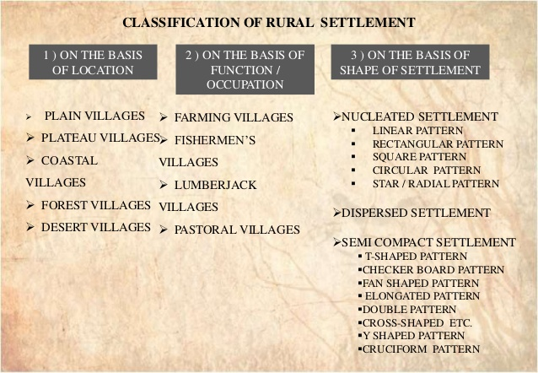

Slide 6
Functional classification of rural settlement
There are four main types of functional classification of rural settlement. They are
1. Farming village
2. Firshering village
3. Lumberjack village
4. Pastoral village

Slide 7
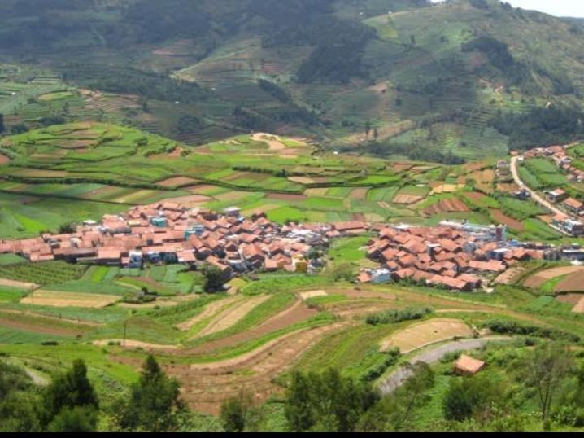
Farming village
It has been settled since the early 19th century, first as a farming village.
This is mainly small scale farming village with farmers producing wheat, barley, vegetables and fruits.
Its a typical farming village which contains 280 houses. But in 1940 the farming village had only 1239 residents.
Originally a farming village, it has grown into an industrial center.
This former farming village showed up about 1950, a steady population decline.

Slide 8

Fishering Village
A fishing village is a village, usually near a fishing ground, with an economy based on catching fish and harvesting seafood.
The continents and islands around the world have coastlines totalling around 356,000 km.
From Neolithic time, these coastline, as well as the shorelines of inland lakes and the banks of rivers, have been punctuated with fishing villages.
Most surviving fishing village are traditional.

Slide 9
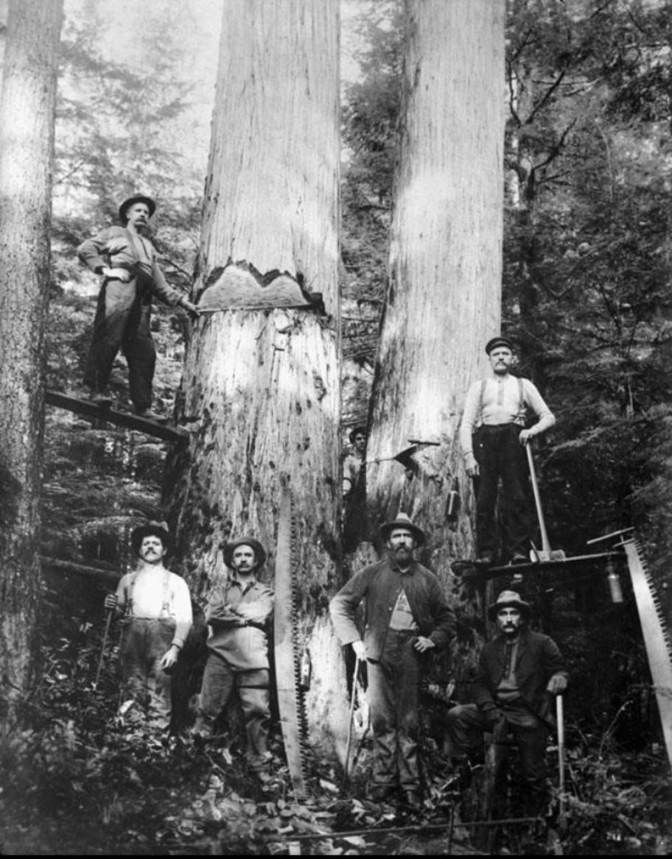
Lumberjacks village
Lumberjacks are mostly North American workers is the logging industry who perform the initial harvesting and transport of trees for ultimate processing into forest products.
The term usually refers to a bygone era (before 1945 in U.S.) when hand tools were used in harvesting trees. Because of his historical ties, the term lumberjack has become ingrained in popular culture through folklore, mass media and spectator sports.
The actual work was difficult, dangerous, intermittent, low-paying and primitive in living conditions.

Slide 10
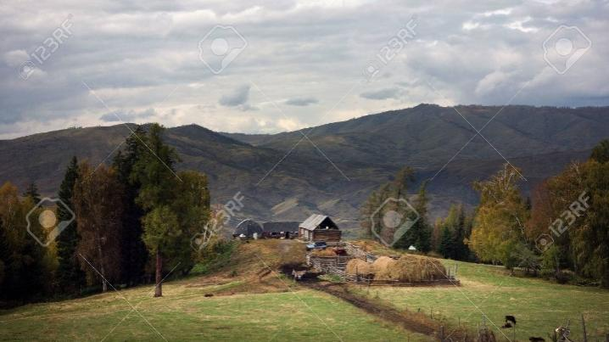
Pastoral village
Pastoral villages are residential regions whose primary land use in pasture for livestock.
Pastured land use in these regions is so intense that more than half of the regions in this anthrome use at least 66% of their land for pasture like other village anthromes, pastoral villages are largely located im Asia.

Slide 11
Classification of rural settlement on the basis of shape
There are four major type of rural settlements are as follows:
1. Dispersed Settlements,
2. Fragmented or Hamleted Settlements,
3. Semi-compact or Composite Settlements, and
4. Compact or Agglomerated Settlements.

Slide 12
Dispersed settlements
Dispersed settlement is also known as sprinkled settlement.
Its characterized by complete diffusion of farmsteads or homesteads over the entire revenue village land.
There is long distance between dwellings compared with the congestion or compactness of the settlements in fertile plains.
These settlements are commonly found in the areas of unsuitable climates, mountainous and hilly areas, thick forests, agricultural lands with poor fertility, regions of extensive cultivation and the regions where it is essential or more fruitful that farmer should live on his farm rather than in a distant compact settlement.
Actually the phenomena of dispersed settlements are not very old but they are relatively recent in age.

Slide 13
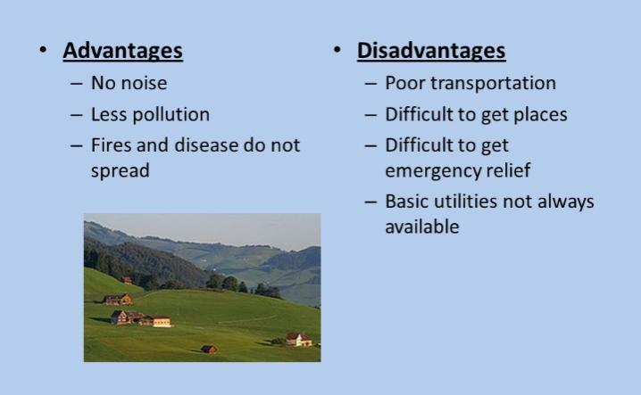
Dispersed settlements

Slide 14
Fragmented or hamleted settlements
This type of settlements consists of several hamlets of fragments.
Sometimes, its difficult to recognize the main site of the village.
The fragmented and hamleted terms are by Enayat Ahmad and R.L.Singh.
In some revenue villages, population is a distributed throughout the land in some hamlets in which it is difficult to trace the main site.
The number of hamlets vary generally from four to ten or more.
The hamlets are separated by the presence of cultivated fields, low lands, garden, nala or even tracts of forest.
Hamleted tendency is caused by the absence of insecurity and economic advantages.
Every hamlet has its own agricultural and pasture fields.

Slide 15
Semi-compact or Composite Settlements
This type of settlement is termed as ‘cluster and hamlet settlement by Enayat Ahmad.
Other wise termed as Hamleted cluster by R.L.Singh.
These settlements, beside a compact village, one or two hamlets are also situated away from the main village in a maiza.
It is an intermediate type between the two extremes i.e., nucleated and dispersion. So this type of settlement is characterised by both types.
Such semi-compact settlements are also known as composite settlements.
Such settlement is marked by one main village with two to five or more hamlets having the population of 100 to 200 people.
These hamlets are linked with the main site by the foot paths or bullock cart tracks. The creation of hamlets around an original nucleated settlement has often occurred in the past, often related with the process of reclamation of land for agriculture – J.P.Misra.

Slide 16
Compact or agglomerated settlements
In compact settlement all the dwellings are agglomerated at one single site or entire population of a village is concentrated in one cluster.
When the individual dwellings are grouped in a relatively small portion of occupied territory and number of dwelling varies from few dozen in small hamlets to thousand of houses in very large villages and exhibit a high degree of cohesion they produce agglomerations of varying shape and size – A. Prasad.
Compact settlement is the result of centripetal forces which are active in the village territory.
Compact villages are found in the perennial river valleys and fertile track of agricultural land and such settlements have been mainly the characteristics of fertile plain since ancient times.
Some attractive forces which have led to the origin of the compact villages are flat plains with fertile soils, sufficient rainfall, agglomeration of water point, a high water table, perennial river, need of cooperation, social, economic, and religious thoughts, crop pattern, rich forest and insecurity im the past.

Slide 17
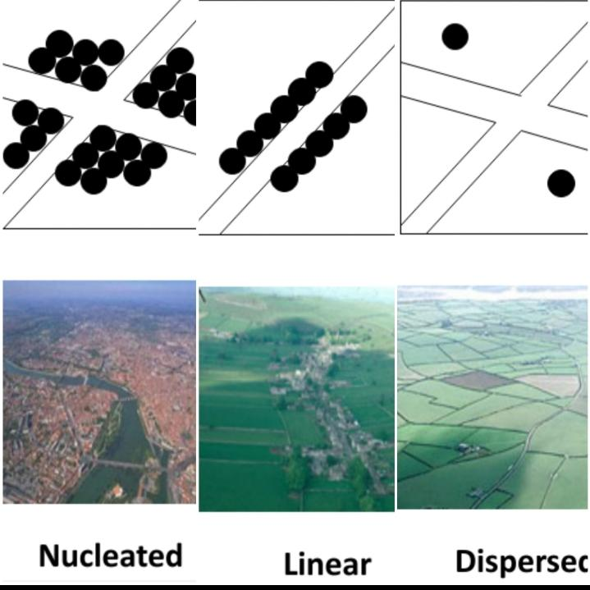
Types of settlement

Slide 18
Thank you

