Slide 1
II M.Sc. APPLIED GEOGRAPHY
GOVERNMENT COLLEGE FOR WOMEN (A) KUMBAKONAM
POPULATION AND SETTLEMENT GEOGRAPHY
TITLE : RURAL MORPHOLOGY
04.09.2020 & 07.09.2020
PRESENTED BY
S. MAHESWARI
GUEST LECTURER IN GEOGRAPHY

Slide 2
RURAL MORPHOLOGY
INTRODUCTION
The study of rural morphology includes all the features that. combine to determine the existing forms of rural landscape. The. ground plan (external outline and internal arrangement of streets.
It includes the study of layout and socio-economic structure and outer shape or pattern of rural settlemens.
TYPES OF RURAL MORPHOLOGY
To make the study convenient, rural morphology may be divided into three broad categories. They are
Physical Morphology of Villages Pattern,
Functional Morphology of villages,
Social Morphology of Villages.

Slide 3
PHYSICAL MORPHOLOGY OF RURAL SETTLEMENT
Physical morphology of rural settlements includes the study of layout and outer shape or villages of a region.
Layout denotes the spatial arrangement of roads and streets of dwellings or houses inside the rural settlements.
The outer shape of a village is the result of its layout plan.
So that internel structure or layout and outer shape or pattern are closely interrelated and integral part of each other.
Along with local geological structure, topography, drainage or slope of the land, socio-economic and cultural factors play very important role in the formation of physical morphology of rural settlements.

Slide 4
Study about the various types of physical morphology of villages are classified as
Linear Pattern,
Rectangular or Square Pattern,
Circular or Oval Pattern,
Radial or Star-like Pattern,
Triangular Pattern,
Semi-Circular Pattern,
Fan Pattern,
Arrow Pattern,
Chess Board Pattern,
L-Shaped Pattern,
T-Shaped Pattern, and
Amorphous Pattern.

Slide 5
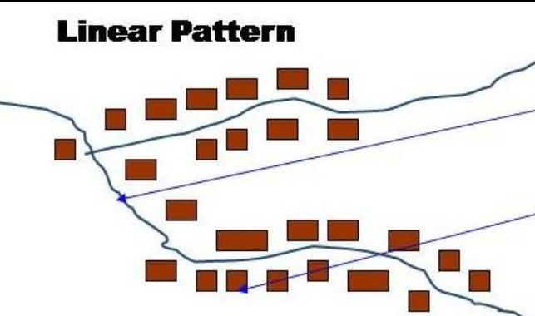
LINEAR PATTERN
Linear pattern is the other most important design of settlements. In the linear settlements, houses are arranged along either side of a road, railway line, river or canal. Such settlements also evolve along the edge of a valley, especially in the mountainous areas, above flood level or along the coast.
The development of linear settlements in the hilly areas is largely controlled by terrain and topography. Along the river banks and the sea shore, the flood and water level influence linear settlements.

Slide 6
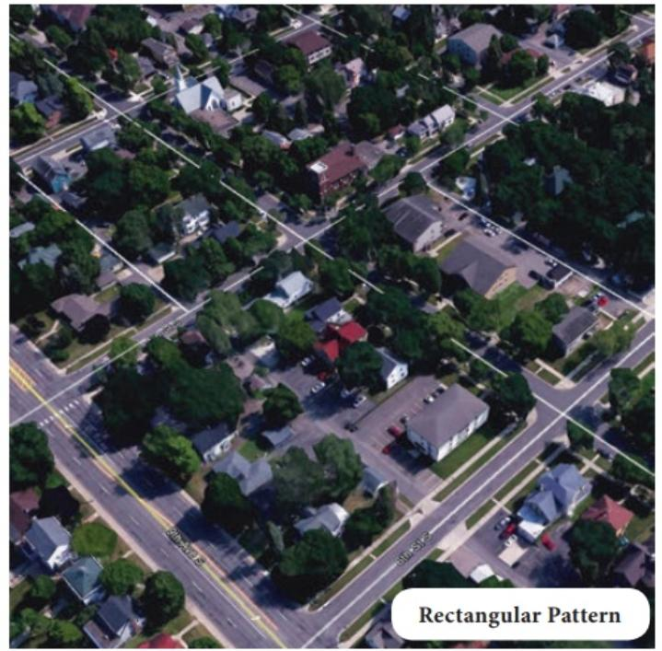
RECTANGULAR PATTERN
Over 50 per cent of the world population lives in rural settlements, and most of the people inhabit the settlements of rectangular pattern. Rectan­gular settlements mainly develop in productive alluvial plains and wide intermontane valleys.
The lanes in the rectangular settlements are almost straight, meeting each other at right angles. The rural settlements of the Sutlej-Ganga plains, especially those which developed on the cross-roads, fall in this category.
The well-planned settlements of Germany, Russia, Central Asian Republics, China, North and South Korea, Vietnam, Malaysia, Israel and France also fall under this category.

Slide 7
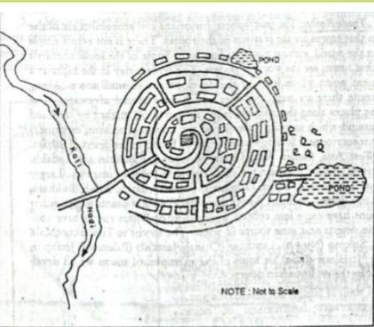
CIRCULAR OR OVAL PATTERN
The settlements in which houses are constructed in a circular shape is known as Circular Pattern. Such kind of settlements is found around lakes, tanks, or a planned village. ... Such kind of settlements is found around the points where several roads cross each other (making star shape).
Circular rural settlements. circular form consists of central open space surrounded by structures (enclosure for animals surrounded by ring of houses).

Slide 8
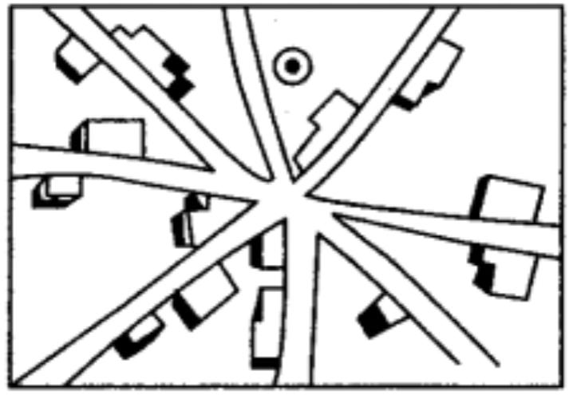
RADIAL PATTERN
The star-like settlements develop on the sites and places where several metalled or unhealed roads converge.
In the star-shaped settlements, houses spread out along the sides of roads in all direction. This pattern is common to both villages and towns, and is caused mostly by new devel­opment, spreading out along the major roads
This type of settlements is the character­istic of the countryside’s of North-West Europe, plains of Yangtzekiang, Punjab province of Pakistan and the Sutlej-Yamuna plains

Slide 9
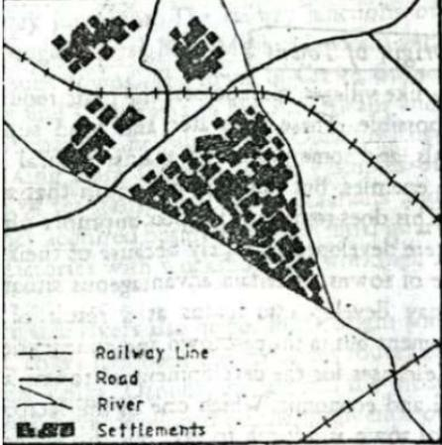
TRIANGULAR PATTERN
Triangular patterns of rural settlement generally develop at the confluence of rivers. The lateral expansion of houses at the confluence is constrained by the rivers. Consequently, the settlement acquires a triangular shape

Slide 10
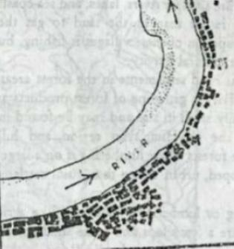
SEMI-CIRCULAR PATTERN
The fishermen and salt producers develop their settlements along the sea coasts and salt lakes, respectively.
Since the people prefer to stay near the water, they construct their houses along the coasts. Such settlements acquire the circular or semi-circular shapes. In the vicinity of crater lakes and on the levees of ox-bow lakes, such settlements are found.
The main occupation of the people of circular settlements is to err their livelihood from the water either by catching fish, water-nuts, grasses, or by providing services to the recreates, picnic goers and aesthetic beauty lovers.

Slide 11
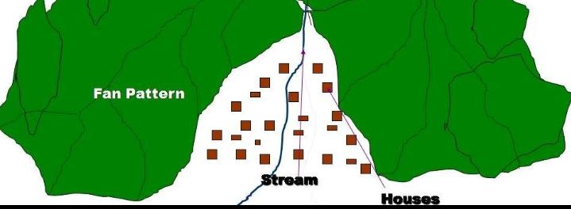
FAN SHAPED PATTERN
Fan shaped villages are found in deltaic and foothill areas.
2. Most of these settlements are located in alluvial fan areas of the Himalayan foothills and in the deltas of Mahandi, Godavari and Krishna rivers.

Slide 12
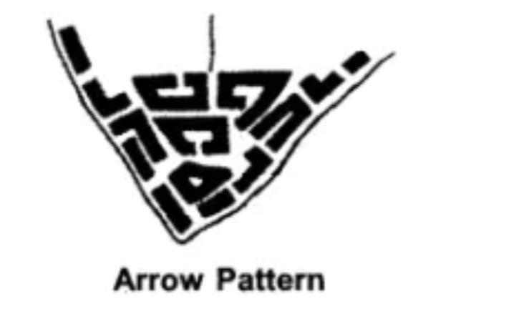
ARROW PATTERN
The shape of a village settled in the end of cape or at the bend od a meandering river or lake becomes like arrow.
In such pattern of rural settlement the main concentrations of houses are along the river, sea or lake and the houses also spread outward along the main road which goes outward from the main settlement.

Slide 13
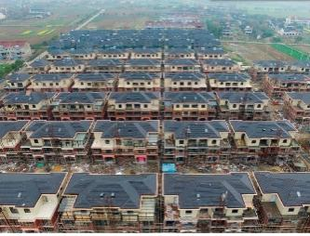
CHESS BOARD PATTERN
This is a type of settlement found generally at the junction of two roads. The village streets meet each other at an angle or are parallel to each other. This pattern is common in the northern plains.

Slide 14
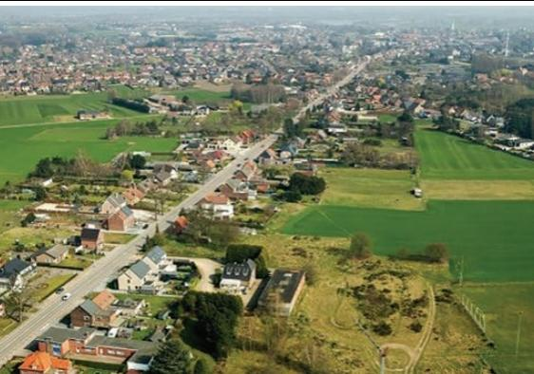
L-SHAPED PATTERN
Sometimes, at the junction of a main road and a minor street or track, two rectangular blocks of houses meet at right angles giving L-shaped pattern.

Slide 15
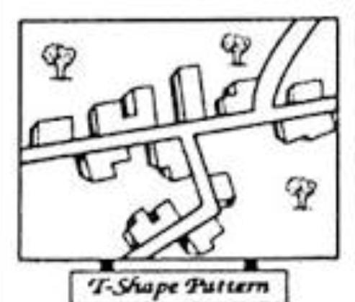
T-SHAPED PATTERN
T -shaped settlements emerge at tri-junction of the roads while Y- shaped settlements develop as the places where two roads meet on the third one and houses are built along these roads. Cruciform settlements grow on the cross-roads and houses spread in all the four directions.

Slide 16
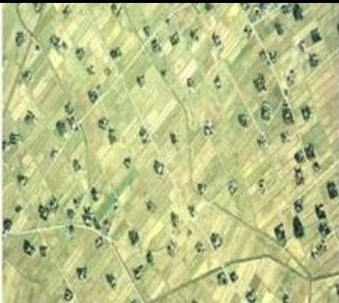
AMORPHOUS PATTERN
The amorphous type, consisting of clustered or scattered settlements built on raised land, is often dispersed throughout the terrain. ... Over time more earth is added to extend the mound as the settlement gradually expands in an amorphous pattern.

Slide 17
FUNCTIONAL MORPHOLOGY OF VILLAGES
This type of a settlement is concerned with the economic activities performed by the people living in it, and the land use pattern of the settlement or a revenue village.
Occupationally, rural settlements are predominantly agricultural and their inhabitants are mostly engaged in primary activities such as agriculture, livestock raising, fishing, collections of wild item, gardening, mining and quarrying etc.
The functional morphology or the land use of Indian village may be described as functional zones in and around the inhabited clustered or semiclustered village.
Various functional zones or land use zones may be seen from inhabited village outwards to its boundary.

Slide 18
Functional zones of a normal Indian village are as follows:
Inhabited Area
Uncultivated Land including Gardens,
Inner Agricultural Land,
Middle Agricultural Land,
Outer Agricultural Land.

Slide 19
INHABITED AREA :
It presents the builtup area which is used mainly for residential purpose.
Its occupied by streets and dwellings and is generally surrounded by gardens, open lands, agricultural lands etc.
The dwellings of different social classes and castes are located generally in different parts or zones of the village.
UNCULTIVATED LAND INCLUDING GARDENS :
Its in the form of a contiguous zone around the inhabited or
build-up area containing community or common land, composite pits, wells, gardens, play ground etc.

Slide 20
INNER AGRICULTURAL LAND :
It is inner belt of the agricultural land situated around the inhabited and uncultivated lands which is usually used to obtain two or more crops in a year, so that it is the zone of intensive cropping.
This land is used mainly for the cropping vegetables, flowers, fodder, etc.
MIDDLE AGRICULTURAL LAND :
Its as an intermediate zone between the zones of inner agricultural land and marginal or outer agricultural land.
This belt is characterized by double cropping system which is used mainly for the production of grain or some commercial crops.

Slide 21
OUTER AGRICULTURAL LAND :
This outer agricultural belt lies along the margin of the village at highest distance.
This agricultural zone provides one or two crops of grain or other items in a years and is generally less productive.
In some cases it may also contain gardens and forested lands, and sometimes wasteland.

Slide 22
SOCIAL MORPHOLOGY OF VILLAGES
Social factors especially the caste system and jajmani system play dominant role in affecting the interal morphological structure of the village in India.
Generally the economic prosperity, social status and functional attributes are very much linked, with the centuries old caste hierarchy which gives a distinct size, shape and layout to the rural dwellings.
Families belonging forward castes possess pretentious houses with large courtyard and separate apartment for each adult member, while socially depressed castes and untouchables have generally single room hut or kachcha houses shared by all members of the family and sometimes by cattle as well without much open space.

Slide 23
In British India, numerous caste-based hamlets emerged within the boundary of revenue village.
Such hamlets together with their inhabitants are closely associated with the main village site following the jajmani system and looks like a single functional unit.
The Indian rural society, in terms of the production-organization system, is constituted of the four socio-economic classes :
Agriculturist,
The artisans,
The services castes, and
Agricultural labourers.

Slide 24
GROWTH MODELS OF RURAL MORPHOLOGY :
As human occupance is a cultural phenomenon, the cultural attributes play significant role in the development of morphological structure at different sites.
Some growth models or rural morphology with single nucleus or multinuclei, all having their socio-spatial and functional dimensions may be hypothesized and tested.
According to socio-spatial organization, following three models are very common in the rural India :
Hamleted Village of Different Castes,
Clustered Village or Various Social Groups, and
Irregular Village Morphology.

Slide 25
Major problem of rural settlements are:
i. Rural settlements in the developing countries have poor infrastructure facilities.
ii. Supply of water to rural settlements in developing countries is not adequate. People in villages, particularly in mountainous and arid areas have to walk long distances to fetch drinking water.
iii. Water borne diseases such as cholera and jaundice are common problem because of lack of safe drinking water and unhygienic conditions.
iv. Villages are adversely affected by the conditions of drought and flood. This in turn affects the crop cultivation.

Slide 26
v. The absence of toilet and garbage disposal facilities cause health related problems.
vi. The houses made up of mud, wood and thatch get damaged during heavy rains and floods.
vii. Most houses have no proper ventilation.
viii. Unmetalled roads and lack of modern communication network causes difficulties in providing emergency services during floods.
ix. It is also difficult to provide adequate health and educational infrastructure for large rural population. The problem is particularly serious where houses are scattered over a large area.

Slide 27
THANK YOU

