Slide 1
GOOD MORNING TO ALL
STATISTICS I
TOPIC:
MEANING OF TABULATION,OBJECTIVES,BASICS PRINCIPLES OF TABULATION,RULES OF TABULATION,TYPES OF TABLES,METHODS OF TABULATION,IMPORTANCE OF TABULATION
S.SASIKALA
LECTURER IN GEOGRAPHY
GCWK(A)

Slide 2
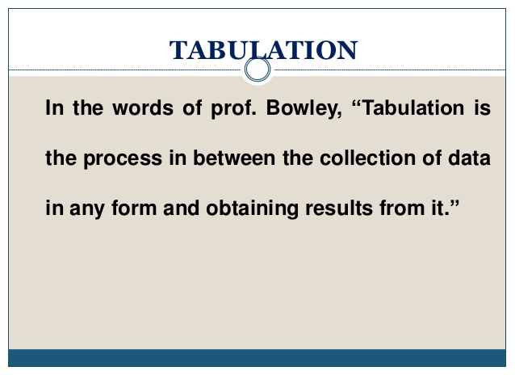

Slide 3
Tabulation Meaning:
Tabulation is a systematic & logical presentation of numeric data in rows and columns, to facilitate comparison and statistical analysis. It facilitates comparison by bringing related information close to each other and helps in further statistical analysis and interpretation.
To put it in other words, the method of placing organised data into a tabular form is called as tabulation. It may be complex, double or simple depending upon the nature of categorisation.

Slide 4
5 Major Objectives Of Tabulation:
(1) To Simplify the Complex Data
It reduces the bulk of information i.e. raw data in a simplified and meaningful form so that it could be easily by a common man in less time.
(2) To Bring Out Essential Features of the Data
It brings out the chief/main characteristics of data.
It presents facts clearly and precisely without textual explanation.
(3) To Facilitate Comparison
Presentation of data in row & column is helpful in simultaneous detailed comparison on the basis of several parameters.

Slide 5
4) To Facilitate Statistical Analysis
Tables serve as the best source of organised data for further statistical analysis.
The task of computing average, dispersion, correlation, etc. becomes much easier if data is presented in the form of a table.
(5) Saving of Space
A table presents facts in a better way than the textual form.
It saves space without sacrificing the quality and quantity of data.

Slide 6
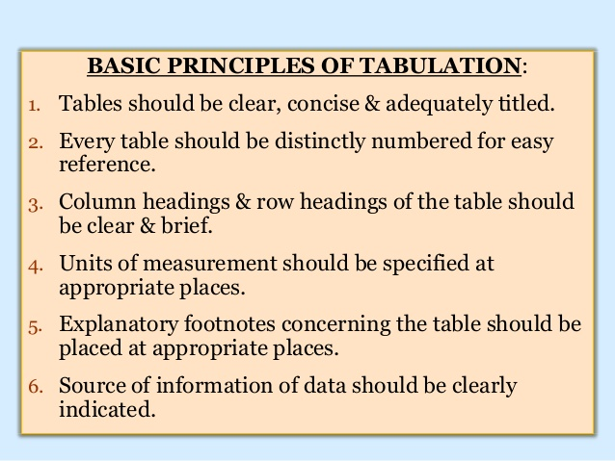

Slide 7
STUDENTS LIST FOR ANALY SIS ABOUT THEM AGE
SL.NO | NAME | D.O.B | D.O.J
1 | NITHYA | 20.
2 | KEERTHANA
3 | LALITHA
4 | MADAVI
5 | VIGNESWARI
6 | ABINAYA
7 | SESHMA

Slide 8
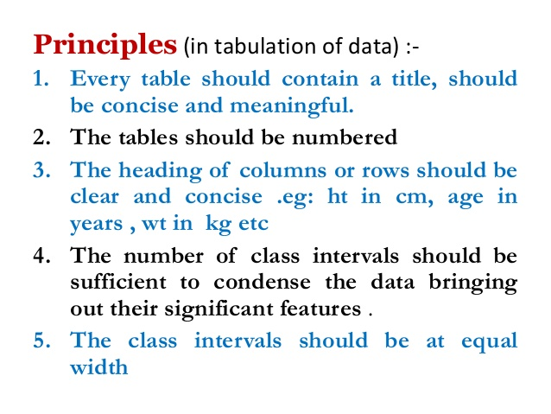

Slide 9
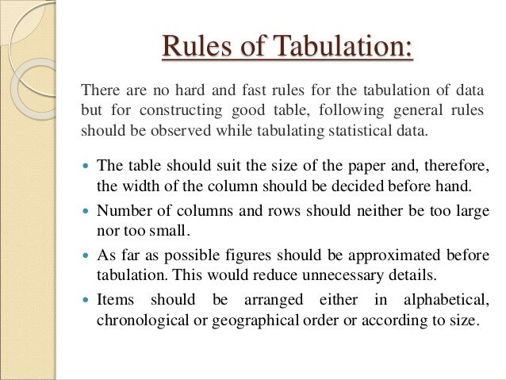

Slide 10
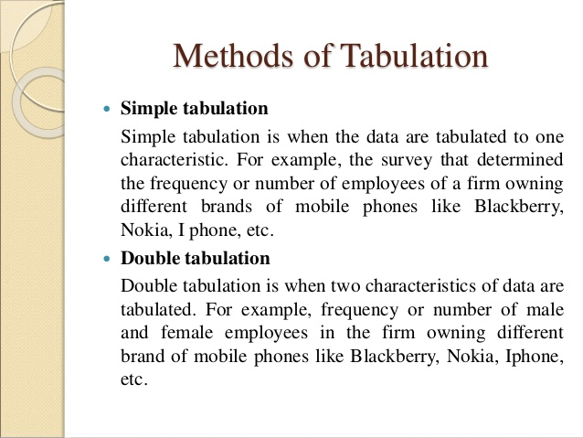

Slide 11
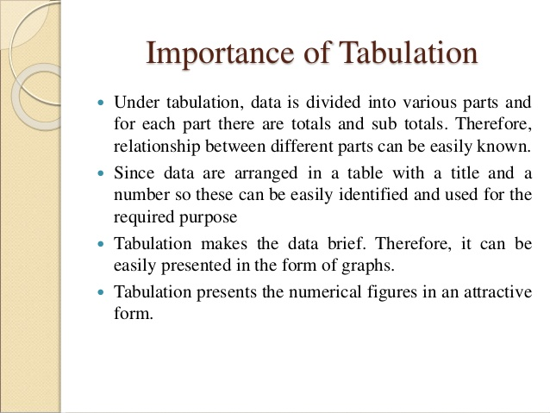

Slide 12
Essential parts of a table:
A statistical table is divided into 8 parts, which are explain below.
i. Title of the table:
A title is a heading at the top of the table describing its contents. A title usually tells us, what is the nature of the data, where the data are, what time period do the data cover, how are the data classified.
ii. Caption:
The headings for various column and rows are called columns caption and row caption.

Slide 13
iii. Box head:
The portion of the table containing Column caption is called box head.
iv. Stub:
The portion of the table containing row caption is called stub.

Slide 14
v. Body of the table:
The body of the table contains the statistical data which have to be presented in different rows and column.
vi. Prefatory notes or head notes:
Prefatory note appears between title and body of the table and enclosed in brackets. It is used to throw some light about the units of measurements e.g. in lakhs, in thousand, in tones etc.

Slide 15
vii. Foot note:
A foot note an always given at the bottom of the table but above the source note. Afoot note is a statement about something which is not clear from headings, title, stubs and captions etc. suppose when the profit earned by a company is shown in a table footnote should define whether it is profit before tax or profit after tax.
viii. Source note:
A source note is placed immediately below the table but after the footnote. It refers to the source from where information has been taken.

Slide 16
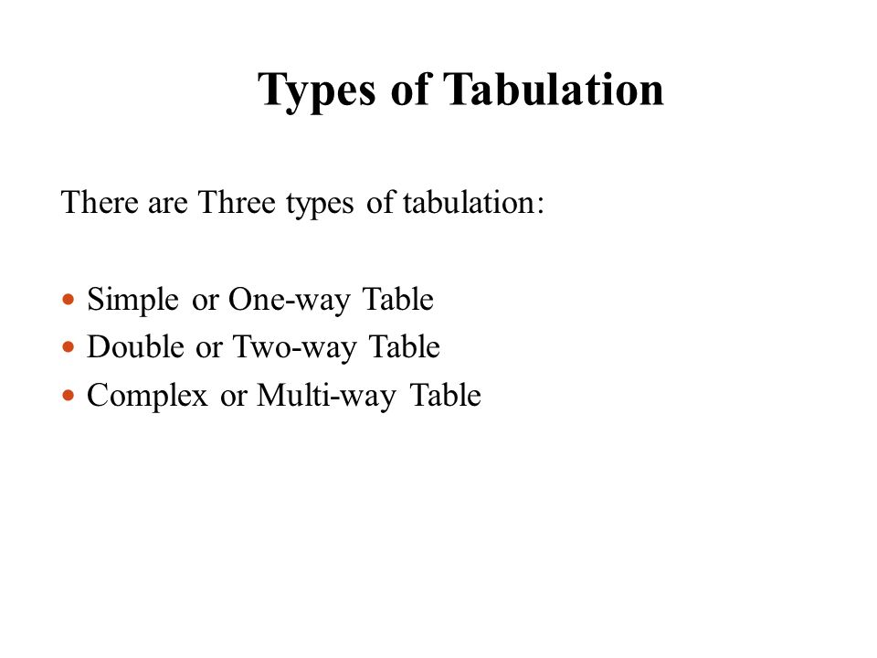

Slide 17
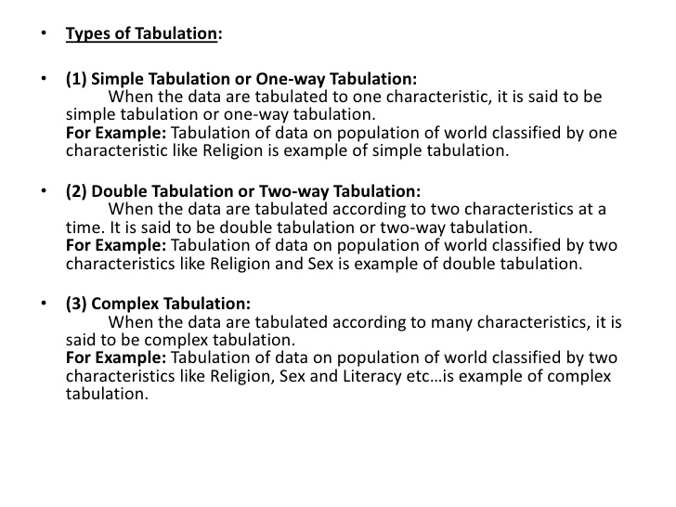

Slide 18
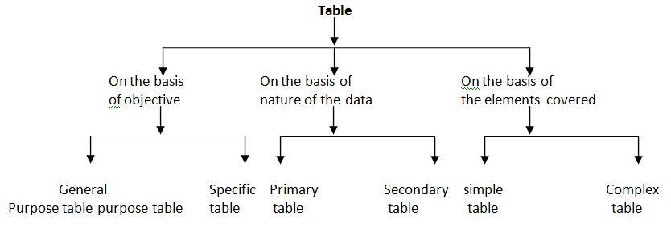

Slide 19
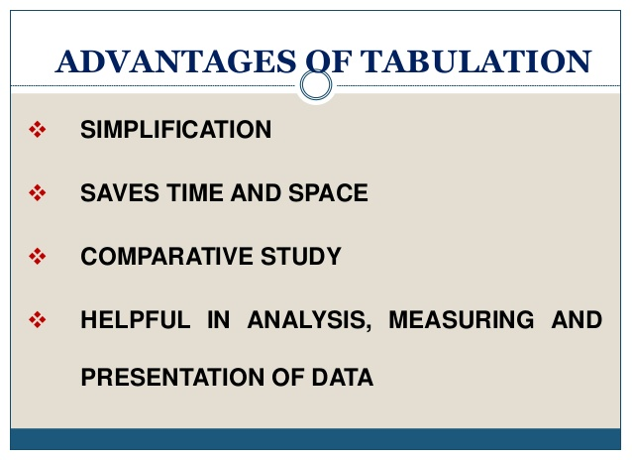

Slide 20
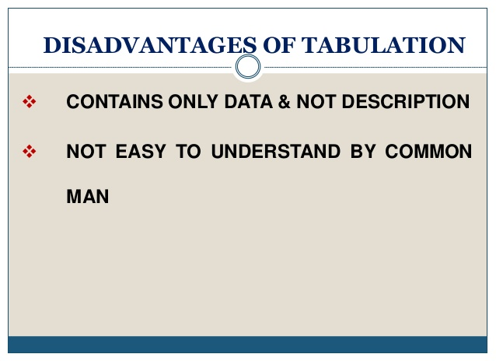

Slide 21
THANKS TO ALL

Slide 22


