Slide 1
PLEASANT MORNING TO ALL
RESEARCH METHODOLOGY
II M.SC GEOGRAPHY
DATE:04.08.2020
DAY ORDER:2
TIME:09:30 TO 10:30
S.SASIKALA
GUEST LECTURER IN GEOGRAPHY
GCWK(A)

Slide 2
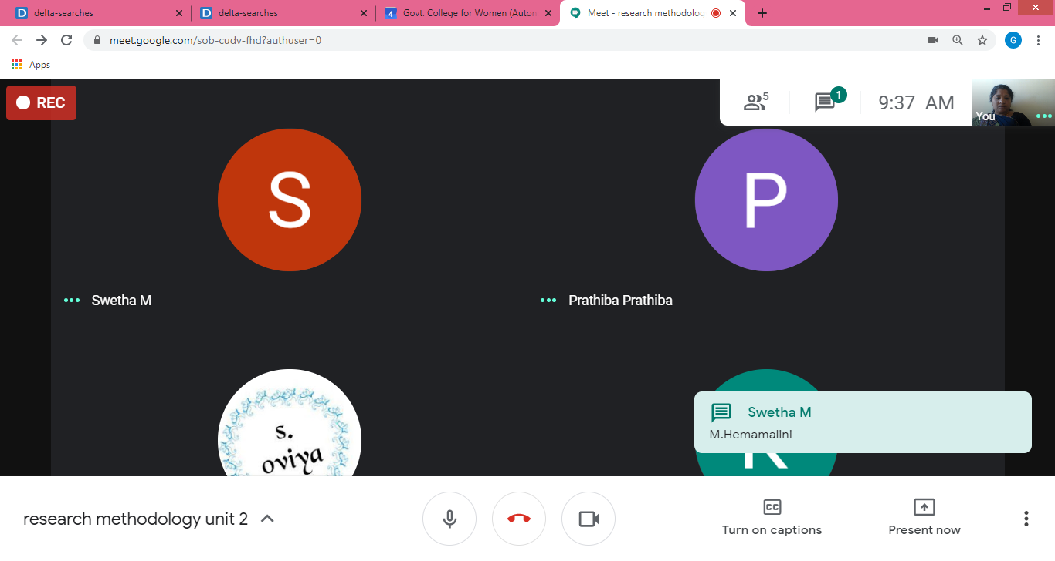

Slide 3
What is Research Ethics?
Research ethics provides guidelines for the responsible conduct of research. In addition, it educates and monitors scientists conducting research to ensure a high ethical standard.
The following is a general summary of some ethical principles:
Honesty:
Honestly report data, results, methods and procedures, and publication status. Do not fabricate, falsify, or misrepresent data.

Slide 4
Objectivity:
Strive to avoid bias in experimental design, data analysis, data interpretation, peer review, personel decisions, grant writing, expert testimony, and other aspects of research.
Integrity:
Keep your promises and agreements; act with sincerity; strive for consistency of thought and action.
Carefulness:
Avoid careless errors and negligence; carefully and critically examine your own work and the work of your peers. Keep good records of research activities.

Slide 5
THANK YOU
STAY HOME! SAVE LIFE!
BE AWARE!

Slide 6
Openness:
Share data, results, ideas, tools, resources. Be open to criticism and new ideas.
Respect for Intellectual Property:
Honor patents, copyrights, and other forms of intellectual property. Do not use unpublished data, methods, or results without permission. Give credit where credit is due. Never plagiarize.
Confidentiality:
Protect confidential communications, such as papers or grants submitted for publication, personnel records, trade or military secrets, and patient records.

Slide 7
Responsible Publication:
Publish in order to advance research and scholarship, not to advance just your own career. Avoid wasteful and duplicative publication.
Responsible Mentoring:
Help to educate, mentor, and advise students. Promote their welfare and allow them to make their own decisions.
Respect for Colleagues:
Respect your colleagues and treat them fairly.
Social Responsibility:
Strive to promote social good and prevent or mitigate social harms through research, public education, and advocacy.

Slide 8
Non-Discrimination:
Avoid discrimination against colleagues or students on the basis of sex, race, ethnicity, or other factors that are not related to their scientific competence and integrity.
Competence:
Maintain and improve your own professional competence and expertise through lifelong education and learning; take steps to promote competence in science as a whole.

Slide 9
Legality:
Know and obey relevant laws and institutional and governmental policies.
Animal Care:
Show proper respect and care for animals when using them in research. Do not conduct unnecessary or poorly designed animal experiments.
Human Subjects Protection:
When conducting research on human subjects, minimize harms and risks and maximize benefits; respect human dignity, privacy, and autonomy.

Slide 10
Curiosity – This is what you’re interested in; what you have wondering about and what you most want to understand; from asking how things work, questioning why they don’t to searching for ways they can be better, curiosity is how the research process starts.

Slide 11
Question development – once you hone in on your interests it is time to nail your research question. Remember, research is the process of designing and implementing a plan for answering your research question so if you have a topic, but are not sure of the question, you simply cannot design a way to get appropriate answers.

Slide 12
Understanding the state of play – now that you have articulated what it is you want to know in the form of a research question, you need to find out what other researchers have already discovered in and around your topic. After all, you’re unlikely to be uncovering a whole new field, and instead will be adding to an existing body of knowledge, something you cannot not do well if you’re not in the know.

Slide 13
Revise/ hone in – will help you hone in on the contribution that your research will make to your field. This needs to be captured in the re-evaluation and articulation of your research question.

Slide 14
Deciding who has / where the answers are – once you have a honed-in, well-articulated research question, it is time to think about where the answer to your question lies. Who has the answer? Does it reside with a population; a key informant; a community; a panel of experts; in documents; on the web; in existing records? Locating sources for answers is the first step to defining method.

Slide 15
Deciding how to collect your data – deciding on appropriate and ethical methods becomes a lot easier when you know where the answers lie. If you think about it logically, if your answers are with an expert – you will need to interview; if your answers are in existing records- you will need to do secondary analysis; if they are in document – you will do document analysis; if they are with community – you are likely to do a survey. Of course, a combination of the above is also a likely possibility.

Slide 16
Getting you data together – data collection, finally! Get conducting your interviews; administering your survey; trolling through the documents etc.
Making sense of what you find – the analysis. Statistics for the quantitative data and thematic analysis for the qualitative data. Think of this as an ongoing process as your data comes in. It is a process of assessing your data and its meaning in relation to your research question at every turn.

Slide 17
Sharing insights – look for the meaning that sits in the words, numbers, and images you have collected. You are trying to develop a narrative here that captures and shares your insights in a meaningful way; first in your discussion and then in your eventuating conclusion.

Slide 18
Offering recommendations – most research arises from concerns; – whether it is in a workplace, community, or political system, most of our research illuminates problems, offers solutions, or evaluates attempts at situation improvement. This means we have the opportunity to move our findings to recommendations and steps for action that can help in evidence based decision making.

Slide 19
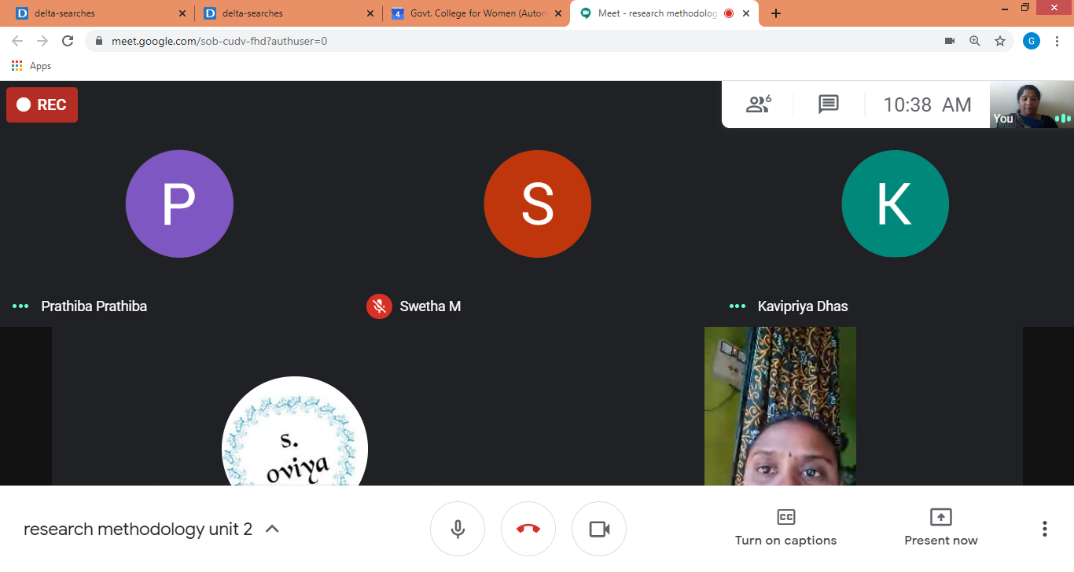

Slide 20
