Slide 1
HYPOTHESIS
II PG APPLIED GEOGRAPHY
RESEARCH METHODOLOGY
SASIKALA.S
GUEST FCULTY.
DEPARTMENT OF GEOGRAPHY.
GCWK(A).

Slide 2
Learning Objectives
What is meant by hypothesis?

Slide 3
Learning Objectives
What is meant by hypothesis?
Characteristics of hypothesis.

Slide 4
Learning Objectives
What is meant by hypothesis?
Characteristics of hypothesis.
Formulation of hypothesis.

Slide 5
Learning Objectives
What is meant by hypothesis?
Characteristics of hypothesis.
Formulation of hypothesis.
Basic concepts of testing hypothesis.

Slide 6
Learning Objectives
What is meant by hypothesis?
Characteristics of hypothesis.
Formulation of hypothesis.
Basic concepts of testing hypothesis.
Examples

Slide 7
Learning Objectives
What is meant by hypothesis?
Characteristics of hypothesis.
Formulation of hypothesis.
Basic concepts of testing hypothesis.
Examples
Conclusion

Slide 8
What is hypothesis?
A Hypothesis is an assumption or

Slide 9
What is hypothesis?
A Hypothesis is an assumption or
claim about some characteristic of a population.

Slide 10
What is hypothesis?
A Hypothesis is an assumption or
claim about some characteristic of a population
Which we should be able to support or reject on the basis of empirical evidences

Slide 11
Characteristics of hypothesis.
Hypothesis should be clear and precise.

Slide 12
Characteristics of hypothesis.
Hypothesis should be clear and precise.
Hypothesis should be capable of being tested.

Slide 13
Characteristics of hypothesis.
Hypothesis should be clear and precise.
Hypothesis should be capable of being tested.
Hypothesis should be state relationship between variables.

Slide 14
Characteristics of hypothesis.
Hypothesis should be clear and precise.
Hypothesis should be capable of being tested.
Hypothesis should be state relationship between variables.
Hypothesis should be stated in most simple terms.

Slide 15
Characteristics of hypothesis.
Hypothesis should be clear and precise.
Hypothesis should be capable of being tested.
Hypothesis should be state relationship between variables.
Hypothesis should be stated in most simple terms.
Hypothesis should be limited in scope and must be specific.

Slide 16
Characteristics of hypothesis.
Hypothesis should be clear and precise.
Hypothesis should be capable of being tested.
Hypothesis should be state relationship between variables.
Hypothesis should be stated in most simple terms.
Hypothesis should be limited in scope and must be specific.
Hypothesis should be consistent with most known facts.

Slide 17
Characteristics of hypothesis.
Hypothesis should be clear and precise.
Hypothesis should be capable of being tested.
Hypothesis should be state relationship between variables.
Hypothesis should be stated in most simple terms.
Hypothesis should be limited in scope and must be specific.
Hypothesis should be consistent with most known facts.
Hypothesis should be amenable to testing within a reasonable time.

Slide 18
Characteristics of hypothesis.
Hypothesis should be clear and precise.
Hypothesis should be capable of being tested.
Hypothesis should be state relationship between variables.
Hypothesis should be stated in most simple terms.
Hypothesis should be limited in scope and must be specific.
Hypothesis should be consistent with most known facts.
Hypothesis should be amenable to testing within a reasonable time.
Hypothesis must explain the facts that gave rise to the need for the explanation.

Slide 19
Hypothesis Testing
When having two groups of study, the two sets of obtained results are never identical.

Slide 20
Hypothesis Testing
When having two groups of study, the two sets of obtained results are never identical.
They show some difference, even with two representative samples drawn from the same

Slide 21
Hypothesis Testing
When having two groups of study, the two sets of obtained results are never identical.
They show some difference, even with two
representative samples drawn from the same universe, due to sampling errors (chance role).
Results are thus submitted to certain
statistical procedures, to test for significance.

Slide 22
Hypothesis Testing
When having two groups of study, the two sets
of obtained results are never identical.
They show some difference, even with two
representative samples drawn from the same
universe, due to sampling errors (chance role).
Results are thus submitted to certain
statistical procedures, to test for significance.
Significance means that the difference is real
and not due to chance.

Slide 23
Basic principle
A difference between groups is observed

Slide 24
Basic principle
A difference between groups is observed
Appropriate statistical test is applied

Slide 25
Basic principle
A difference between groups is observed
Appropriate statistical test is applied
Test statistic is obtained

Slide 26
Basic principle
A difference between groups is observed
Appropriate statistical test is applied
Test statistic is obtained
Statistical tables are consulted your
error if you conclude that the difference
is real and not due to chance.

Slide 27
Basic principle
A difference between groups is observed
Appropriate statistical test is applied
Test statistic is obtained
Statistical tables are consulted your
error if you conclude that the difference
is real and not due to chance.
Difference Statistical test test
statistic significance conclusion

Slide 28
Hypothesis formulation
1. The very first step with definition of
the study question.

Slide 29
Hypothesis formulation
1. The very first step with definition of
the study question.
2. The Null Hypothesis: No difference
between groups (H0 = H1)

Slide 30
Hypothesis formulation
1. The very first step with definition of
the study question.
2. The Null Hypothesis: No difference
between groups (H0 = H1)
3. The Alternative Hypothesis (research):
the 2 groups are different (H0 ≠ H1)

Slide 31
Hypothesis formulation
A not equal B (A or B could be better)
Non-directional

Slide 32
Hypothesis formulation
A not equal B (A or B could be better)
Non-directional
A is better than B: Directional [powerful]

Slide 33
Hypothesis formulation
A not equal B (A or B could be better)
Non-directional
A is better than B: Directional [powerful]
The statistical test gives the probability
of rejection of a true null hypothesis (false +ve).

Slide 34
Hypothesis formulation
A not equal B (A or B could be better)
Non-directional
A is better than B: Directional [powerful]
The statistical test gives the probability
of rejection of a true null hypothesis (false +ve).
The sample size governs the power of the
test (ability to detect significance)

Slide 35
Study Conclusion
Types of Statistical Errors
Truth in the population versus the results in the study sample: the four possibilities
Results
in the
study
sample
2 Groups are
Different
2 groups are
similar

Slide 36
Study Conclusion
Types of Statistical Errors
Truth in the population versus the results in the study sample: the four possibilities
Truth in the population
2 Groups are 2 Groups are
different similar
Results
in the
study
sample
2 Groups are
different
2 groups are
similar

Slide 37
Study Conclusion
Types of Statistical Errors
Truth in the population versus the results in the study sample: the four possibilities
Truth in the population
2 Groups are 2 Groups are
different similar
Results
in the
study
sample
Reject null
Hypothesis
2 groups are
similar

Slide 38
Study Conclusion
Types of Statistical Errors
Truth in the population versus the results in the study sample: the four possibilities
Truth in the population
2 Groups are 2 Groups are
different similar
Results
in the
study
sample
Reject null
Hypothesis
Fail to reject
Null hypothesis

Slide 39
Study Conclusion
Types of Statistical Errors
Truth in the population versus the results in the study sample: the four possibilities
Truth in the population
Reject null
hypothesis
Fail to reject
null hypothesis
Results
in the
study
sample
Reject null
Hypothesis
Fail to reject
Null hypothesis

Slide 40
Study Conclusion
Types of Statistical Errors
Truth in the population versus the results in the study sample: the four possibilities
Truth in the population
Reject null
hypothesis
Fail to reject
null hypothesis
Results
in the
study
sample
Reject null
Hypothesis
Fail to reject
Null hypothesis
Correct

Slide 41
Study Conclusion
Types of Statistical Errors
Truth in the population versus the results in the study sample: the four possibilities
Truth in the population
Reject null
hypothesis
Fail to reject
null hypothesis
Results
in the
study
sample
Reject null
Hypothesis
Fail to reject
Null hypothesis
Correct
 | Correct

Slide 42
Study Conclusion
Types of Statistical Errors
Truth in the population versus the results in the study sample: the four possibilities
Truth in the population
Reject null
hypothesis
Fail to reject
null hypothesis
Results
in the
study
sample
Reject null
Hypothesis
Fail to reject
Null hypothesis
Correct | Type I Error
 | Correct

Slide 43
Study Conclusion
Types of Statistical Errors
Truth in the population versus the results in the study sample: the four possibilities
Truth in the population
Reject null
hypothesis
Fail to reject
null hypothesis
Results
in the
study
sample
Reject null
Hypothesis
Fail to reject
Null hypothesis
Correct | Type I Error
Type II Error | Correct

Slide 44
Study Conclusion
Types of Statistical Errors
Truth in the population versus the results in the study sample: the four possibilities
Truth in the population
Association
between predictor
and outcome
No association
between predictor
and outcome
Results
in the
study
sample
Reject null
Hypothesis
Fail to reject
Null hypothesis
Correct | Type I Error
Type II Error | Correct

Slide 45
Statistical Errors
Error: rejection of a true Null Hypothesis [type 1 error]
Conclusion: presence of a difference that does not exist
Could be considered as false +ve
Measured by the p-value, the threshold of significance: 5% (p <= 0.05)

Slide 46
Statistical Errors
β Error: failure to reject a false Null Hypothesis [type 2 error]
Conclusion: failure to detect a difference that really exists
Could be considered as false -ve
Related to the number of subjects,
Usually fixed between 5% - 10%
Power of test = 1- β

Slide 47
Examples
Null Hypothesis (H_{o})
As age increases pressure will not increases.

Slide 48
Examples
Null Hypothesis (H_{o})
As age increases pressure will not increases.
Rural young students are non smokers.

Slide 49
Examples
Null Hypothesis (H_{o})
As age increases pressure will not increases.
Rural young students are non smokers.
Among the rural women antenatal care is poor.

Slide 50
Examples
Null Hypothesis (H_{o})
As age increases pressure will not increases.
Rural young students are non smokers.
Among the rural women antenatal care is poor.
GPA scores are more those who studied less hours.

Slide 51
Examples
Alternative Hypothesis (H₁)
Let us take one example
As age increases pressure will increases.

Slide 52
Examples
Alternative Hypothesis (H₁)
Let us take one example
As age increases pressure will increases.
So, to test the above mentioned hypothesis I used Chi-square Test.

Slide 53
DATA COLLECTED
Person | Age | Pressure
A | 43 | 120
B | 48 | 128
C | 50 | 135
D | 55 | 146
E | 60 | 149
F | 68 | 150
G | 72 | 167

Slide 54
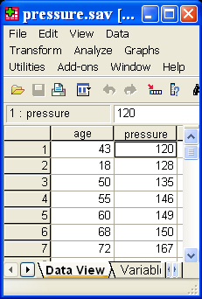
Entered into SPSS

Slide 55
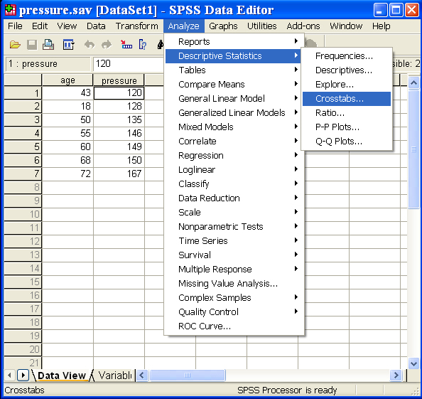
Analyzing

Slide 56
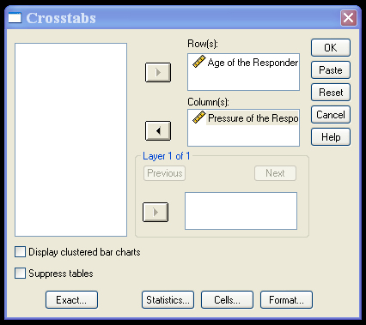
Selection of Variables

Slide 57
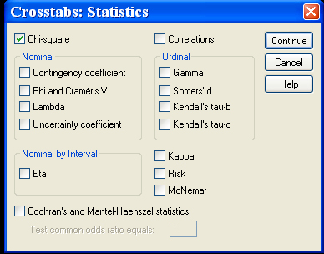
Selection of Chi-square

Slide 58
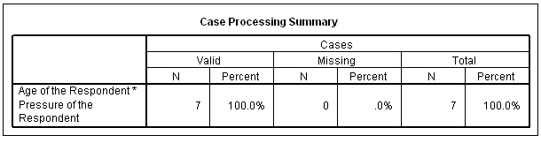
Output view-1-SPSS

Slide 59
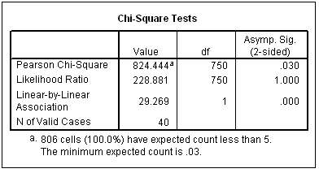
Output view-2-SPSS

Slide 60
Finding Chi-square

Slide 61
Significance level
In our example the p value of .030 is less than the commonly accepted levels of either.05 or .10

Slide 62
Significance level
In our example the p value of .030 is less than the commonly accepted levels of either.05 or .10
So, we can reject the null hypothesis and

Slide 63
Significance level
In our example the p value of .227 is less than the commonly accepted levels of either.05 or .10
So, we can reject the null hypothesis and
Accepting Alternative hypothesis.

Slide 64
Significance level
In our example the p value of .227 is less than the commonly accepted levels of either.05 or .10
So, we can reject the null hypothesis and
Accepting Alternative hypothesis.
Which mean that “ As age increases pressure also increases”

Slide 65

THANK YOU

