Slide 1
GOOD AFTERNOON TO ALL
BIO GEOGRAPHY
TOPIC : ECOTONE,FORMATION,CHARACTER OF ECOTONE
DAY ORDER:6
TIME :2:30 P.M TO 3:30 P.M
S.NITHYA
LECTURER IN GEOGRAPHY,
GCWK(A)

Slide 2
ECOTONE
An ecotone is a transition area between two biological communities,
[1] where two communities meet and integrate.
[2] It may be narrow or wide, and it may be local (the zone between a field and forest) or regional (the transition between forest and grassland ecosystems).
[3] An ecotone may appear on the ground as a gradual blending of the two communities across a broad area, or it may manifest itself as a sharp boundary line.
The word ecotone was coined from a combination of ecology plus -tone, from the Greek tonos or tension – in other words, a place where ecologies are in tension.

Slide 3
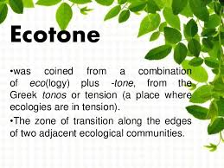

Slide 4
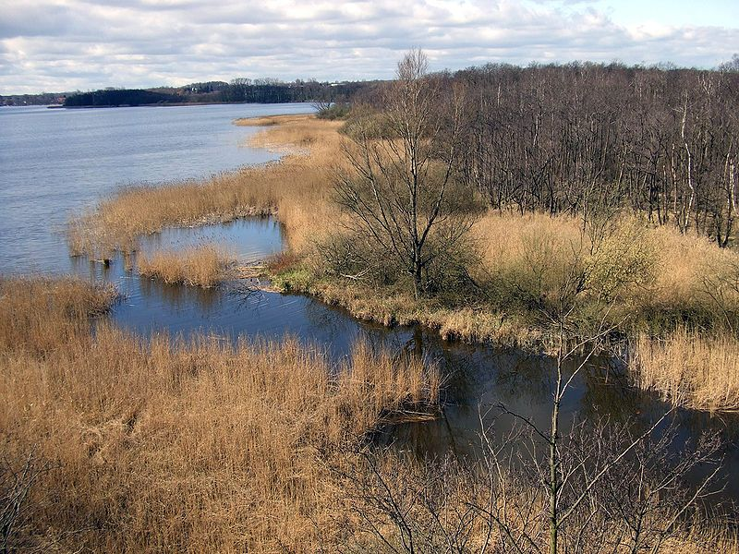
ECOTONE

Slide 5
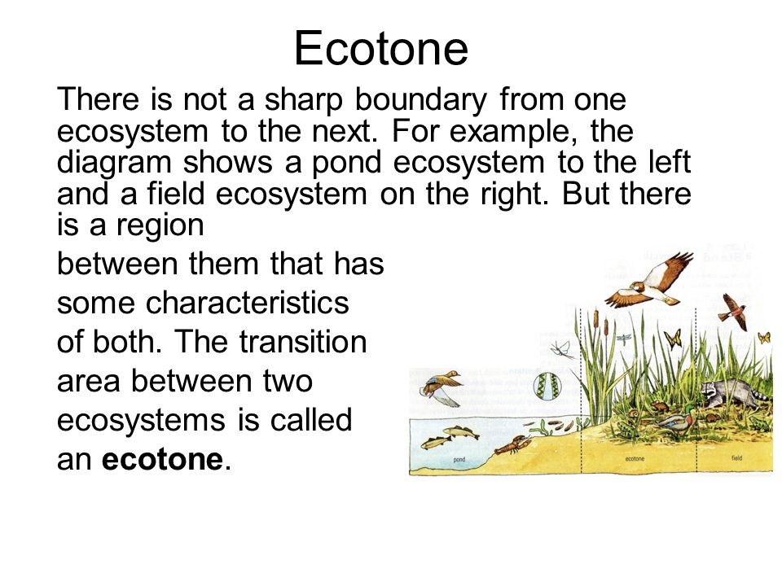
ECOTONE

Slide 6
ECOTONE FORMATION:
Changes in the physical environment may produce a sharp boundary, as in the example of the interface between areas of forest and cleared land. Elsewhere, a more gradually blended interface area will be found, where species from each community will be found together as well as unique local species. Mountain ranges often create such ecotones, due to the wide variety of climatic conditions experienced on their slopes. They may also provide a boundary between species due to the obstructive nature of their terrain. Mont Ventoux in France is a good example, marking the boundary between the flora and fauna of northern and southern France.[7] Most wetlands are ecotones. The spatial variation of ecotones often form due to disturbances, creating patches that separate patches of vegetation. Different intensity of disturbances can cause landslides, land shifts, or movement of sediment that can create these vegetation patches and ecotones

Slide 7
an ecotone is the area where two communities interact. Ecotones can be easily identified by distinct change in soil gradient and soil composition between two communities.[

Slide 8
Characteristics of Ecotone
It may be narrow (between grassland and forest) or wide (between forest and desert).
It has conditions intermediate to the adjacent ecosystems. ...
Usually, the number and the population density of the species of an outgoing community decreases as we move away from the community or ecosystem.

Slide 9
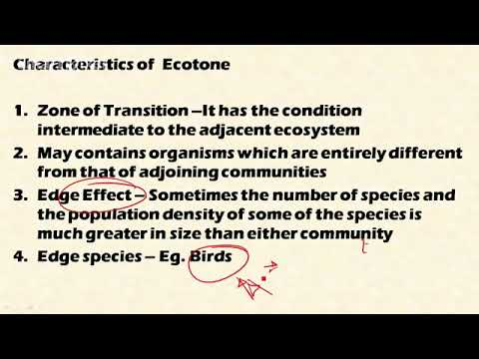

Slide 10
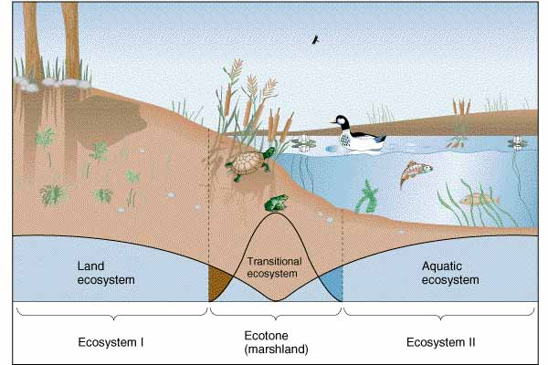
Characteristics of Ecotone

Slide 11
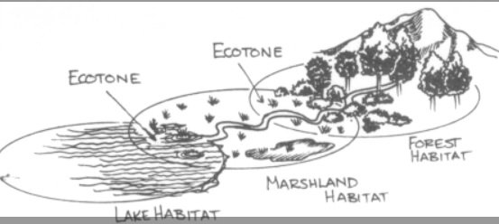
EXAMPLES OF Ecotone

Slide 12
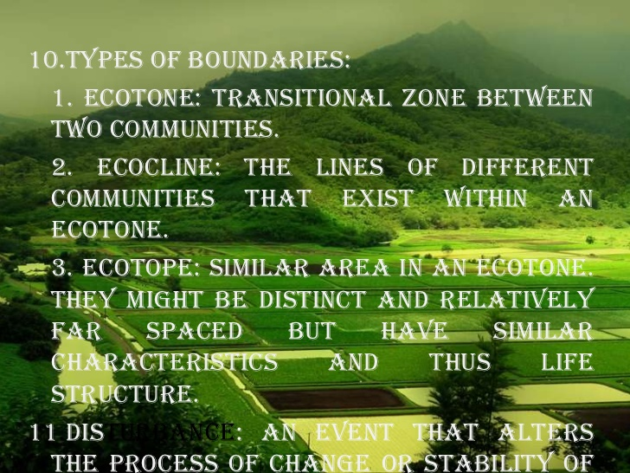

Slide 13
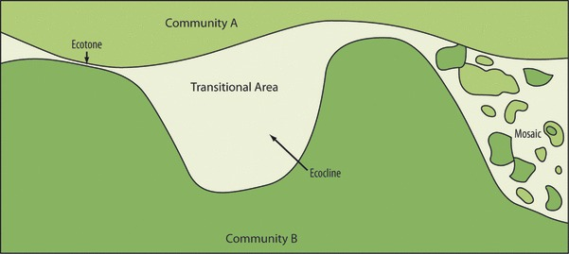
ECOTONE AND ECOLINE

Slide 14
community
community is a group or association of populations of two or more different species occupying the same geographical area at the same time, also known as a biocoenosis. The term community has a variety of uses. In its simplest form it refers to groups of organisms in a specific place or time, for example, "the fish community of Lake Ontario before industrialization".

Slide 15
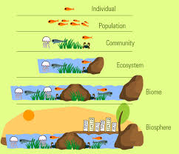
COMMUNITY

Slide 16
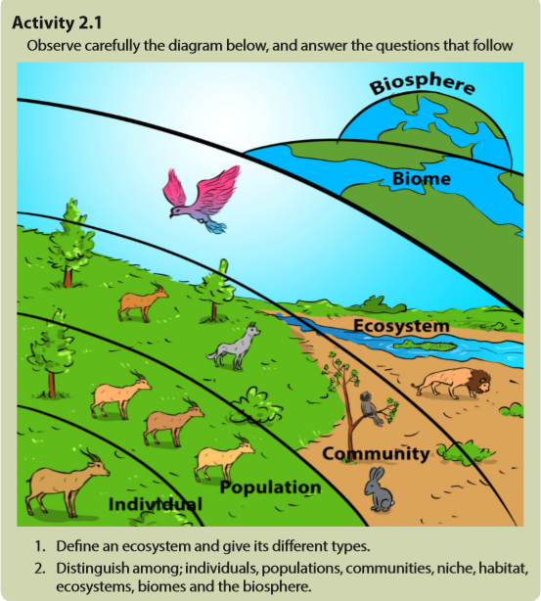

Slide 17
THANKS TO ALL

Slide 18


Slide 19
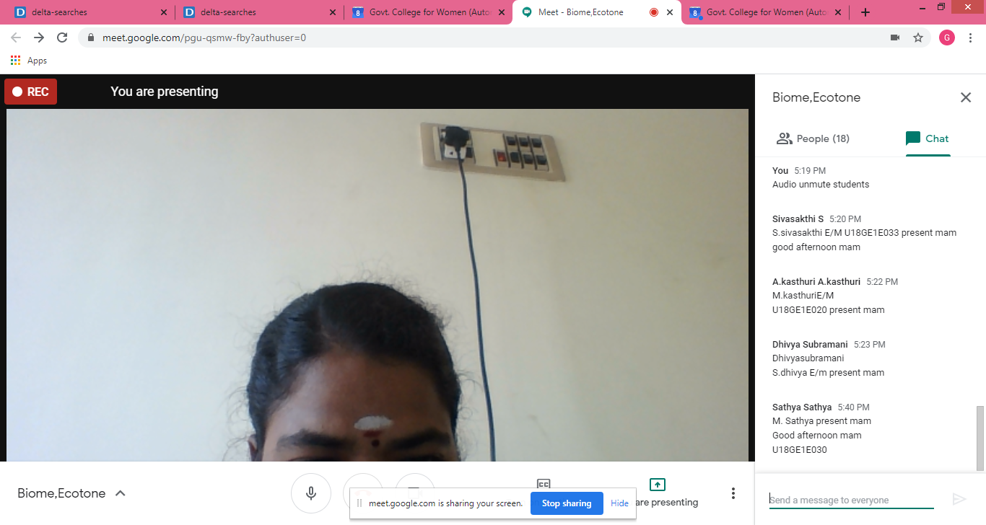

Slide 20


