Slide 1
GOOD MORNING TO ALL
DAY ORDER:I
DATE:10.08.2020
TIME:10:30 TO 11:30
BIO - GEOGRAPHY
COMMUNITY,STRUCTURE,AND COMMUNITY MAJOR BIOMES
S.NITHYA,
LECTURER IN GEORAPHY
GCWK(A)

Slide 2
A community is the set of all populations that inhabit a certain area. Communities can have different sizes and boundaries. These are often identified with some difficulty.
An ecosystem is a higher level of organization the community plus its physical environment. Ecosystems include both the biological and physical components affecting the community/ecosystem. We can study ecosystems from a structural view of population distribution or from a functional view of energy flow and other processes.

Slide 3
Community Structure
Ecologists find that within a community many populations are not randomly distributed. This recognition that there was a pattern and process of spatial distribution of species was a major accomplishment of ecology. Two of the most important patterns are open community structure and the relative rarity of species within a community.
Do species within a community have similar geographic range and density peaks? If they do, the community is said to be a closed community, a discrete unit with sharp boundaries known as ecotones. An open community, however, has its populations without ecotones and distributed more or less randomly.

Slide 4
In a forest, where we find an open community structure, there is a gradient of soil moisture. Plants have different tolerances to this gradient and occur at different places along the continuum. Where the physical environment has abrupt transitions, we find sharp boundaries developing between populations. For example, an ecotone develops at a beach separating water and land.

Slide 5
Open structure provides some protection for the community. Lacking boundaries, it is harder for a community to be destroyed in an all or nothing fashion. Species can come and go within communities over time, yet the community as a whole persists. In general, communities are less fragile and more flexible than some earlier concepts would suggest.
Most species in a community are far less abundant than the dominant species that provide a community its name: for example oak-hickory, pine, etc. Populations of just a few species are dominant within a community, no matter what community we examine. Resource partitioning is thought to be the main cause for this distribution.

Slide 6
There are two basic categories of communities: terrestrial (land) and aquatic (water). These two basic types of community contain eight smaller units known as biomes. A biome is a large-scale category containing many communities of a similar nature, whose distribution is largely controlled by climate
Terrestrial Biomes: tundra, grassland, desert, taiga, temperate forest, tropical forest. Terrestrial biome .
Aquatic Biomes: marine, freshwater.

Slide 7
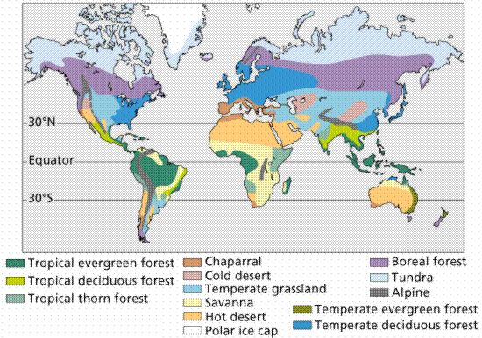

Slide 8
Terrestrial Biomes
Tundra and Desert
The tundra and desert biomes occupy the most extreme environments, with little or no moisture and extremes of temperature acting as harsh selective agents on organisms that occupy these areas. These two biomes have the fewest numbers of species due to the stringent environmental conditions. In other words, not everyone can live there due to the specialized adaptations required by the environment.

Slide 9
Tropical Rain Forests
Tropical rain forests occur in regions near the equator. The climate is always warm (between 20° and 25° C) with plenty of rainfall (at least 190 cm/year). The rain forest is probably the richest biome, both in diversity and in total biomass. The tropical rain forest has a complex structure, with many levels of life. More than half of all terrestrial species live in this biome. While diversity is high, dominance by a particular species is low.

Slide 10
While some animals live on the ground, most rain forest animals live in the trees. Many of these animals spend their entire life in the forest canopy. Insects are so abundant in tropical rain forests that the majority have not yet been identified. Charles Darwin noted the number of species found on a single tree, and suggested the richness of the rain forest would stagger the future systematist with the size of the catalogue of animal species found there. Termites are critical in the decomposition and nutrient cycling of wood. Birds tend to be brightly colored, often making them sought after as exotic pets. Amphibians and reptiles are well represented. Lemurs, sloths, and monkeys feed on fruits in tropical rain forest trees. The largest carnivores are the cats (jaguars in South America and leopards in Africa and Asia). Encroachment and destruction of habitat put all these animals and plants at risk.

Slide 11
Epiphytes are plants that grow on other plants. These epiphytes have their own roots to absorb moisture and minerals, and use the other plant more as an aid to grow taller. Some tropical forests in India, Southeast Asia, West Africa, Central and South American are seasonal and have trees that shed leaves in dry season. The warm, moist climate supports high productivity as well as rapid decomposition of detritus.

Slide 12
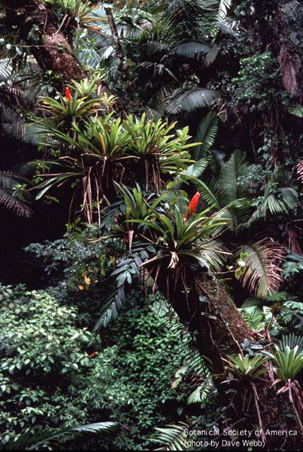
10

Slide 13
The temperate forest biome occurs south of the taiga in eastern North America, eastern Asia, and much of Europe. Rainfall is abundant (30-80 inches/year; 75-150 cm) and there is a well-defined growing season of between 140 and 300 days. The eastern United States and Canada are covered (or rather were once covered) by this biome's natural vegetation, the eastern deciduous forest. Dominant plants include beech, maple, oak; and other deciduous hardwood trees. Trees of a deciduous forest have broad leaves, which they lose in the fall and grow again in the spring.

Slide 14
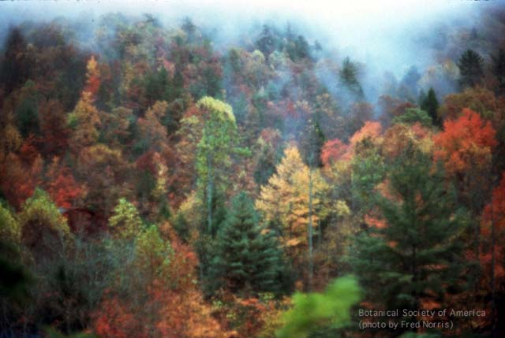

Slide 15
Shrubland (Chaparral)
The shrubland biome is dominated by shrubs with small but thick evergreen leaves that are often coated with a thick, waxy cuticle, and with thick underground stems that survive the dry summers and frequent fires. Shrublands occur in parts of South America, western Australia, central Chile, and around the Mediterranean Sea. Dense shrubland in California, where the summers are hot and very dry, is known as chaparral, shown in Figure 4. This Mediterranean-type shrubland lacks an understory and ground litter, and is also highly flammable. The seeds of many species require the heat and scarring action of fire to induce germination.

Slide 16
Most grasslands have now been utilized to grow crops, especially wheat and corn. Grasses are the dominant plants, while grazing and burrowing species are the dominant animals. The extensive root systems of grasses allows them to recover quickly from grazing, flooding, drought, and sometimes fire.
Temperate grasslands include the Russian steppes, the South American pampas, and North American prairies. A tall-grass prairie occurs where moisture is not quite sufficient to support trees. A short-grass-prairie, shown in Figure 5, survives on less moisture and occurs between a tall-grass prairie and desert.

Slide 17
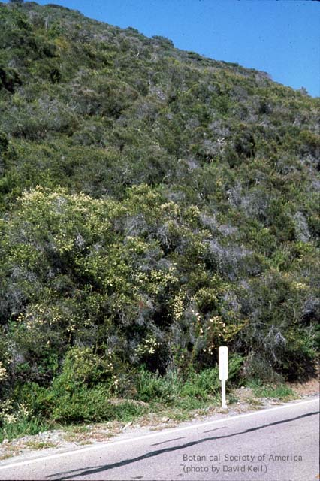

Slide 18
Grasslands
Grasslands occur in temperate and tropical areas with reduced rainfall (10-30 inches per year) or prolonged dry seasons. Grasslands occur in the Americas, Africa, Asia, and Australia. Soils in this region are deep and rich and are excellent for agriculture. Grasslands are almost entirely devoid of trees, and can support large herds of grazing animals. Natural grasslands once covered over 40 percent of the earth's land surface. In temperate areas where rainfall is between 10 and 30 inches a year, grasslan
d is the climax community because it is too wet for desert and too dry for forests.

Slide 19
Animal life includes mice, prairie dogs, rabbits, and animals that feed on them (hawks and snakes). Prairies once contained large herds of buffalo and pronghorn antelope, but with human activity these once great herds ahve dwindled.
The savanna is a tropical grassland that contains some trees. The savanna contains the greatest variety and numbers of herbivores (antelopes, zebras, and wildebeests, among others). This environment supports a large population of carnivores (lions, cheetahs, hyenas, and leopards). Any plant litter not consumed by grazers is attacked by termites and other decomposers. Once again, human activities are threatening this biome, reducing the range for herbivores and carnivores. Will extinction of the great cats be a resul

Slide 20
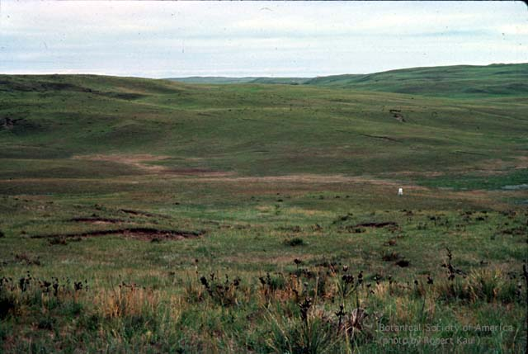

Slide 21
Deserts
Deserts are characterized by dry conditions (usually less than 10 inches per year; 25 cm) and a wide temperature range. The dry air leads to wide daily temperature fluctuations from freezing at night to over 120 degrees during the day. Most deserts occur at latitudes of 30o N or S where descending air masses are dry. Some deserts occur in the rainshadow of tall mountain ranges or in coastal areas near cold offshore currents. Plants in this biome have developed a series of adaptations (such as succulent stems, and small, spiny, or absent leaves) to conserve water and deal with these temperature extremes. Photosynthetic modifications (CAM) are another strategy to life in the drylands.

Slide 22
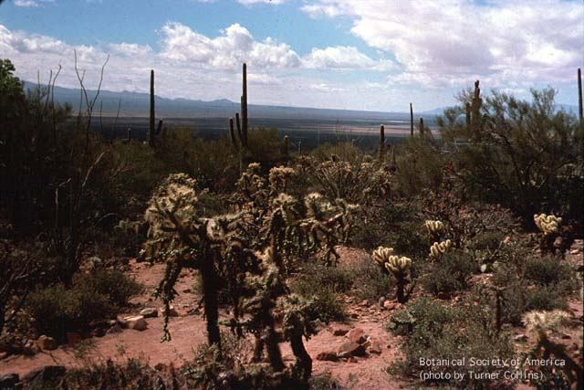

Slide 23
Taiga (Boreal Forest)
The taiga (pronounced "tie-guh" and shown in Figure 8) is a coniferous forest extending across most of the northern area of northern Eurasia and North America. This forest belt also occurs in a few other areas, where it has different names: the montane coniferous forest when near mountain tops; and the temperate rain forest along the Pacific Coast as far south as California. The taiga receives between 10 and 40 inches of rain per year and has a short growing season. Winters are cold and short, while summers tend to be cool. The taiga is noted for its great stands of spruce, fir, hemlock, and pine. These trees have thick protective leaves and bark, as well as needlelike (evergreen) leaves can withstand the weight of accumulated snow. Taiga forests have a limited understory of plants, and a forest floor covered by low-lying mosses and lichens. Conifers, alders, birch and willow are common plants; wolves, grizzly bears, moose, and caribou are common animals. Dominance of a few species is pronounced, but diversity is low when compared to temperate and tropical biomes.

Slide 24
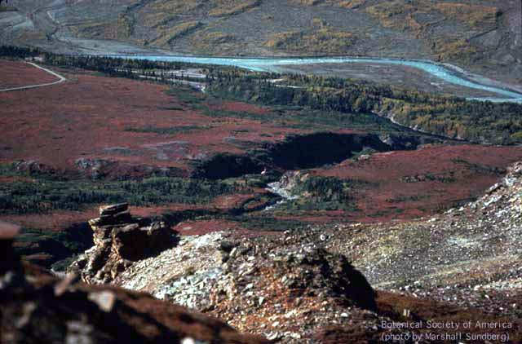

Slide 25
Tundra
The tundra, shown in Figure 9, covers the northernmost regions of North America and Eurasia, about 20% of the Earth's land area. This biome receives about 20 cm (8-10 inches) of rainfall annually. Snow melt makes water plentiful during summer months. Winters are long and dark, followed by very short summers. Water is frozen most of the time, producing frozen soil, permafrost. Vegetation includes no trees, but rather patches of grass and shrubs; grazing musk ox, reindeer, and caribou exist along with wolves, lynx, and rodents. A few animals highly adapted to cold live in the tundra year-round (lemming, ptarmigan). During the summer the tundra hosts numerous insects and migratory animals. The ground is nearly completely covered with sedges and short grasses during the short summer. There are also plenty of patches of lichens and mosses. Dwarf woody shrubs flower and produce seeds quickly during the short growing season. The alpine tundra occurs above the timberline on mountain ranges, and may contain many of the same plants as the arctic tundra.

Slide 26
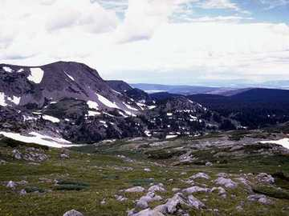

Slide 27


Slide 28


