Slide 1
GOOD AFTERNOON TO ALL
BIO – GEOGRAPHY
TPOIC:ANIMALCOMMUNITY
DAY ORDER:III
DATE:21.08.2020
TIME :2:30 TO 3:30
S.NITHYA
LECTURER IN GEOGRAPHY
GCWK(A)

Slide 2
Species: Individual organisms that can interbreed to make fertile off springs
Population: Total number of a species in a given place/time
Community: A combination of more than one population in a place
Therefore: Animal Community is simply the various species of animals in an habitat or microhabitat or occupying the same niche.

Slide 3
ANIMAL COMMUNITY
If one considers all of the various populations that are found in a given area, that is known as a biological community.
For example, all the organisms living on a dead tree can be considered a community. Various species of worms, insects, moles, moss, fungi, etc. will all reside there and carry out various niches.

Slide 4
Community, also called biological community, in biology, an interacting group of various species in a common location.
For example, a forest of trees and undergrowth plants, inhabited by animals and rooted in soil containing bacteria and fungi, constitutes a biological community.

Slide 5
The various species in a community each occupy their own ecological niche. The niche of a species includes all of its interactions with other members of the community, including competition, predation, parasitism, and mutualism. The organisms within a community can be positioned along food chains by showing which eats which, and these positions are known as trophic levels. The first level includes the producers—the photosynthetic plants—which convert the Sun’s radiant energy into nutrients available to other organisms in the community. These plants are eaten by herbivores (plant-eaters, or primary consumers), the second trophic level. Herbivores are, in turn, eaten by carnivores (flesh-eaters), which are frequently eaten by larger carnivores (secondary and tertiary consumers, respectively). The food chain ends when the last link dies and is attacked by various bacteria and fungi, the decomposers that break down dead organic matter and thereby release essential nutrients back into the environment.

Slide 6
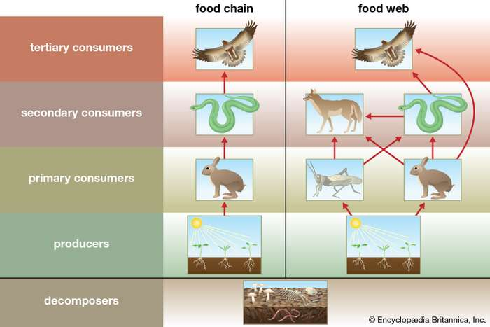

Slide 9
THANKS TO ALL

