Slide 1
GOOD MORNING STUDENTS
BIO – GEOGRAPHY
TOPIC: DISTRIBUTION OF PLANTS
DAY ORDER: III
DATE: 29.08.2020
TIME: 9:30 TO 10:30
S.NITHYA
LETURER IN GEOGRAPHY
GCWK(A)

Slide 2
Distribution of Plants: 6 Kingdoms
There is a wide range of variations in the distri­bution of vegetation on the globe. There is a zonal pattern of vegetation from equator towards the poles and from seal level to vegetation level on the high mountains
The distribution of plants is affected and controlled by a variety of factors e.g.
(i) Climatic factors (sunlight, temperature, moisture and humidity, pre­cipitation, soil-moisture etc.);
(ii) Edaphic factors (soil nutrients, soil texture, soil structure, acidity and alka­linity, nature and properties of soil profiles etc.)
(iii) Biotic factors (effects of living organisms mainly animals and man of a particular habitat on plants, interactions between different plant species and between plants and animals like natural selection, com­petition, mutualism, paraticism etc.)

Slide 3
(iv) Physical factors (reliefs and topography, slope angle, gradient and slope aspect, etc.);
(v) Tectonic factors (continental displacement and drift, plate movements, endogenetic forces and movements, vulcanicity and seismic events etc.);
(vi) Fire factor (forest fire-natural forest fire through lightning, man-induced forest fire-both inten­tional and accidental;
(vii) Dispersion of plants, and
(viii) Human interferences.

Slide 4
Distribution of plants may be attempted in a variety of ways viz
(i) On the basis of habitats as the distribution of terrestrial and aquatic plants,
(ii) On the basis of floral divisions,
(iii) On the basis of latitudinal and altitudinal extents, and
(iv) On the basis of characteristic features of plant communities etc.
The land plant species of the world are grouped into 6 major floristic kingdoms on the basis of their worldwide distribution

Slide 5
(1) Australian Kingdom:
This floristic kingdom includes the plants of whole Australia which is characterized by typical plant species e.g., eucalyptus. The different species of this unique genera of eucalyptus are so dominant in Aus­tralia that they represent 75 percent of all Australian plants. There are over 600 species of eucalyptus which greatly vary as regards their general characteristics as they range from tall, giant and shady eucalyptus trees to dwarf and stunted desert eucalyptus trees. Eucalyp­tus is said to be related to mimosa which is still found in South America (only a few species).

Slide 6
Eucalyptus has been dispersed and distributed by man (deliberately) from Australia to almost every continent. One can see extensive plantation of eucalyptus in India particularly along the rail and road sides and it is being expanded rapidly by deliberate actions of man in all parts of the country irrespective of environmental requirements and suitability of this unique exotic plant. The typical endemic floras of Australia having unique characteristics have developed due to its isolation from other continents of the southern hemisphere because of continental drift.

Slide 7
(2) Cape Kingdom:
The floral kingdom has developed in the south­ern tip of Africa wherein the plants having bulbs and tubers have developed and these represent the typical plant species of this floral kingdom. The plants of this kingdom belong to the category of cryptophytes which bear buds in the form of bulbs and tubers which are buried in the soils. These bulbs and tubers give birth to other plants as new shoots come out from these bulbs and tubers and are developed as plants.

Slide 8
These plants represent most plants of the gradient such as garden flowering plants (e.g., Loplia, Kniphogia, Erica Freesia etc.). The dispersal of these garden plants became possible when South Africa was colonized by Europe­ans who distributed these garden flowering plants from South Africa to the gardens of other parts of the world.
There is gradual decrease in the number and area of these garden flowering plants in their own native areas (southern part of South Africa) because their areas are continuously being replaced by agricultural lands. The untouched areas still have sclerophyllous shrubs which attain the height of a few meters. There is undergrowth of herbaceous shrubs in the sclerophyllous shrubs.

Slide 9
It may be remembered that the native vegetation of this region before the European colonization consisted of temperate evergreen forests which were extensively cleared off by the Europeans for agricultural proposes and thus the sclerophyllous shrubs developed in this region at later date as secondary succession of vegeta­tion.

Slide 10
(3) Antarctic Kingdom:
This kingdom includes a narrow strip in the north of Antarctica which runs from Patagonia and southern Chile of South America to New Zealand. The most important representative plant of this zone is Nothofagus which is also known as Southern Beech. About 100 million years ago temperate grasses devel­oped as the native vegetation of this region (New Zealand).
The most outstanding and typical species of the grasses were Tussock Grasses though a few spe­cies of Sedges (plants which grow in water) and dicoty­ledon shrubs were also developed but these original native vegetation have undergone massive modifica­tion and transformation since the colonization of New Zealand by the Europeans.

Slide 11
Thus, the present-day veg­etation of New Zealand is of modified type which is still characterized by two types of tussock grasses viz.:
(i) Short Tussock Grasslands have two main species e.g., festuca and poa. The average height of these grass is upto 0.5 m and the colour is yellow-grey,
(ii) Tall Tussock Grasslands have the main species of Chiomechloa.
Warm temperate areas of New Zealand are characterized by the dominance of the forest of gym-nosperms and angiosperms trees. The main species of the coniferous family of gymnosperms are Podcarpaceae, Cupressaceae and Araucariaceae whereas flowering plants are included in Angiosperms of which Nothofagus is the most important plant.

Slide 12
The sub-tropical forests of New Zealand are of evergreen type which is characterized by dense cover of tall trees having different vertical strata of other plants. The original vegetation of New Zealand has been greatly modified and destroyed by human activi­ties and the mammals (mainly grazing red deers and rabbits) brought by them from Europe. This has led to the destabilization of vegetation community at large scale.

Slide 13
(4) Palaeotropical Kingdom:
This kingdom includes most of Africa, South West Asia, South Asia, South East Asia and southern and middle portions of China.
This floral kingdom is further divided into 3 sub-kingdoms e.g.:
(i) African sub-kingdom,
(ii) Indo-Malaysian sub-kingdom, and
(iii) Polynesian sub-kingdom. This floral kingdom is also divided into several floral provinces or region West African rainforest region, Mada­gascar region, Iran-Turanian region, East Asian region, etc. There is great variation in plant species from one region to another region but few plants are common to all sub- kingdoms and regions.

Slide 14
5) Neotropical Kingdom:
This region includes the whole of South America except southern Chile and Patagonia. A few genera are common to this kingdom and palaeotropical kingdom mainly Africa because the original flowering plants were developed in South America and Africa during Cretaceous period when all members of Gondwanaland were united together.
Later on the spreading of Atlantic sea-floor, disruption of Gondwanaland and west­ward drift of South America from Africa became responsible for the origin and development of new species at regional level and therefore variations in the plant species of South America and Africa were intro­duced.

Slide 15
(6) Boreal Kingdom:
This floral kingdom includes the whole of North America except Middle America, Greenland, entire Europe, northern Asia and Arctic region. This is the most extensive kingdom of all the floral kingdoms. This is again divided into several sub-kingdoms and regions or provinces e.g. Rocky Mountainous Region (RMR); Atlantic – North American Region Arctic and Sub-Arctic Region (ASAR); Europe-Siberian Region (ESR); Mediterranean Re­gion (MR) etc.
Genera and family of plants and major vegetation of the aforesaid floral kingdoms and floral provinces or regions.

Slide 16
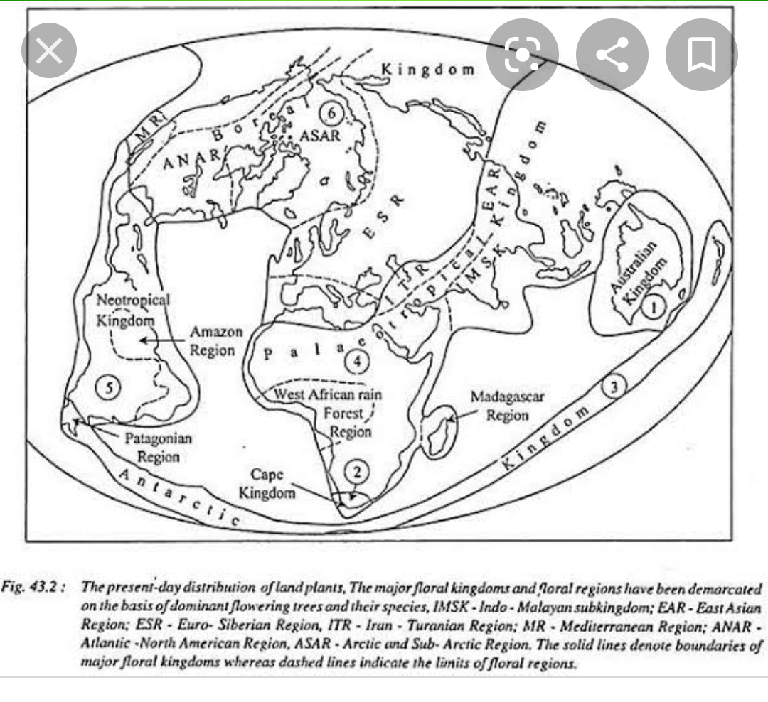

Slide 17
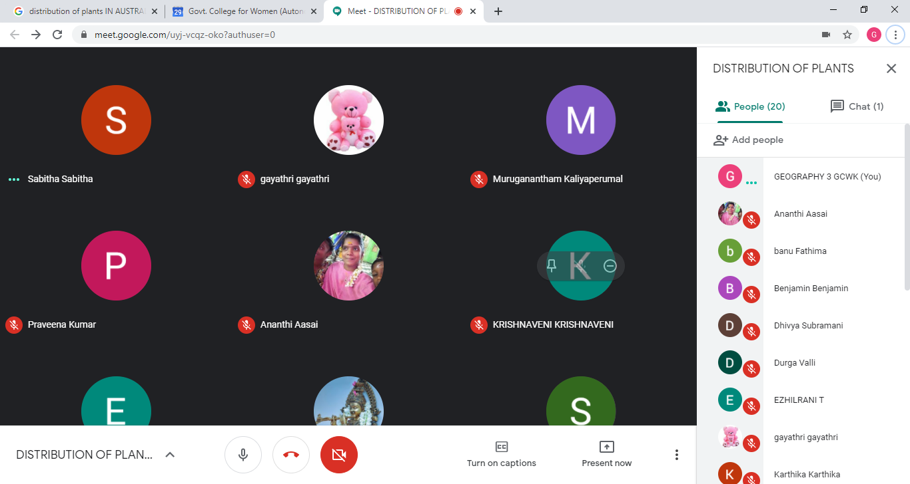

Slide 18


Slide 19


Slide 20


