Slide 1
GOOD MORNING STUDENTSS
BIO – GEOGRAPHY
TOPIC: EVOLUTIONARY HISTORY OF THE WORLD PLANT COMMUNITY
DAY ORDER:IV /I
DATE :24.08.2020/26.8.2020
TIME:9:30 TO 10:30 & 10:30 T0 11:30
S.NITHYA
LECTURER IN GEOGRAPHY
GCWK(A)

Slide 2
Plant evolution is an aspect of the study of biological evolution, predominantly involving evolution of plants suited to live on land, greening of various land masses by the filling of their niches with land plants, and diversification of groups of land plants.

Slide 3
Earliest plants
In the strictest sense, the name plant refers to those land plants that form the clade Embryophyta, comprising the bryophytes and vascular plants. However, the clade Viridiplantae or green plants includes some other groups of photosynthetic eukaryotes, including green algae. It is widely believed that land plants evolved from a group of charophytes, most likely simple single-celled terrestrial algae similar to extant Klebsormidiophyceae^{[1]}

Slide 4
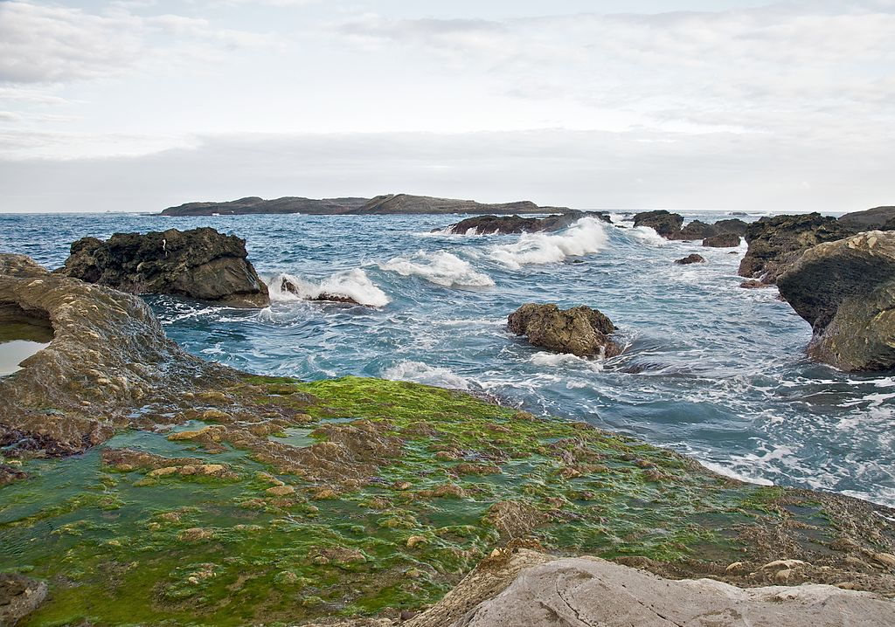
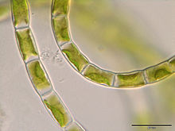
Viridiplantae

Slide 5
Paleozoic flora
Cambrian flora
Early plants were small, unicellular or filamentous, with simple branching. The identification of plant fossils in Cambrian strata is an uncertain area in the evolutionary history of plants because of the small and soft-bodied nature of these plants. It is also difficult in a fossil of this age to distinguish among various similar appearing groups with simple branching patterns, and not all of these groups are plants. One exception to the uncertainty of fossils from this age is the group of calcareous green algae, Dasycladales found in the fossil record since the middle Cambrian. These algae do not belong to the lineage that is ancestral to the land plants. Other major groups of green algae had been established by this time, but there were no land plants with vascular tissues until the mid-Silurian.

Slide 6
ORDOVICIAN FLORA:
The evidence of plant evolution changes dramatically in the Ordovician with the first extensive appearance of spores in the fossil record (Cambrian spores have been found, also). The first terrestrial plants were probably in the form of tiny plants resembling liverworts when, around the Middle Ordovician, evidence for the beginning of the terrestrialization of the land is found in the form of tetrads of spores with resistant polymers in their outer walls. These early plants did not have conducting tissues, severely limiting their size.

Slide 7
They were, in effect, tied to wet terrestrial environments by their inability to conduct water, like extant liverworts, hornworts, and mosses, although they reproduced with spores, important dispersal units that have hard protective outer coatings, allowing for their preservation in the fossil record, in addition to protecting the future offspring against the desiccating environment of life on land. With spores, plants on land could have sent out large numbers of spores that could grow into an adult plant when sufficient environmental moisture was present.

Slide 8
SILIRIAN FLORA:
The first fossil records of vascular plants, that is, land plants with vascular tissues, appeared in the Silurian period. The earliest known representatives of this group (mostly from the northern hemisphere) are placed in the genus Cooksonia. They had very simple branching patterns, with the branches terminated by flattened sporangia. By the end of the Silurian much more complex vascular plants, the zosterophylls, had diversified^{[3]} and primitive lycopods, such as Baragwanathia (originally discovered in Silurian deposits in Victoria, Australia),^{[4]} had become widespread.

Slide 9
Devonian Flora:
the Devonian Period, the colonization of the land by plants was well underway. The bacterial and algal mats were joined early in the period by primitive plants that created the first recognizable soils and harbored some arthropods like mites, scorpions and myriapods. Early Devonian plants did not have roots or leaves like the plants most common today, and many had no vascular tissue at all. They probably relied on arbuscular mycorrhizal symbioses with fungi to provide them with water and mineral nutrients such as phosphorus.^{[5]} They probably spread by a combination of vegetative reproduction forming clonal colonies, and sexual reproduction via spores and did not grow much more than a few centimeters tall.

Slide 10
The 'greening' of the continents acted as a carbon dioxide sink, and atmospheric concentrations of this greenhouse gas may have dropped.^{[6]} This may have cooled the climate and led to a massive extinction event. see Late Devonian extinction.
Also in the Devonian, both vertebrates and arthropods were solidly established on the land.

Slide 11
Carboniferous Flora:
Carboniferous plants were the Equisetales (Horse-tails), Sphenophyllales (scrambling plants), Lycopodiales (Club mosses), Lepidodendrales (arborescent clubmosses or scale trees), Filicales (Ferns), Medullosales (previously included in the "seed ferns", an artificial assemblage of a number of early gymnosperm groups) and the Cordaitales. These continued to dominate throughout the period, but during late Carboniferous, several other groups, Cycadophyta (cycads), the Callistophytales (another group of "seed ferns"), and the Voltziales (related to and sometimes included under the conifers), appeared

Slide 12
Permian Flora:
The Permian began with the Carboniferous flora still flourishing. About the middle of the Permian there was a major transition in vegetation. The swamp-loving lycopod trees of the Carboniferous, such as Lepidodendron and Sigillaria, were replaced by the more advanced conifers, which were better adapted to the changing climatic conditions. Lycopods and swamp forests still dominated the South China continent because it was an isolated continent and it sat near or at the equator. The Permian saw the radiation of many important conifer groups, including the ancestors of many present-day families. The ginkgos and cycads also appeared during this period. Rich forests were present in many areas, with a diverse mix of plant groups. The gigantopterids thrived during this time; some of these may have been part of the ancestral flowering plant lineage, though flowers evolved only considerably later.

Slide 13
Jurassic flora
The arid, continental conditions characteristic of the Triassic steadily eased during the Jurassic period, especially at higher latitudes; the warm, humid climate allowed lush jungles to cover much of the landscape. Conifers dominated the flora, as during the Triassic; they were the most diverse group and constituted the majority of large trees. Extant conifer families that flourished during the Jurassic included the Araucariaceae, Cephalotaxaceae, Pinaceae, Podocarpaceae, Taxaceae and Taxodiaceae.^{[8]} The extinct Mesozoic conifer family Cheirolepidiaceae dominated low latitude vegetation, as did the shrubby Bennettitales.^{[9]} Cycads were also common, as were ginkgos and tree ferns in the forest. Smaller ferns were probably the dominant undergrowth. Caytoniaceous seed ferns were another group of important plants during this time and are thought to have been shrub to small-tree sized. Ginkgo-like plants were particularly common in the mid- to high northern latitudes. In the Southern Hemisphere, podocarps were especially successful, while Ginkgos and Czekanowskiales were rare.

Slide 14
Cretaceous flora
Flowering plants, also known as angiosperms, spread during this period, although they did not become predominant until near the end of the period (Campanian age)^{[12]}. Their evolution was aided by the appearance of bees; in fact angiosperms and insects are a good example of coevolution. The first representatives of many modern trees, including figs, planes and magnolias, appeared in the Cretaceous. At the same time, some earlier Mesozoic gymnosperms, like Conifers continued to thrive, although other taxa like Bennettitales died out before the end of the period.

Slide 15
Cenozoic flora
The Cenozoic began at the Cretaceous–Paleogene_extinction_event with a massive disruption of plant communities. It then became just as much the age of savannas, or the age of co-dependent flowering plants and insects. At 35 Ma, grasses evolved from among the angiosperms. About ten thousand years ago, humans in the Fertile Crescent of the Middle East develop agriculture. Plant domestication begins with cultivation of Neolithic founder crops. This process of food production, coupled later with the domestication of animals caused a massive increase in human population that has continued to the present.

Slide 16
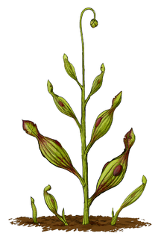
CARNIVORES PLANT

Slide 17
THANKS TO ALL

