Slide 1
GOOD MORNING STUDENTS
REGIONAL PLANNING
TOPIC :REGIONAL PLANNING IN TAMILNADU
DAY ORDER:II
DATE:28.08.2020
TIME:11:30 TO 12:30
S.NITHYA
LECTURER IN GEOGRAPHY
GCWK(A)

Slide 2
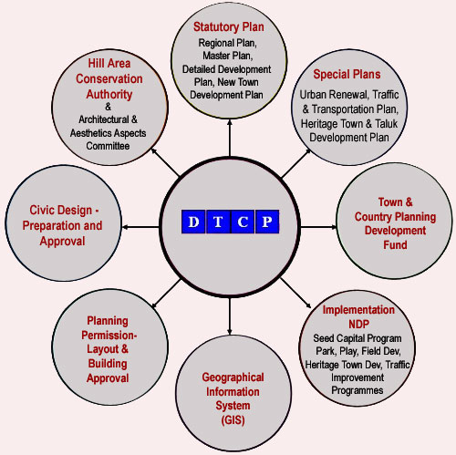

Slide 3
State of Tamil Nadu
Department of Town & Country Planning (DTCP)
Government of Tamil Nadu (GoTN) enacted Town & Country Planning Act (T&CP Act), 1971. It functions under the control of Housing & Urban Development Department (H&UD) of the Secretariat. The department has its jurisdiction over the entire Tamil Nadu except Chennai Metropolitan Development Area (CMDA).

Slide 4
Aims/goals of the Directorate:
To provide effective land development plan with adequate infrastructural facilities for conducive living environment required for the society. This is achieved by integrating the physical, economic as well as social planning for the diverse conditions viz., physiographic, pattern of urbanization, traditional practices, socio-economic equalities etc., prevalent in different parts of the towns and villages.
To achieve socio-economic development of the state through systematic development and regulation of growth of urban and rural areas of the State through Master Plans/New Town Development Plans and Detailed Development Plans.

Slide 5
To arrest the rural migration to cities and towns by rural-urban integration through Regional Plans.
To preserve the historical, heritage and tourism important places in the state.
To protect environmentally and ecologically sensitive areas of the state.

Slide 6
The major functions of the State Planning Commission are as follows:
Preparing Five Year and Annual Plans based on the policies and priorities of the Government.
Undertaking Mid Term review of the Five Year Plan and advising the Government on appropriate modification and restructuring of the schemes.
Evaluating major plan schemes through Department of Evaluation and Applied Research.
Monitoring development indicators that influence the Human Development Index, Gender Development Index, etc., at a disaggregated level.

Slide 7
Undertaking special studies as required for formulation and implementation of plan projects and programmes.
Monitoring the Tamil Nadu economy and sending reports to Government as and when necessary.
Implementing and monitoring State Balanced Growth Fund (SBGF) to address the regional disparities.
Coordinating the functions of District Planning Cells and initiating planning process at District/Block/Village level.

Slide 8
The Commission has the following technical divisions
Agricultural Policy and Planning
Industries, Power and Transport
Land Use
Education and Employment
Health and Social Welfare
District Planning and Rural Development
Plan Co-ordination

Slide 9
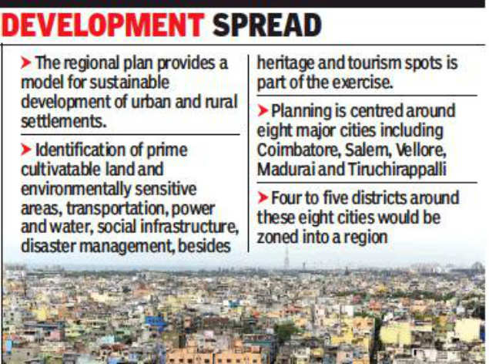

Slide 10
Why do we need regional planning?
Integrating a much wider areas for overall growth of “region” is the purpose served by regional planning; Planning for integration of rural area and the overall balanced development of the region. ... Regional planning also helps in reducing the conflicts and competition for resources between cities in a region

Slide 11
When did regional planning start in India?
The impetus that led to the origin of regional planning in India was the rapid urbanization and industrialization that India faced after independence in 1947. Along with this urbanization, regional disparities increased within rural and urban areas mainly in terms of concentration of economic opportunities

Slide 12
Who first divided India into planning region?
C.S. Chandrasekhar (1972) proposed a scheme of planning regions . He divided India into 13 micro and 35meso planning regions. He used the criteria of physical, economic and ecological factors to demarcate the macro planning regions .

Slide 13
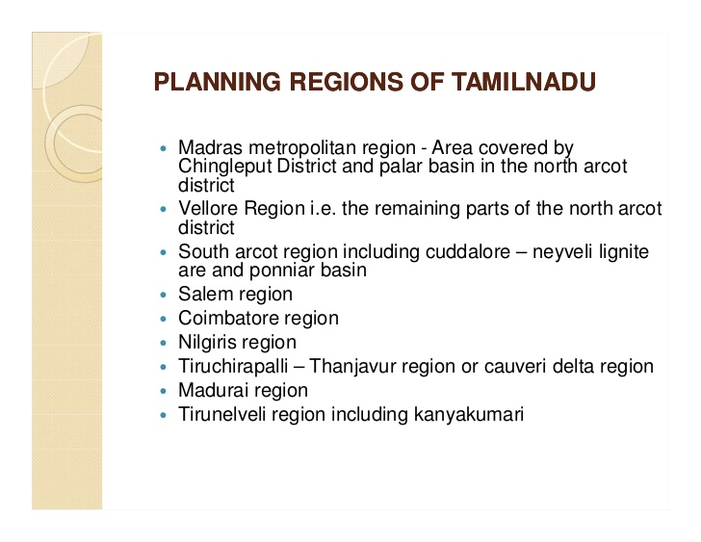

Slide 14
THANKS TO ALL

Slide 15
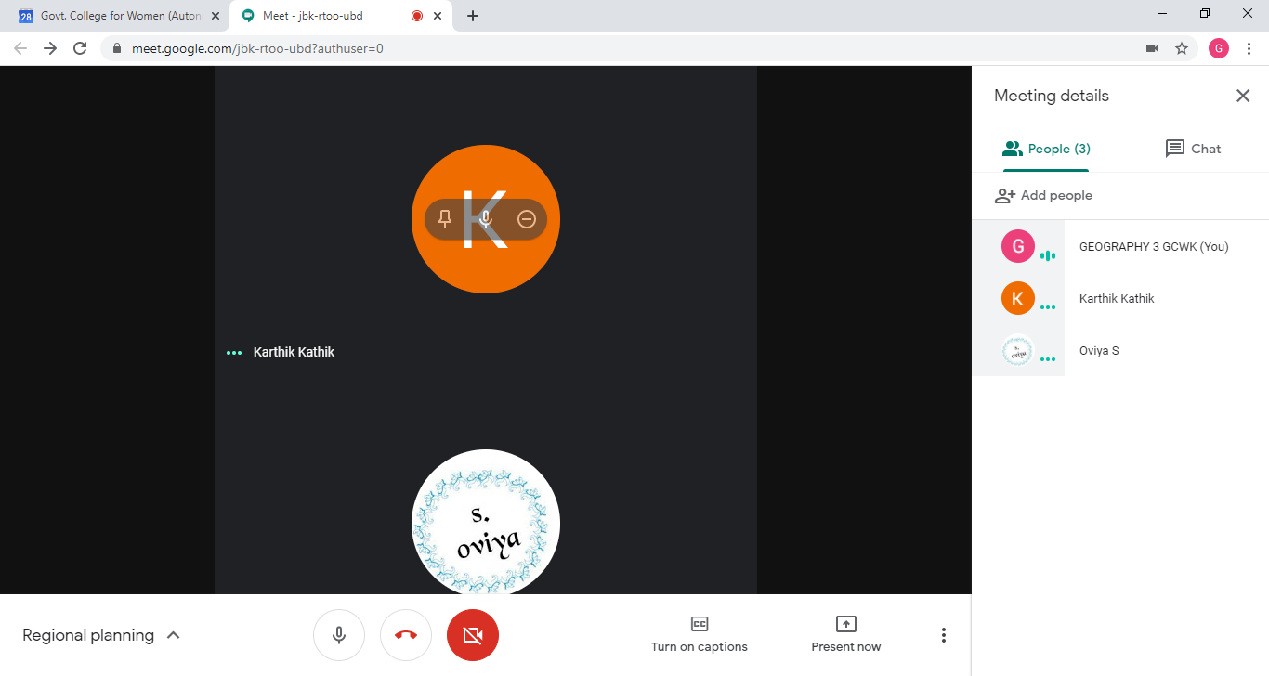

Slide 16
