Slide 1
PAPER: HUMAN GEOGRAPHY
CLASS: III.B.SC GEOGRAPHY
DATE : 06/08/2020
TIME: 1.30AM TO 2:30AM
Content : HUMAN RACE AND ITS CHARACTERISTICS
Prepared by , A.SUMATRA Guest Lecturer Department of Geography Govt College for Women(A) Kumbakonam

Slide 2
popmap

Slide 3
The Major Divisions of the Human Race
Most anthropologists recognize 3 or 4 basic races of man in existence today. These races can be further subdivided into as many as 30 subgroups.
Ethnographic division into races from Meyers Konversationslexikon of 1885-90 is listing:

Slide 4
Caucasian races (Aryans, Hamites, Semites) Mongolian races (northern Mongolian, Chinese and Indo-Chinese, Japanese and Korean, Tibetan, Malayan, Polynesian, Maori, Micronesian, Eskimo, American Indian), Negroid races (African, Hottentots, Melanesians/Papua, “Negrito”, Australian Aborigine, Dravidians, Sinhalese) Astraloid and American Indian

Slide 5
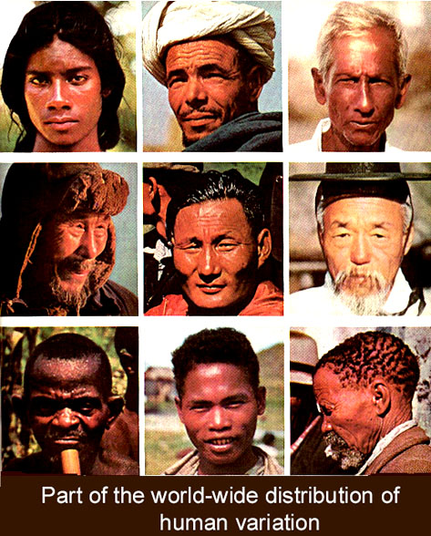
Human variation I

Slide 6
Caucasion:
Skull: Dolicephalic(Long-Head),High forehead,Little supraobital development.
Face: Mainly Leptoproscopic( Narrow)Sometimes Meso- or even Euryproscopic, Neither Facial nor alveolar prognathism occurs except among some archaic peoples.
Nose:Long,narrow,high in both root and bridge.

Slide 7
Mongoloid:
Skull: High incidence of Brachycephaly(Short Round Head)
American Indians while Mongoloid are often Dolicephalic.
Foreheads slightly lower than that of the Caucasoid.
No Supraobital development.
Face: Wide and short, projecting cheek bones, Prognathism rare. Shovel shaped incisors common especialy in Asia.
Nose: Mesorine(Low and Broad in both root and bridge.

Slide 8
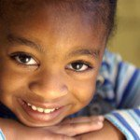
Negroid:
Skull: usually Dolicephalic, a small minority are Brachycephalic.
Forehead most often high, little supraobital development.
Face: Leproscopic (to a much lesser degree than the Caucasion), Prognathism common in most Negro populations.
Nose: Low & broad in root and bridge with characteristic depression at root.

Slide 9
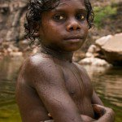
Another popular division recognizes 4 major races
The world population can be divided into
4 major races, namely white/Caucasian, Mongoloid/Asian, Negroid/Black, and Australoid. This is based on a racial classification made by Carleton S. Coon in 1962.

Slide 10
There is no universally accepted classification for “race”, however, and its use has been under fire over the last few decades.
The United Nations, in a 1950 statement, opted to “drop the term ‘race’ altogether and speak of “ethnic groups”. In this case, there are more than 5,000 ethnic groups in the world, according to a 1998 study published in the Scientific American

Slide 11
A race is a grouping of humans based on shared physical or social qualities into categories generally viewed as distinct by society. The term was first used to refer to speakers of a common language and then to denote national affiliations.
By the 17th century the term began to refer to physical (phenotypical) traits. The main human races are Caucasoid, Mongoloids

Slide 12
Mongoloids (including Chinese, Japanese, Koreans, and American Indians, etc.),
and Negroid. Khoisanoids or Capoids (Bushmen and Hottentots)
and Pacific races (Australian aborigines, Polynesians, Melanesians, and Indonesians) may also be distinguished. What was the first race in the world?

