Slide 1

Migration and types of migration

Slide 2
Migration is a way to move from one place to another in order to live and work. Movement of people from their home to another city, state or country for a job, shelter or some other reasons is called migration.

Slide 3

Population distribution
Pattern of where people live
Sparsely populated = few people
Densely populated = many people
Notes:
Population distribution means the pattern of where people live
Places that are sparsely populated contain few people
Places that are densely populated contain many people

Slide 4

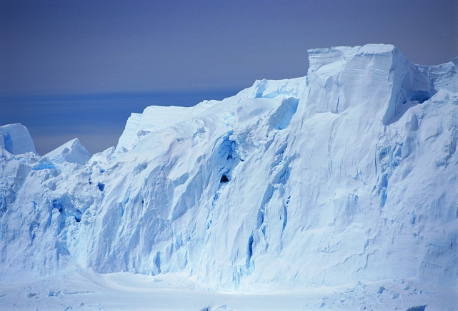
Population distribution
Sparsely populated - more hostile environments
Densely populated - more habitable environments
Notes:
Places that are sparsely populated tend to be more hostile environments
Places that are densely populated tend to be more habitable environments

Slide 5
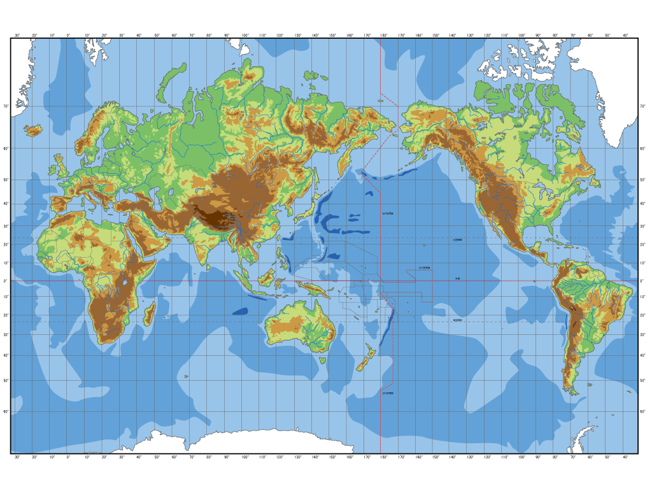

Slide 6
Physical Factors
1. Relief and landforms
Lowland plains, flat river valleys and deltas and volcanic areas with fertile soil tend to have high population densities. Mountainous areas with steep slopes and poor quality soil tend to have low population densities.

Slide 7
2. Weather and climate
Temperate areas which experience few extremes of weather and climate tend to be more attracted than areas which experience extremes. Areas which are very dry, very cold or very wet tend to have sparse populations whereas areas which have a moderate climate with evenly distributed rainfall or with monsoon type climates have denser populations.

Slide 8
Soil type and quality
Areas which have rich, fertile soils allowing successful agriculture tend to have higher population densities than areas which have poor quality soils have sparse populations. Good quality soils may be found in low lying areas such as river flood plains and deltas where silt is deposited; in volcanic areas; in areas which have a high natural humus content.

Slide 9
Poor quality soils may be found in areas with steep slopes; areas with very high rainfall throughout the year which tends to leach nutrients fro the soil; cold areas of permafrost; areas experiencing soil degradation through human management e.g. over-grazing/deforestation.

Slide 10
Vegetation
Some types of vegetation make the development of settlement more likely, e.g. grasslands. Areas with particularly dense rainforest, coniferous forests or those with little vegetation tend to have sparse populations.

Slide 11
Raw materials/natural resources
Areas with a wealth of natural resources such as oil, coal or minerals may have higher population densities than areas which do not. It is important to remember though that natural resources may be found in otherwise harsh environments and that they may be traded and exported/used in areas other than where they are extracted.

Slide 12
Natural threats
These may affect population density as people may try to avoid areas where pests, threatening animals and diseases are particular risks.

Slide 13
Human Factors
1) Agriculture
Areas with well developed farming of crops or animals are often densely populated.
2) Secondary industry
Those areas in which manufacturing has developed tend to be densely populated. It is worth noting that even in old industrial areas in which manufacturing has declined or even closed, population densities may remain high.

Slide 14
Accessibility
Areas with well developed transport infrastructure and links through road, rail, shipping, canals and air are likely to be more densely populated than areas which are poorly connected
4) Political decisions
Government policy can have a significant impact upon population densities. This can occur if governments decide to open up previously underdeveloped areas (e.g. Brasilia and the

Slide 15
(e.g. Brasilia and the development of the Trans-Amazonian Highway in Brazil; the movement of Han Chinese to Tibet; the development of Abuja as a new capital city in Nigeria). If governments decide not to invest in an area it may also lose large numbers of people leading to reduced population density.

Slide 16
5) Conflict
Wars and conflicts can lead to significant movements of population and a simultaneous decrease in density in some areas while others may increase.

Slide 17
Water supply
Water supply is essential for human survival and development and because of this areas which have sufficient water (but not too much) tend to have denser populations than areas which are dry or suffer from regular drought or areas which have excessive rainfall or which may be prone to flooding.

Slide 18
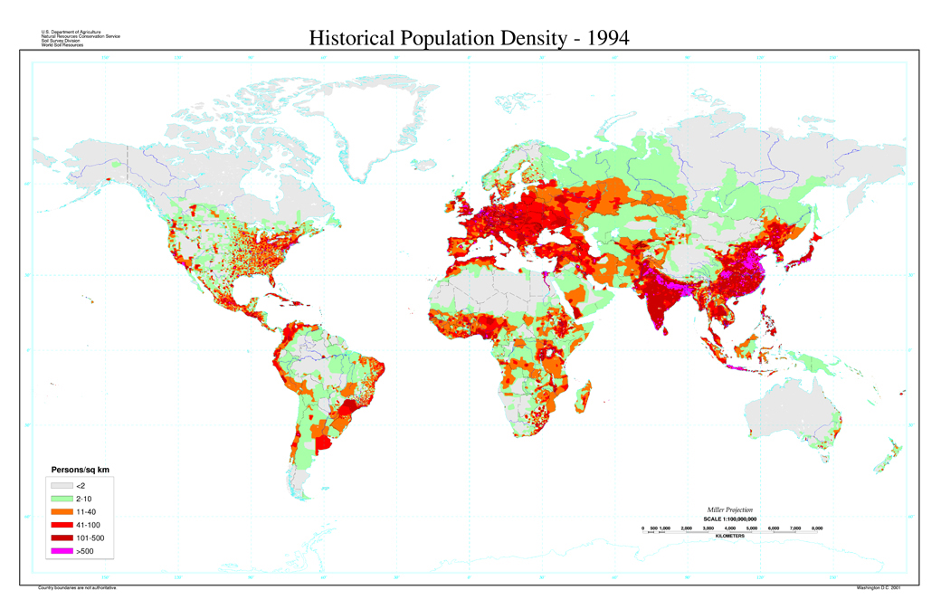
Global Population Distribution
Source: US Department of Agriculture - http://soils.usda.gov/use/worldsoils/mapindex/popden.html

Slide 19
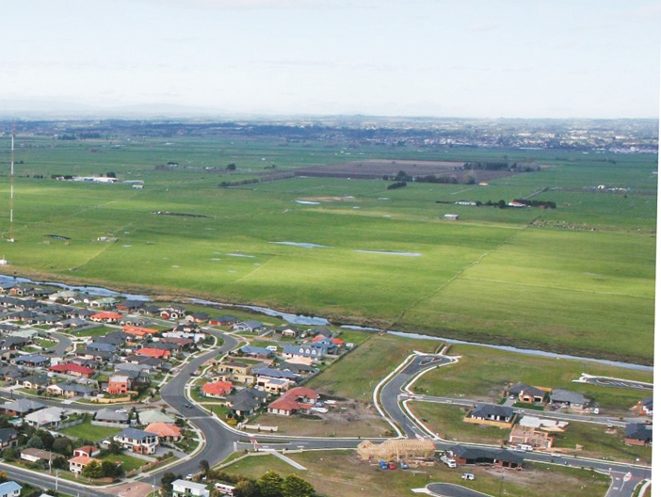
Population density
  measurement of number of people living in an area
  calculated by dividing the number of people by area
  shown as the number of people per square kilometre
Photo © Smart Growth
Notes:
Population density is
the measurement of the number of people that live in an area
usually calcuated by dividing the number of people by area
usually shown as the number of people per square kilometer

Slide 20
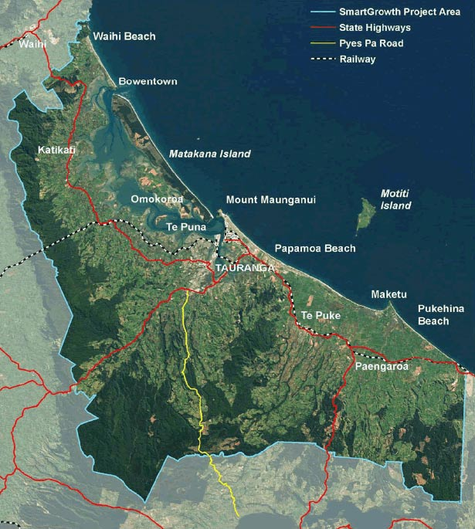
Western Bay of Plenty Sub-region
Includes:
Western Bay of Plenty District Council
Tauranga City Council
Coastal Marine Area
Total land area 2289km²
Population 2001 130,000
Activity / Mahi
Calculate sub-region’s population density
Notes:
The western Bay of Plenty sub-region encompasses the territorial areas of the Western Bay of Plenty District Council and Tauranga City Council and the Coastal Marine Area (this map shows the sub region)
The total land area of the sub-region is 2289km²
The population in 2001 was 130,000
Activity / Mahi
Calculate the population density for the sub-region

Slide 21
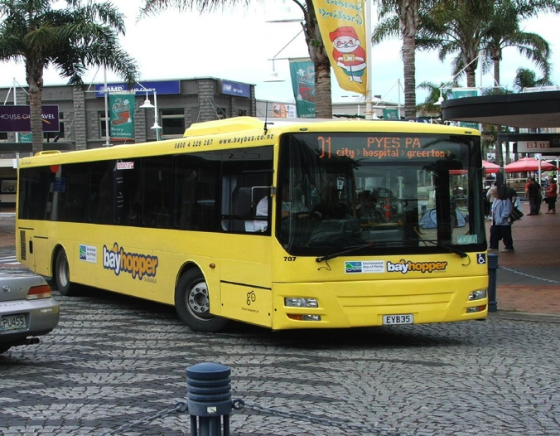
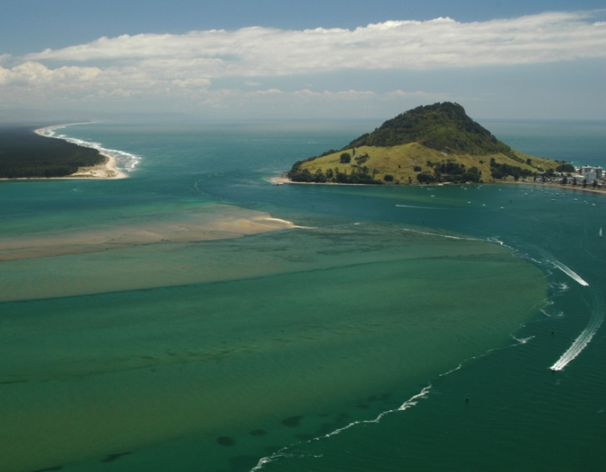
Factors affecting population density
Physical factors
Human factors
Photos © Tauranga City Council (top); Indigo Pacific (below)
Notes:
Factors that affect population density include physical factors and human factors
Some examples of physical and human factors are explored in the following slides

Slide 22
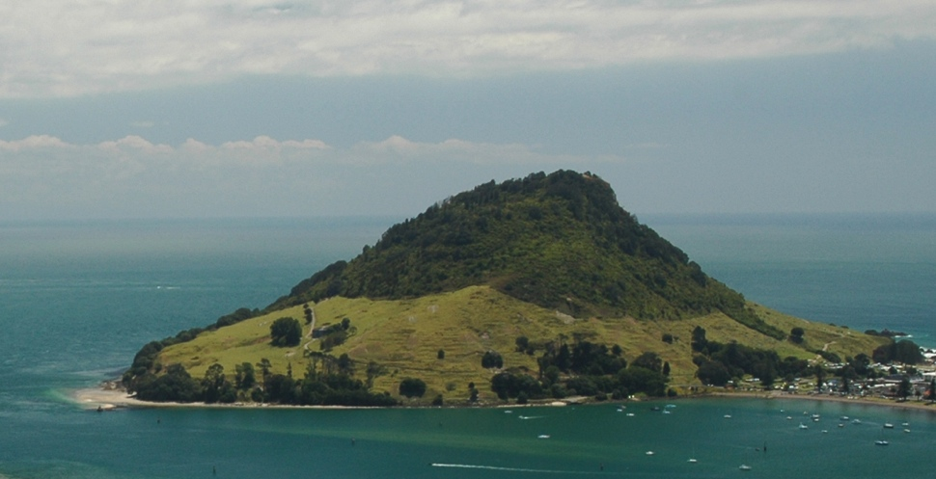
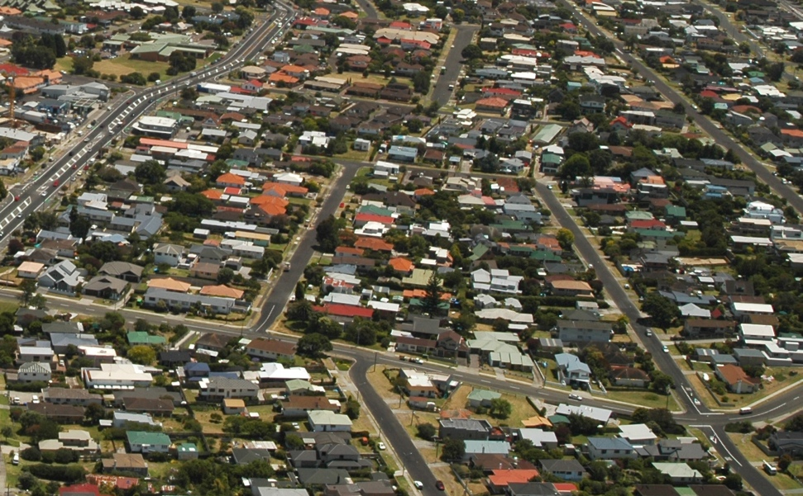
Physical factors: relief
Mountainous land - sparsely populated
Flat land - higher density populations
Question / Pātai
Examples of flat land, steep land in sub-region?
How dense / sparse is the population?
Photos © Indigo Pacific
Notes:
Relief, the shape and height of the land
Mountainous land is more likely to be sparsely populated
Flat land may have higher density populations
Question / Pātai
Think of examples of flat land and steep land in the western Bay of Plenty sub-region (and/or land near where you live). How dense or sparse is the population in these places?

Slide 23


Physical factors: resources
Water, fertile soil, fish, wood, coal, oil....
Tāmure or Snapper - Photo © Indigo Pacific
Notes:
Resources include things like water, fertile soil, fish, wood, coal, oil....
Areas that have few resources tend to be sparsely populated
Areas that are rich in resources tend to be more densely populated
Question / Pātai
What physical resources are there in the western Bay of Plenty sub-region (and/or the area where you live)? Is the density of population reflected in the distribution of resources?

Slide 24


Physical factors: climate
  Climate:
    Temperate climates - more densely populated than extreme climates
Notes:
Climate
Temperate climates are often more densely populated than areas with extreme climates

Slide 25
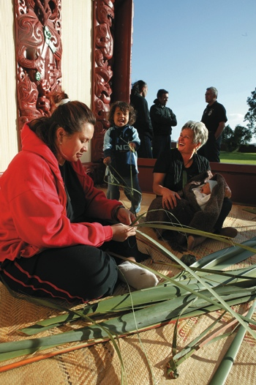

Human factors
Political factors – government stability
Social factors - desire of people to live close to one another / whānaungatanga
Economic factors - job opportunities
Question / Pātai
Photos © Smart Growth
Notes:
Political factors can include stability of governments
Social factors can include the desire of people to live close to one another / whānaungatanga
Economic factors can include job opportunities
Question / Pātai
What human factors make the western Bay of Plenty sub-region (and / or the place where you live) a good place to live for you and your family or whānau?

