Slide 1

Population distribution and density
Topic 1 - Population Growth

Slide 2

Population distribution
Pattern of where people live
Sparsely populated = few people
Densely populated = many people
Notes:
Population distribution means the pattern of where people live
Places that are sparsely populated contain few people
Places that are densely populated contain many people

Slide 3

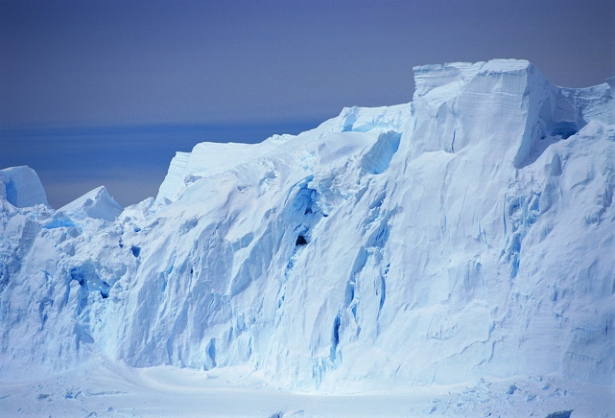
Population distribution
Sparsely populated - more hostile environments
Densely populated - more habitable environments
Notes:
Places that are sparsely populated tend to be more hostile environments
Places that are densely populated tend to be more habitable environments

Slide 4
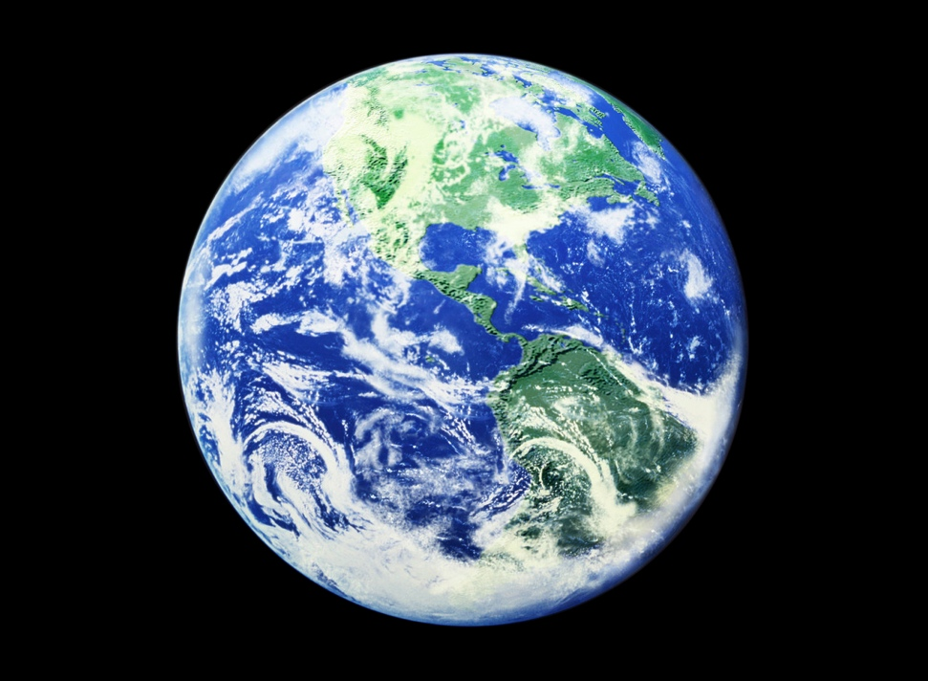
Population distribution
World population distribution uneven
Activity / Mahi
Identify three parts of the world:
sparsely populated
densely populated
Notes:
World population distribution is uneven
Activity / Mahi
Look at the world map on the next slide and identify three parts of the world that are sparsely populated and three parts that are densely populated

Slide 5
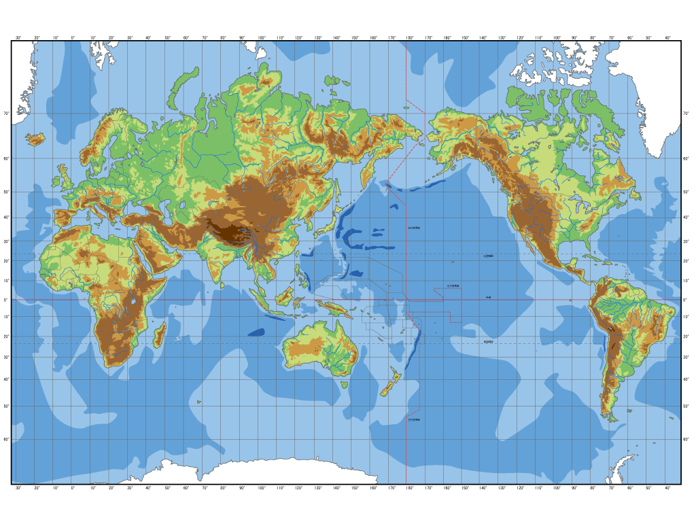

Slide 7
Question / Pātai:
Reasons for dense and sparse population?
Notes:
What reasons might there be for the dense and sparse population in the places you identified?

Slide 8
Question / Pātai:
Why do you think some of these places are sparsely or densely populated?
Notes:
Look at the differing population density for different parts of the world on the map on the next slide. Why do you think some of these places are sparsely or densely populated?

Slide 9
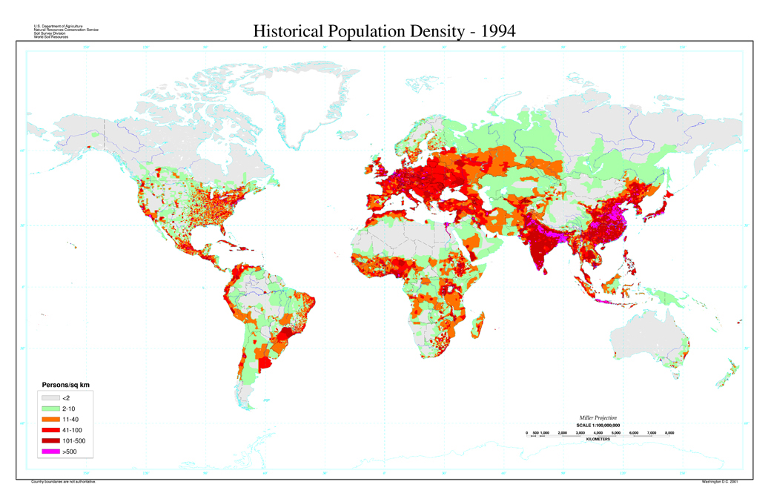
Global Population Distribution
Source: US Department of Agriculture - http://soils.usda.gov/use/worldsoils/mapindex/popden.html

Slide 10
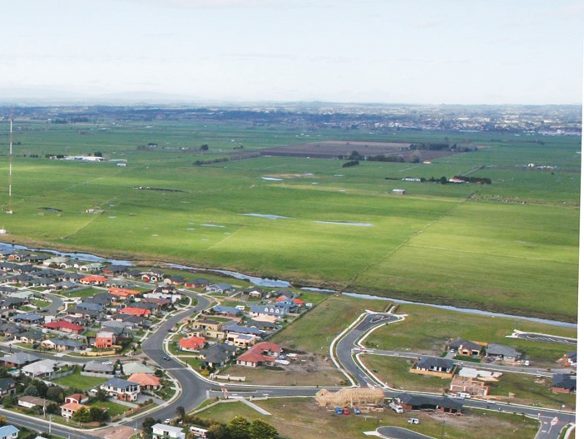
Population density
  measurement of number of people living in an area
  calculated by dividing the number of people by area
  shown as the number of people per square kilometre
Photo © Smart Growth
Notes:
Population density is
the measurement of the number of people that live in an area
usually calcuated by dividing the number of people by area
usually shown as the number of people per square kilometer

Slide 11
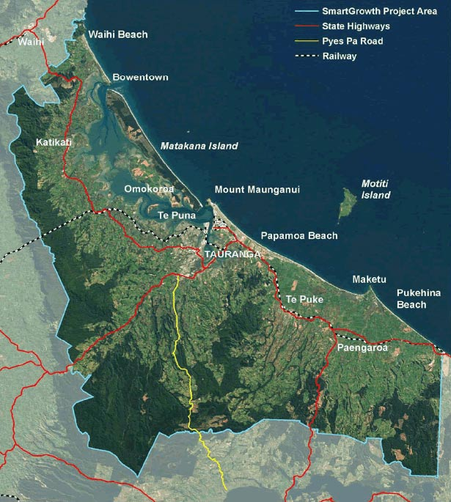
Western Bay of Plenty Sub-region
Includes:
Western Bay of Plenty District Council
Tauranga City Council
Coastal Marine Area
Total land area 2289km²
Population 2001 130,000
Activity / Mahi
Calculate sub-region’s population density
Notes:
The western Bay of Plenty sub-region encompasses the territorial areas of the Western Bay of Plenty District Council and Tauranga City Council and the Coastal Marine Area (this map shows the sub region)
The total land area of the sub-region is 2289km²
The population in 2001 was 130,000
Activity / Mahi
Calculate the population density for the sub-region

Slide 12
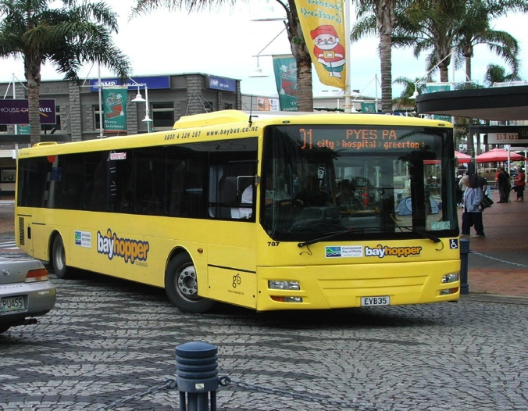
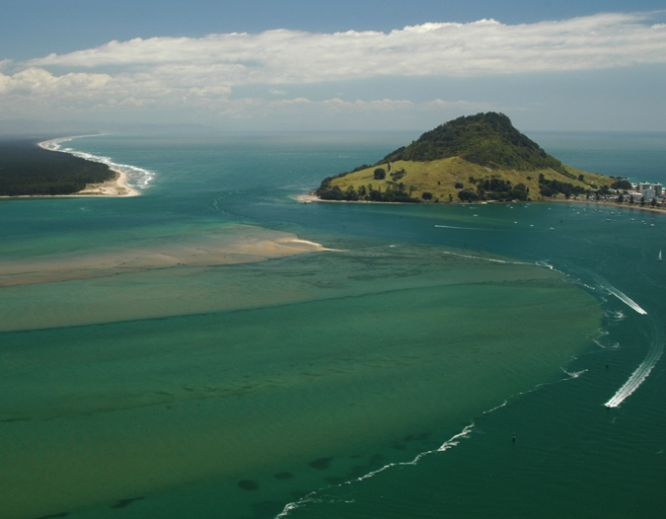
Factors affecting population density
Physical factors
Human factors
Photos © Tauranga City Council (top); Indigo Pacific (below)
Notes:
Factors that affect population density include physical factors and human factors
Some examples of physical and human factors are explored in the following slides

Slide 13
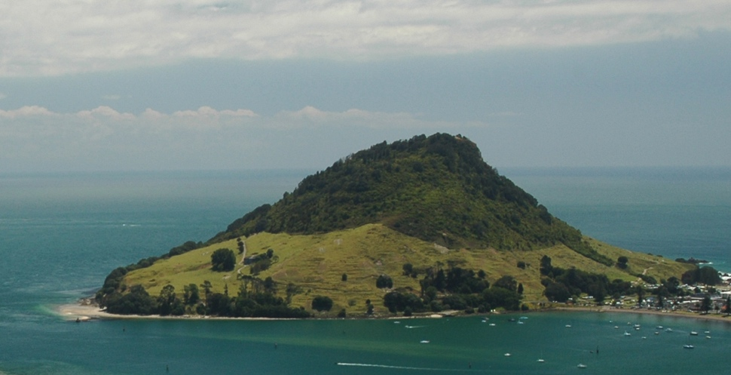
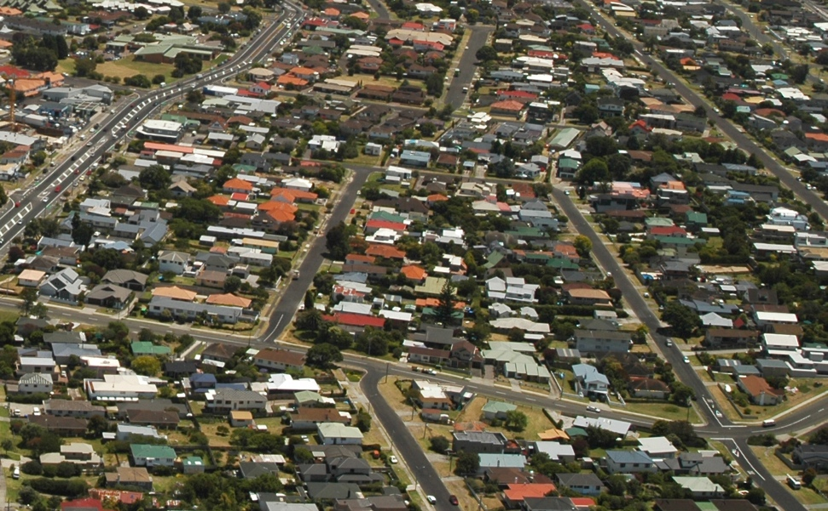
Physical factors: relief
Mountainous land - sparsely populated
Flat land - higher density populations
Question / Pātai
Examples of flat land, steep land in sub-region?
How dense / sparse is the population?
Photos © Indigo Pacific
Notes:
Relief, the shape and height of the land
Mountainous land is more likely to be sparsely populated
Flat land may have higher density populations
Question / Pātai
Think of examples of flat land and steep land in the western Bay of Plenty sub-region (and/or land near where you live). How dense or sparse is the population in these places?

Slide 14


Physical factors: resources
Water, fertile soil, fish, wood, coal, oil....
Question / Pātai
What physical resources are there? Is population density reflected in resource distribution?
Tāmure or Snapper - Photo © Indigo Pacific
Notes:
Resources include things like water, fertile soil, fish, wood, coal, oil....
Areas that have few resources tend to be sparsely populated
Areas that are rich in resources tend to be more densely populated
Question / Pātai
What physical resources are there in the western Bay of Plenty sub-region (and/or the area where you live)? Is the density of population reflected in the distribution of resources?

Slide 15


Physical factors: climate
  Climate:
    Temperate climates - more densely populated than extreme climates
Notes:
Climate
Temperate climates are often more densely populated than areas with extreme climates

Slide 16
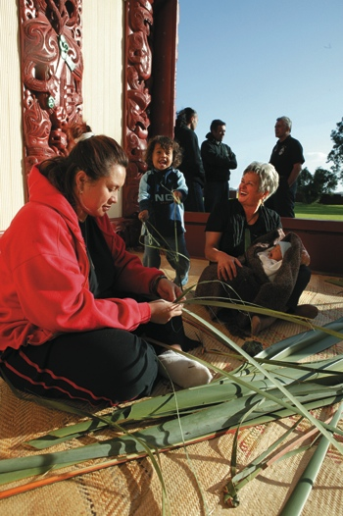
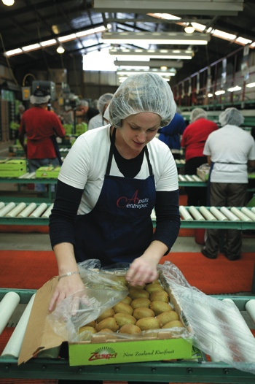
Human factors
Political factors – government stability
Social factors - desire of people to live close to one another / whānaungatanga
Economic factors - job opportunities
Question / Pātai
What human factors make the sub-region a good place to live?
Photos © Smart Growth
Notes:
Political factors can include stability of governments
Social factors can include the desire of people to live close to one another / whānaungatanga
Economic factors can include job opportunities
Question / Pātai
What human factors make the western Bay of Plenty sub-region (and / or the place where you live) a good place to live for you and your family or whānau?

Slide 17
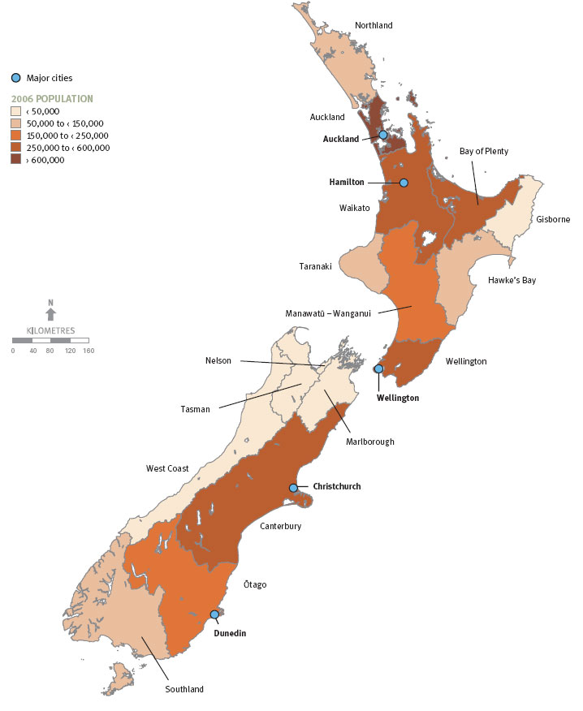
Population Distribution
Activity / Mahi
Complete:
Identify sparse / dense population
Physical characteristics that may contribute
Human characteristics that may contribute
Share answers
Source: Ministry for the Environment
http://www.mfe.govt.nz/publications/ser/enz07-dec07/html/chapter2-environment/page3.html
Notes:
In groups complete the following:
1. Identify an area in Aotearoa New Zealand that has a sparse population and an area that has a dense population
2. List the physical characteristics that may contribute to this areas population density
3. List the human characteristics that may contribute to this areas population density
4. Share your answers with the rest of the class

Slide 18
Your place
Visit Google Earth, look at your district or town
Activity / Mahi
In groups:
  1. Identify two areas with sparse / dense populations
  2. List physical characteristics that may contribute
  3. List human characteristics that may contribute
  4. Share your answers
Notes:
Visit Google Earth and look at an image of your district or town
Activity / Mahi
In groups complete the following:
1. Identify two areas in and around your neighbourhood that have sparse populations and two areas that have dense populations
2. List the physical characteristics that may contribute to these areas population density
3. List the human characteristics that may contribute to these areas population density
4. Share your answers with the rest of the class

Slide 19
Western BOP sub-region
Includes Tauranga City and Western Bay of Plenty District
Look at the slides and complete the activity slide
Notes:
The western BOP sub-region includes Tauranga City and Western Bay of Plenty District
The following slides show the population distribution across the sub-region according to district/city boundaries
Look at the slides and complete the activity on the final slide

Slide 20
Tauranga City population distribution
Source: SmartGrowth: Development Trends Report 2009, for 2008 to 2009 prepared by Tauranga City and Western Bay of Plenty District Councils

Slide 21
WBOP District population distribution
Source: SmartGrowth: Development Trends Report 2009, for 2008 to 2009 prepared by Tauranga City and Western Bay of Plenty District Councils

Slide 22
Activity/ Mahi:
Look at each table on the last two slides
What do they tell you about:
  Population distribution
  Growth
  Residential housing
Notes:
Look at each table on the last two slides
What do they tell you about the sub-region’s:
Population distribution
Growth
Residential housing

Slide 23
True / False Quiz
  Densely populated places contain many people.
  The world’s population distribution is even.
    (What would have to happen to make this statement true?)
  Areas rich in resources tend to be more densely populated.
  Human factors affecting population density: political, climate and economic.
  Total land area of Western Bay of Plenty sub-region is 2,289km².
Notes:
Places that are densely populated contain many people (true)
The worlds population distribution is even (false it is uneven)
What would have to happen to make this statement true? (encourage discussion here about factors that draw people to live in new locations, how do governing bodies such as councils make areas more attractive to live in?)
Areas that are rich in resources tend to be more densely populated (true)
The human factors that impact upon population density are political, climate and economic (false, climate is not a human factor, social is)
The total land area of the Western BoP sub-region is 2 289km² (true)

