Slide 1
Indian Metropolitan Cities Dr.K.Indhira Guest Lecturer, Department of Geography, Govt College for Women (Autonomous), Kumbakonam

Slide 2
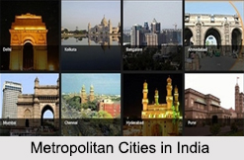
Metropolitan Cities
Metropolitan Cities in India are regarded as vital economical, cultural and political centres. Metropolitan cities in India have good connectivity with roadways, airways and railways. These cities in India are developed with the contemporary infrastructure in the field of education, culture and tourism.

Slide 3
Regulations for Metropolitan Cities in India The Constitution’s 74th Amendment Act, 1992 defines a metropolitan area in India as, ‘an area having a population of 10 lakhs or more, comprised in one or more districts and consisting of two or more Municipalities or Panchayats or other contiguous areas, specified by the Governor by public notification to be a Metropolitan area’. According to this definition, a city has to fulfil the requirements mentioned in the clause in order to become a metropolitan area and be a part of the Metropolitan Cities in India.

Slide 4
Division of Metropolitan Cities in India Cities with populations of 10 lakhs and above are referred to as the ‘Million Plus Cities’. On the other hand, cities with more than 40 lakhs in populations are referred to as the ‘Mega Cities’. Taking these into consideration, there are about 46 Metropolitan Cities in India. This number is based on the latest Census of 2011. Out of these 46 Metropolitan Cities in India, 8 of them are considered as ‘Mega Cities’. The remaining 38 are considered as ‘Million Plus Cities’.

Slide 5
India is a country, which is reaching new heights in terms of economic development. There has been a focus on the development of cities and many cities are now emerging as metropolitans, with the best facilities and amenities.
Here is a list of top 12 famous and best metropolitan cities in India 2018:

Slide 6
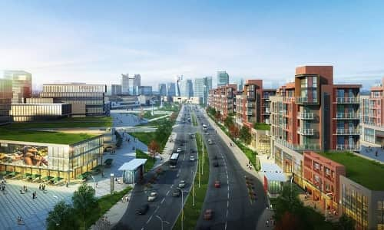
Indore
Indore is the largest city in the state of Madhya Pradesh, which is also known for commerce, research, finance, entertainment, technology, and fashion. It has the third oldest stock exchange in the country.

Slide 7
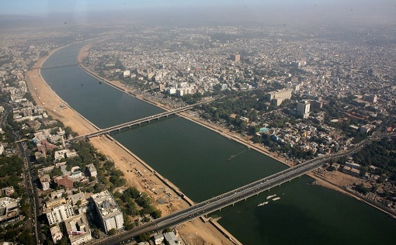
Ahmedabad
Ahmedabad is the former capital city of Gujarat and also the largest city in the state, which also has the seat of
Gujarat High Court. It is the 5th largest city in the country, which has a population nearing 6 million. It lies on the
banks of River Sabarmati and houses a flourishing textile industry, in addition to automobile,
gemstone and jewelry, pharmaceuticals, detergent and IT industries.

Slide 8
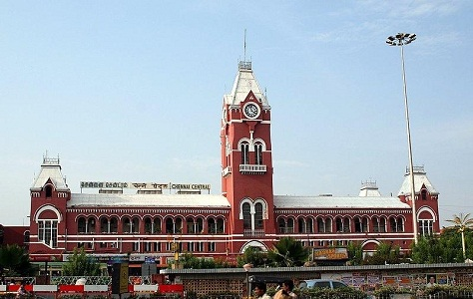
Chennai
Chennai is another leading metro city in the country, which is also known by the name of Gateway to South India.
It has a growing automobile industry, which has earned it the title of Detroit of India. Population wise,
Chennai is the 4th largest metro city in the country. It is a major tourist hub and center of art and culture,
besides housing numerous corporate houses. Talking about the area, the city is spread over an area of 426 sq km and the city has a population of over 8 Million. There many weekend getaways near city and two of the most popular getaways are Mahabalipuram and Puducherry. The city had been impacted by the floods many time but the city never gave up and continued towards the path of development like any invincible hero.

Slide 9
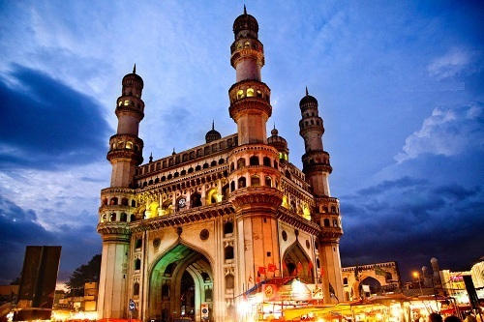
Hyderabad
Another South Indian city to feature on this list is Hyderabad, the capital city of the state of Telangana.
The area of the city is about 650 sq km and in addition to this, the city was earlier a part of Andhra Pradesh but it became a part of Telangana after the formation of new state.It is considered as the 4th most populous city in India, having crossed the 12 million mark this year. Besides being famous for its historical sites and Nawabi cuisine, the city is famous for its biotechnology and IT industries.There are many amazing architectures across the city like Charminar, Chowmalla Palace, and Birla Mandir. Hyderabad is also voted as one of the best city to live in and that is because of the amazing climate as well as the facilities that city offers. There are many beautiful lakes across the city and it is also the home of Telugu Film Industry.

Slide 10
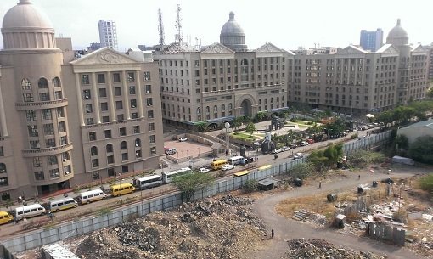
Pune
The city of Pune comes next on the list of top 12 metropolitan cities of India, which has made it to the list on account of being home of some of the best educational institutions, corporate houses and shopping malls in the city. The city has an area of 243 sq km and the population of the city has grown to 3.1 Million. In addition to this, the city has a budding IT industry which has a lot of population increase in the city. Apart from this, the city also has an air base which is responsible for the protection of western command. The city is still under development it is also one of the best city to live in.

Slide 11
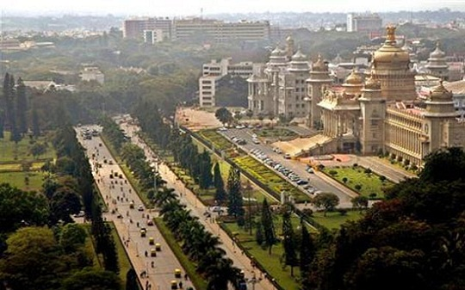
Bengaluru (Bangalore)
Also called the Silicon Valley of India, Bengaluru is the IT hub of the country,with a large number of IT industries in the city. It is the city of Indian Space Research Organization (ISRO) and is considered as one of the best cities to live in. it also has a large number of leading public sector companies and educational institutions. Bengaluru is also known as the silicon valley of India and it is also famous for many historical places. The city has an area of 709 sq km which houses a population of over 12 Million people.

Slide 12
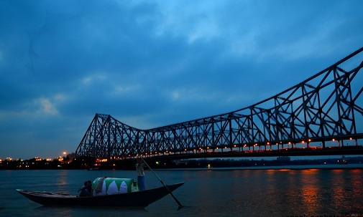
Kolkata
Next on the list of the most famous metros in the country is the Eastern city of Kolkata, the capital of West Bengal. It is the 7th most populous city in the country and a major commercial, cultural and educational hub in this part of the country. It is ranked 3rd on the list of highest GDP cities, after Mumbai and Delhi. Talking about the land area, the city has an area of 1886 sq km which provides shelter to over 14 Million people. Many of the designers brands in the country originated in this city and they are popular for their traditional bridal collection. Kolkata is also the home of Bengali film industry and fine arts.

Slide 13
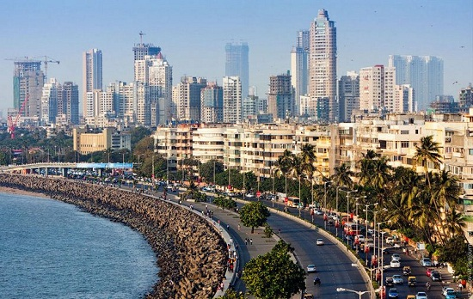
Mumbai
Next on the list of top 12 metropolitan cities of India is the city of Mumbai, which is the 5th most populous city in the world.The city is a natural harbor and has the highest GDP in the country. It is the commercial and entertainment capital of the country, which is the home to large industries, stock exchange and the Hindi film industry, Bollywood. Mumbai is also known as the financial hub of the country and the GDP of the city is higher than the GDP of many countries in the world. You might be surprised to know that 33% of income tax in India comes from Mumbai.

Slide 14
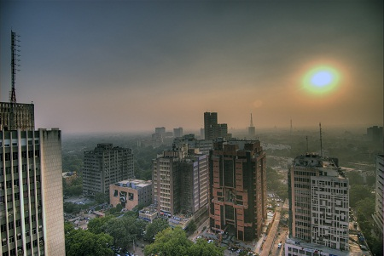
Delhi
Delhi is the capital of the country and also the second most densely populated city in India, with nearly 25 million residents. It is a Union Territory, which is administered by the Central Government along with the local government of Delhi. Besides having the major government offices, this city has a large number of historical sites and is also the epitome of economicdevelopment and progress of the country, housing numerous industries as well as corporate offices. The city is also known for many popular food joints and there is a popular saying ‘Dilli Dilwalon Ka Shehr’.
All these cities in India are becoming the best places to live in as they provide numerous opportunities for growth and advancement.

Slide 15
The 8 Mega Metropolitan Cities in India are: Mumbai, Maharashtra Mumbai is the home of Indian Film Industry, known as Bollywood, Bombay Stock Exchange and skyscrapers. This capital city in western Indian state is popular for its festivals, culture, cuisines and music. New Delhi, Indian Union Territory New Delhi; the modern capital of India, is noted for the bustling back streets, colonial sculptures, dusty and dazzling markets and glitzy malls.

Slide 16
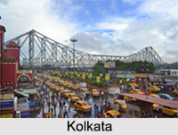
Kolkata, West Bengal Kolkata known as City of Joy is the cultural capital where one can find the mixture of conservative and liberal philosophy in the midst of greenery and rich history. Chennai, Tamil Nadu Chennai is recognized as "Automobile</b> Capital of India", which was developed from the Pallava era and has many Hindu temples, eco parks, national parks and popular sea beaches.

Slide 17
Bengaluru, Karnataka Bengaluru, referred as the Silicon Valley of India, is the third largest city and it is the abode of the Information Technology industries and Kannada film industry. Bengaluru is also gateway to the tourism destinations like Lalbagh Park, Cubbon Park, Puducherry, Nandi Hills and many others. Hyderabad, Telangana Hyderabad, a medieval capital of Nizams and Qutb Sahis, is now serving as a capital city of Telangana. This city is filled with Mughal architecture and traditional artwork of Bidri, paintings and markets.

Slide 18
Ahmedabad, Gujarat Ahmedabad is considered as the largest city located near the bank of Sabarmati River. This city is popular for Sabarmati Ashrama, textile and pharmaceuticals industries. Pune, Maharashtra Pune is proud for being the world's largest two-wheeler manufacturing city and it is an important centre of education, crafts, culture and art after Mumbai.

Slide 19
The 38 million metropolitan cities in India are Surat, Jaipur, Kanpur, Lucknow, Nagpur, Ghaziabad, Indore, Coimbatore, Kochi, Patna, Visakhapatnam, Kozhikode, Bhopal, Thrissur, Vadodara, Agra, Malappuram, Thiruvananthapuram, Kannur, Ludhiana, Nashik, Vijayawada, Madurai, Varanasi, Meerut, Faridabad, Rajkot, Jamshedpur, Jabalpur, Srinagar, Gwalior, Vasai-Virar, Allahabad, Dhanbad, Aurangabad and Kollam Altogether, these are 46 Metropolitan Cities of India. These cities are listed according to the populations..

