Slide 1
Cartography
I M.Sc Geography
Date : 03/12/2020
Time : 11.30 to 12.30
Topic : Map Settings – Earth and Coordinate System
Dr.K.Indhira M.sc.,Ph.d.,
Guest Lecturer
Department of geography
Government College for women (A)kumbakonam

Slide 2
Coordinate systems
A coordinate system is a grid used to identify locations on a page or screen that are equivalent to grid locations on the globe
The coordinates are (x, y) pairs that are based on some universal origin point for reference.
The most commonly used is latitude and longitude

Slide 3
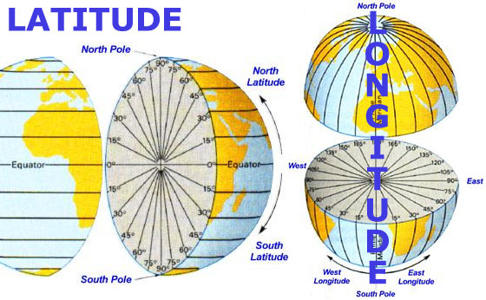
Latitude and longitude refer to degree, minutes and seconds of arc from reference lines that run East-West (latitude; equator) or North-South (longitude; prime meridian)

Slide 4
The reference datum is referred to in the coordinate system, typically by the year and the geographic region that it was developed for.
For example, the NAD1983 GCS is a reference datum developed to use with maps of North America (North American Datum) as that is where it fits the best, with the reference surface determined using available data from 1980. NAD1927 is from a reference datum developed in 1866.

Slide 5
Specialized Coordinate Systems
There are many specialized tweaks for the NAD1983 GCS, where more precise measurements have been used to develop a better representation
e.g., NAD 1983 (2011); NAD 1983 (CORS96)
DON’T USE THESE UNLESS TOLD TO DO SO
Doing so can create alignment issues with different data sets
GIS software allows you to transform data using one of several different formulas/methods
All of which introduce some errors that may or may not influence the accuracy of your map

Slide 6
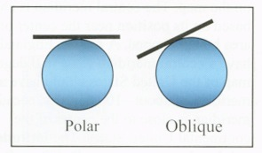
Projection types used in making maps

Slide 7
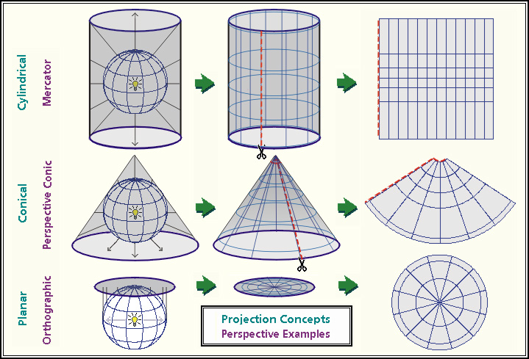
Map projections

Slide 8
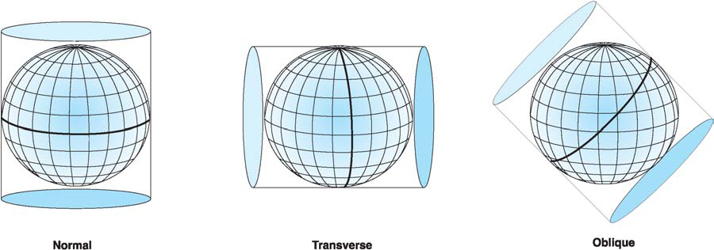
Cylindrical Projections
Different lines are tangential, but directions are true

Slide 9
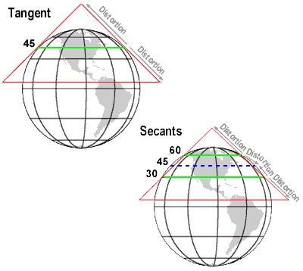
Conic projections- Tangential vs Secant
In tangential one line is true where others are distorted;
In secant 2 lines are true

Slide 10
Azimuthal (also called stereographic or orthographic) Projections

Slide 11
Regardless of what type of map you make (using whatever projection you choose) the representation of the Earth will be distorted in at least 1 (or more) aspects
Shape- maps that preserve shape are called conformal maps
Area- equal area maps preserve the actual amount of the surface area the region takes up on the globe relative to other areas of interest
Distance- equidistant maps preserve distance for all lines that pass through a specified point
Direction- azimuthal maps preserve direction for at least one point on the map, such that all lines that pass through that point show true direction.
No map can show all 4 things without distortion, and no map is able to preserve all of the characteristics equally, regardless of the type
In any projection there is no distortion on the line where the globe touches the cone, plane or cylinder (i.e., there’s always at least one true set of coordinate lines

Slide 12
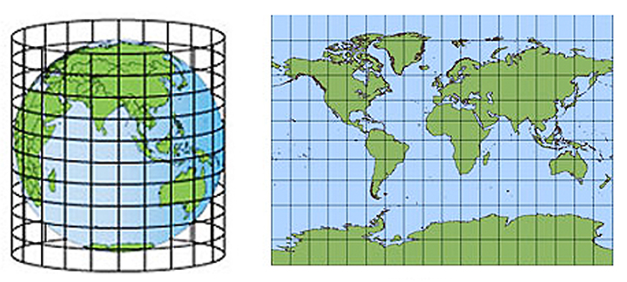
Cylindrical Projection and related distortion on map
The Universal Transverse Mercator (UTM) grid coordinate system was developed using this type of projection. It is widely used because direction is not distorted and can be used for navigation. Area and shape are distorted (Look how big Greenland appears compared to Australia).

Slide 13
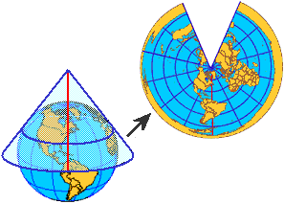
Conic (tangential) projection map

Slide 14
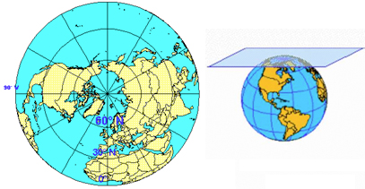
Azimuth (polar) projection map

Slide 15
Map parameters
Refers to properties that can be customized for showing particular features and locations
The most common is the central meridian (X-axis or x = 0) and/or the reference latitude Y-axis or y=0)
these two lines are the Y and X axis respectively.
They can be adjusted to make the map show whatever reference values you want to use, but they must be recorded for the next user to know what you’ve done.
For example- its possible to create a new coordinate system based off a standard set of lines for the purposes of having only positive values on the map.
Reference Longitude (central meridian (x=0)
Reference latitude (y=0)

Slide 16
Raster coordinate systems
Some raster data has a coordinate system predetermined; other do not have it established. If it has a coordinate system its GEOREFERENCED
that means each pixel has an X,Y coordinate that corresponds to a location on the earth’s surface
In cases where a coordinate system was developed but cannot be accessed by the software, you may need to look at the header of the data file (not easy or common), or look for an associated 6 line text file that describes the coordinates for georeferencing the raster
In other cases you must provide ground control points to verify the precise location of places that can be identified on the image.
Affine transformation is a first order translation that usually involves simple realignment of the X,Y coordinates
Why bother? In some cases, the raster, if it is to be combined with other data sets (raster or Vector) may need to be aligned georeferenced before it can be transformed

Slide 17
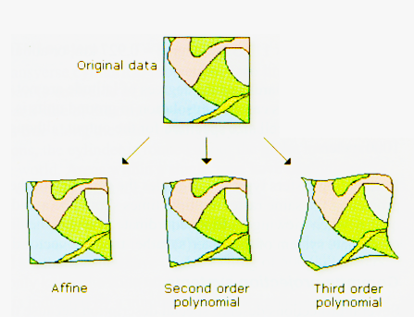

Slide 18
Common projection systems
A Geographic Coordinate System (GCS)
Not actually a projection, but commonly treated as one
Takes degrees (measured as arc or non planar distances) and treats them like equirectangular planar distances
This introduces some error, as lines of longitude converge and a 1° x 1° will not be either a square (except at the equator) or even a rectangle due to the convergence at the poles.

Slide 19
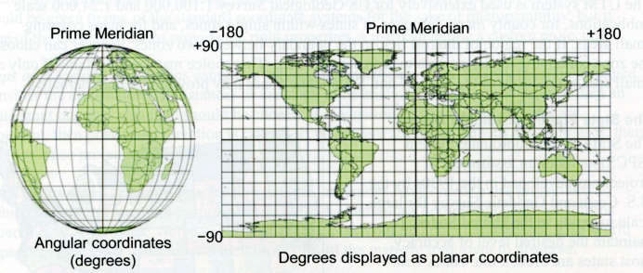

Slide 20
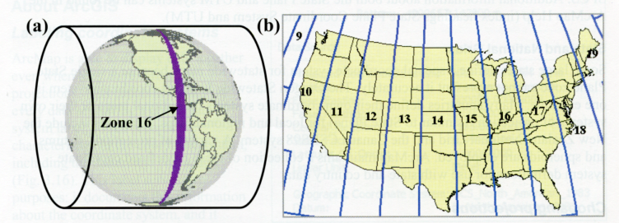
Universal Transverse Mercator (UTM)
Based on Secant transverse cylindrical projection
Divides up Earth’s surface into zones that are approximately 180 KM across (where the secant of the cylinder occurs as it intersects the globe’s surface.

Slide 21
State plane coordinate system
Developed for large scale (small area) mapping of the US
Developed to minimize distortion within a state
Most states are split into at least two (and sometimes more ) zones, similar to zones within UTM
They can use different projections depending on the orientation of the state being projected and where it is located within the US
Lambert conformal conic
Transverse Mercator
Oblique Mercator

Slide 22
