Slide 1
CHEMOTHERAPY

Slide 2
The term chemotherapy has come to connote non-specific usage of intracellular poisons to inhibit mitosis (cell division) or induce DNA damage, which is why inhibition of DNA repair can augment chemotherapy. The connotation of the word chemotherapy excludes more selective agents that block extracellular signals (signal transduction). The development of therapies with specific molecular or genetic targets, which inhibit growth-promoting signals from classic endocrine hormones (primarily estrogens for breast cancer and androgens for prostate cancer) are now called hormonal therapies. By contrast, other inhibitions of growth-signals like those associated with receptor tyrosine kinases are referred to as targeted therapy.

Slide 3
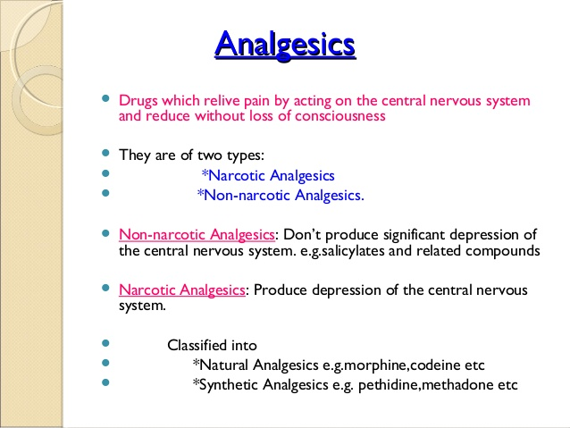

Slide 4
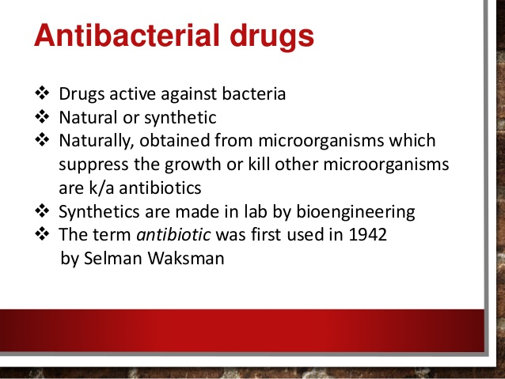

Slide 5
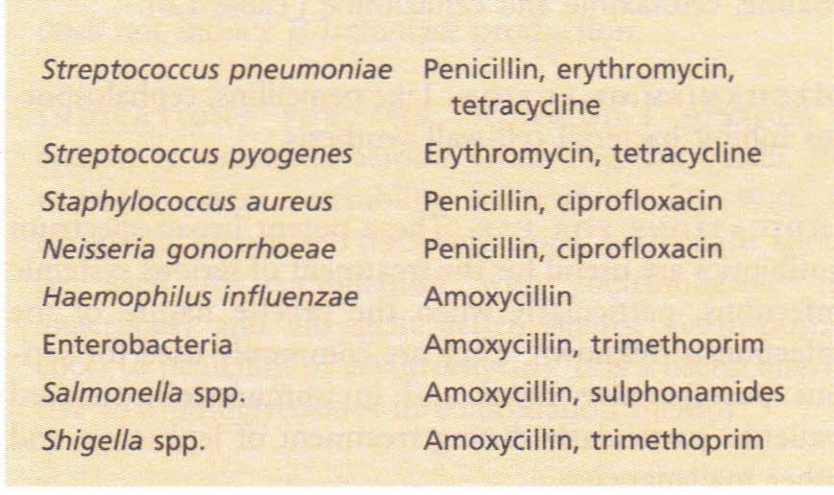

Slide 6
Anti-Inflammatory
What is inflammation?
Certain foods we eat, such as red meat, higher fat dairy products, and fat (saturated and trans) can lead to the development of inflammation. Inflammation is unhealthy and could increase your risk for health problems. Choosing healthy foods can reduce your risk for inflammation and health-related problems.

Slide 7
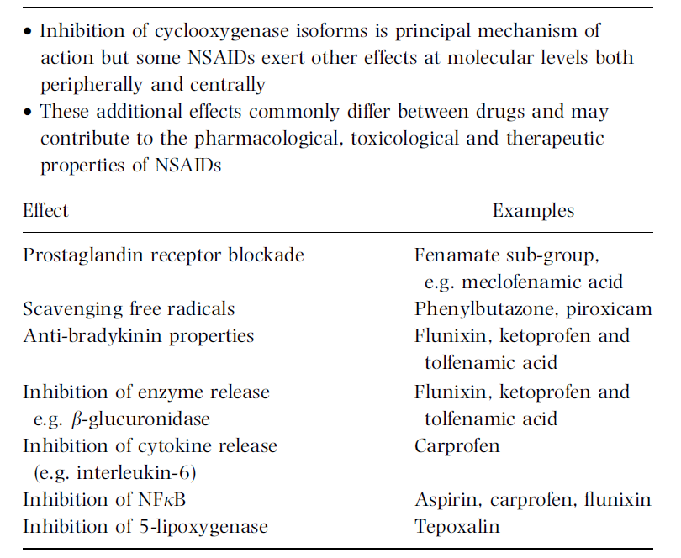

Slide 8
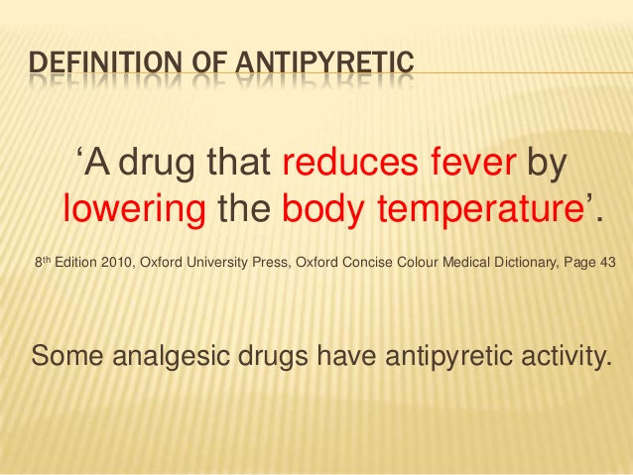
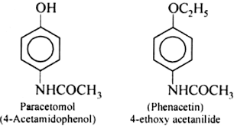

Slide 9
Antibiotic
An antibiotic is a type of antimicrobial substance active against bacteria. It is the most important type of antibacterial agent for fighting bacterial infections, and antibiotic medications are widely used in the treatment and prevention of such infections. They may either kill or inhibit the growth of bacteria.
Antibiotic drug
Amoxicillin.
cephalexin

Slide 10
