Slide 1
Tranquilizers

Slide 2
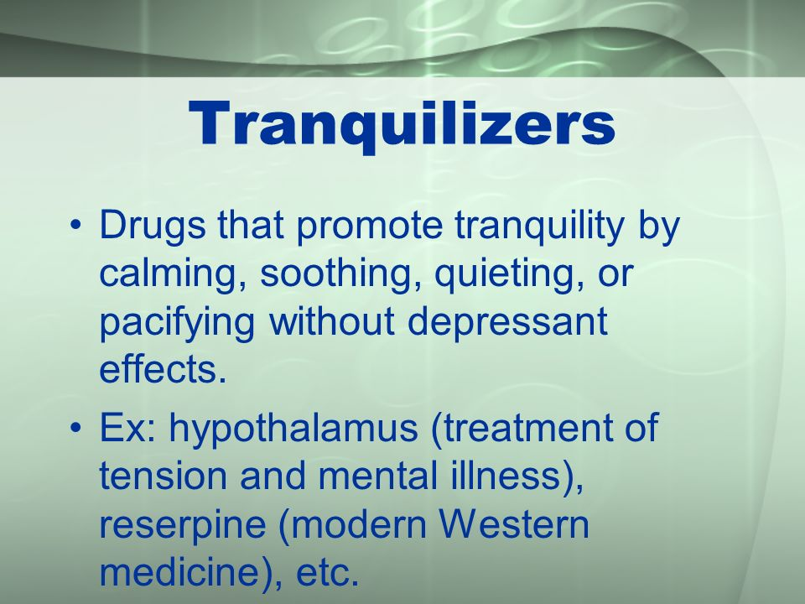

Slide 3
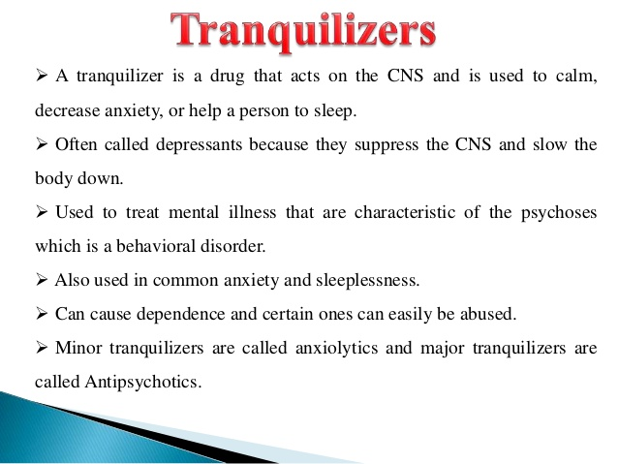

Slide 4
Some examples of tranquilizers are iproniazid and phenelzine.
Benzodiazepines

Slide 5
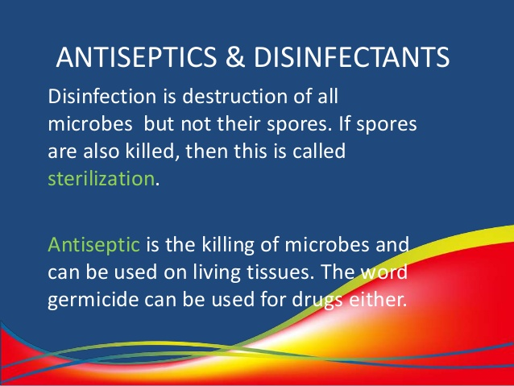

Slide 6
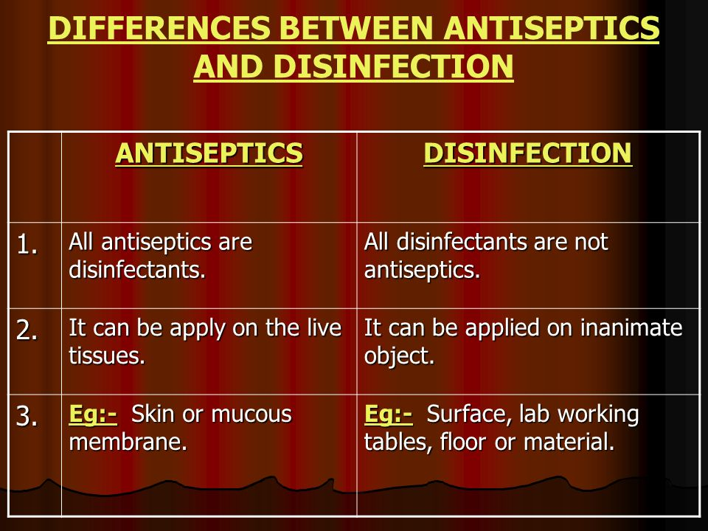

Slide 7
Commonly used antiseptic groups include alcohols, quaternary ammonium compounds, chlorhexidine and other diguanides, antibacterial dyes, chlorine and hypochlorites, inorganic iodine compounds, metals, peroxides and permanganates, halogenated phenol derivatives and quinolone derivatives.
Anti-infectives is a general term used to describe any medicine that is capable of inhibiting the spread of an infectious organism or by killing the infectious organism outright. This term encompasses antibiotics, antifungals, anthelmintics, antimalarials, antiprotozoals, antituberculosis agents, and antivirals.

Slide 8
Anti Malaria
What is Malaria
Malaria is a life-threatening disease. It’s typically transmitted through the bite of an infected Anopheles mosquito. Infected mosquitoes carry the Plasmodium parasite. When this mosquito bites you, the parasite is released into your bloodstream.
Chloroquine
Hydroxychloroquine

Slide 9
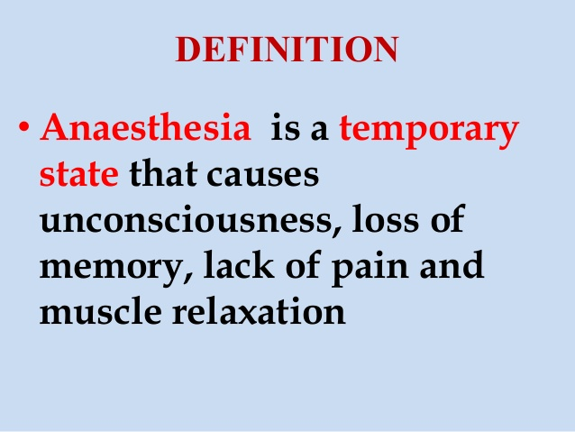

Slide 10
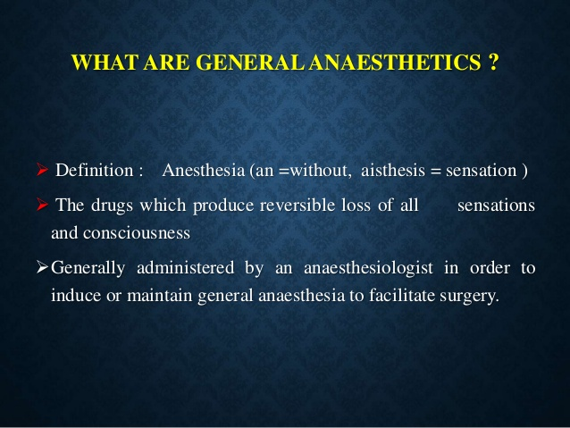

Slide 11
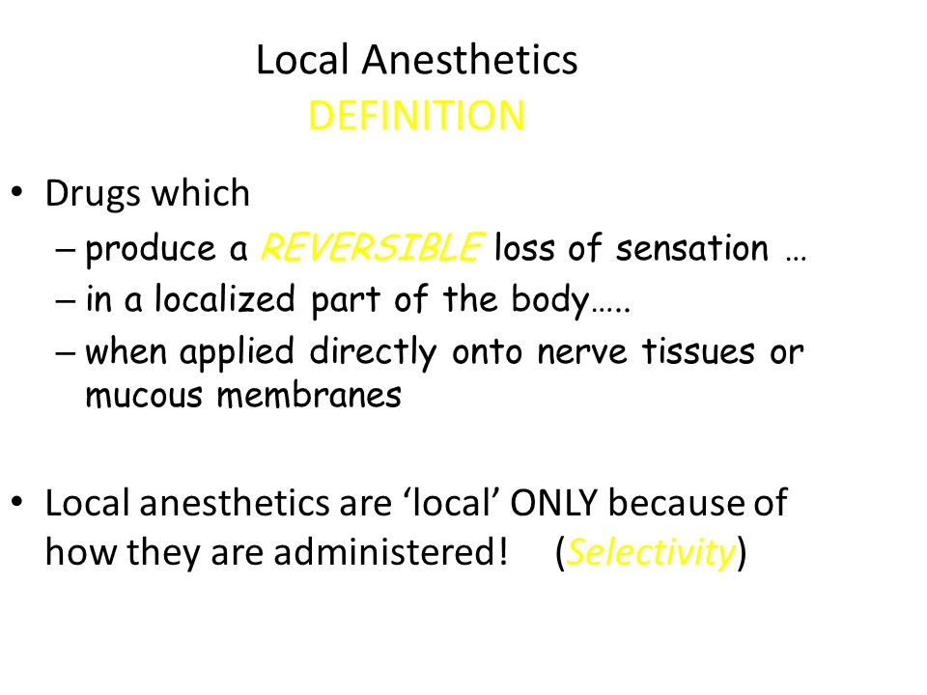

Slide 12
