Slide 1
Fructose

Slide 2
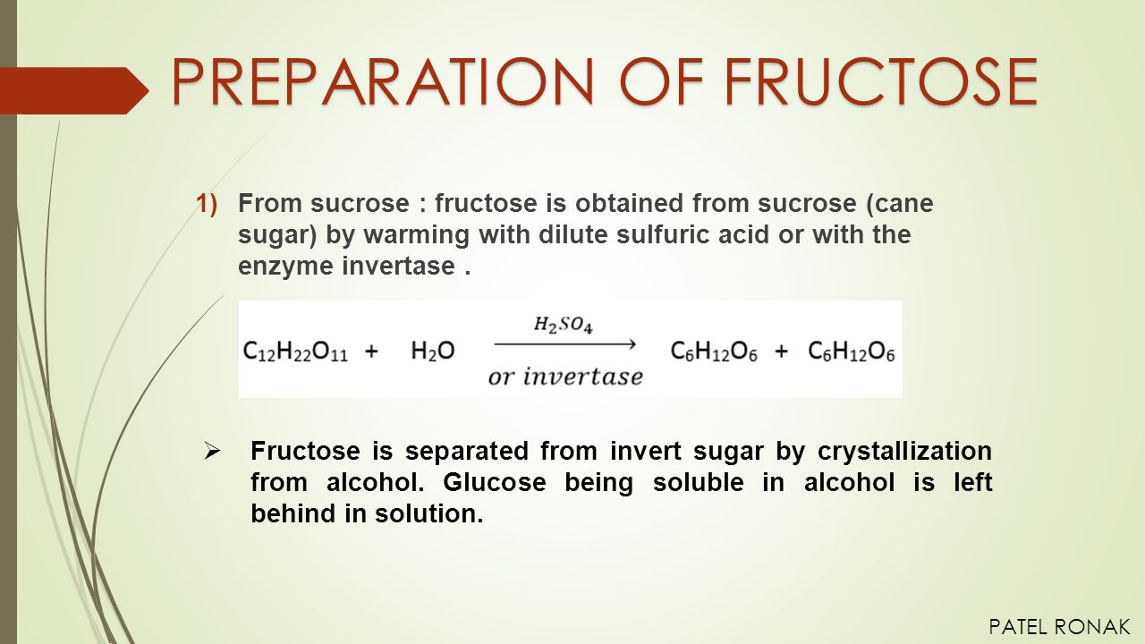

Slide 3
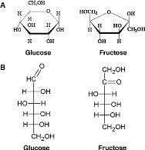

Slide 4
Structure of Fructose
Fructose has a cyclic structure.
Due to the presence of the keto group, it results in the formation of the intramolecular hemiacetal.
In this arrangement, C₅-OH combines with the ketonic group present in the second position.
This results in the formation of chiral carbon and two arrangements of CH₂OH and OH group.
Hence, D-fructose exhibits stereoisomerism in which α-D-fructopyranose and β-D-fructopyranose are the isomers

Slide 5
Physical and Chemical Properties of Fructose
The carbohydrate can be fermented anaerobically with the help of yeast or bacteria in which they are converted into carbon dioxide and ethanol.
Fruit sugar is used in Maillard Reaction with amino acids over glucose as the reaction occurs rapidly as they are present in an open-chain form.
These compounds dehydrate rapidly to give hydroxymethylfurfural. (‘HMF’).
It is a white crystalline solid.
These carbohydrates are highly soluble when compared to other sugars.
They absorb moisture quickly and release it slowly into the environment with respect to other sugars.

Slide 6
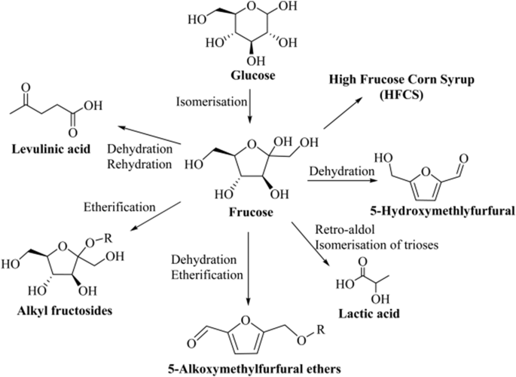

Slide 7
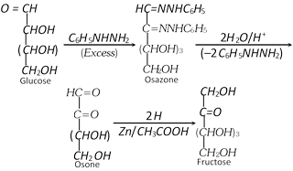

Slide 8
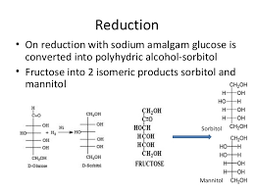

Slide 9
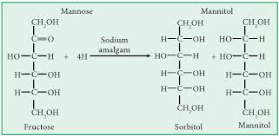

Slide 11
