Slide 1
Acidity constants

Slide 2
The pK_{a} 's of some typical carboxylic acids are listed in the following table. When we compare these values with those of comparable alcohols, such as ethanol (pK_{a} = 16) and 2-methyl-2-propanol (pK_{a} = 19), it is clear that carboxylic acids are stronger acids by over ten powers of ten! Furthermore, electronegative substituents near the carboxyl group act to increase the acidity.

Slide 3
Compound | pK_{a} |  | Compound | pK_{a}
HCO₂H | 3.75 |  | CH₃CH₂CH₂CO₂H | 4.82
CH₃CO₂H | 4.74 |  | ClCH₂CH₂CH₂CO₂H | 4.53
FCH₂CO₂H | 2.65 |  | CH₃CHClCH₂CO₂H | 4.05
ClCH₂CO₂H | 2.85 |  | CH₃CH₂CHClCO₂H | 2.89
BrCH₂CO₂H | 2.90 |  | C₆H₅CO₂H | 4.20
ICH₂CO₂H | 3.10 |  | p-O₂NC₆H₄CO₂H | 3.45
Cl₃CCO₂H | 0.77 |  | p-CH₃OC₆H₄CO₂H | 4.45

Slide 4


this text.
Why should the presence of a carbonyl group adjacent to a hydroxyl group have such a profound effect on the acidity of the hydroxyl proton? To answer this question we must return to the nature of acid-base equilibria and the definition of pK_{a} , illustrated by the general equations given below. These relationships were described in an previous section of this text.

Slide 5
We know that an equilibrium favors the thermodynamically more stable side, and that the magnitude of the equilibrium constant reflects the energy difference between the components of each side. In an acid base equilibrium the equilibrium always favors the weaker acid and base (these are the more stable components). Water is the standard base used for pK_{a} measurements; consequently, anything that stabilizes the conjugate base (A:^{(–)}) of an acid will necessarily make that acid (H–A) stronger and shift the equilibrium to the right. Both the carboxyl group and the carboxylate anion are stabilized by resonance, but the stabilization of the anion is much greater than that of the neutral function, as shown in the following diagram. In the carboxylate anion the two contributing structures have equal weight in the hybrid, and the C–O bonds are of equal length (between a double and a single bond).

Slide 6
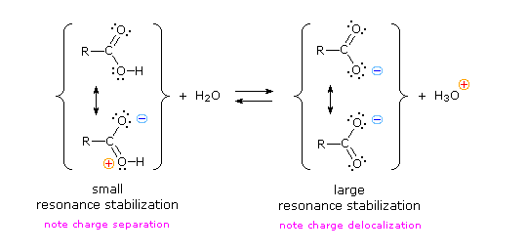

Slide 7
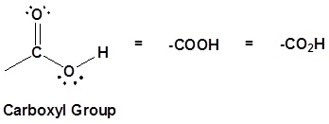
Structure of the carboxyl acid group
Carboxylic acids are organic compounds which incorporate a carboxyl functional group, CO₂H. The name carboxyl comes from the fact that a carbonyl and a hydroxyl group are attached to the same carbon.

Slide 8
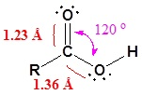
The carbon and oxygen in the carbonyl are both sp² hybridized which give a carbonyl group a basic trigonal shape. The hydroxyl oxygen is also sp² hybridized which allows one of its lone pair electrons to conjugate with the pi system of the carbonyl group. This make the carboxyl group planar an can represented with the following resonance structure.

Slide 9
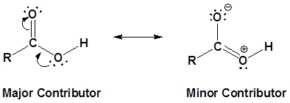
structure.
Carboxylic acids are named such because they can donate a hydrogen to produce a carboxylate ion. The factors which affect the acidity of carboxylic acids will be discussed later.

Slide 10
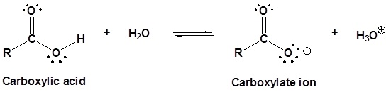
later.

Slide 11
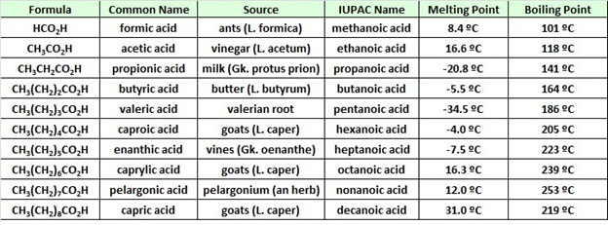
Physical Properties of Some Carboxylic Acids

Slide 12
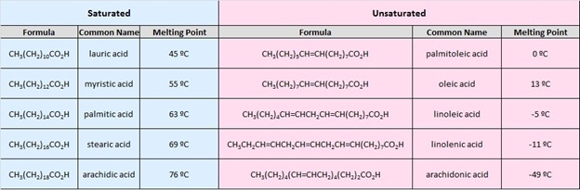
Carboxylic Acids
Carboxylic Acids
Carboxylic Acids

