Slide 1
Di carboxylic acid

Slide 2
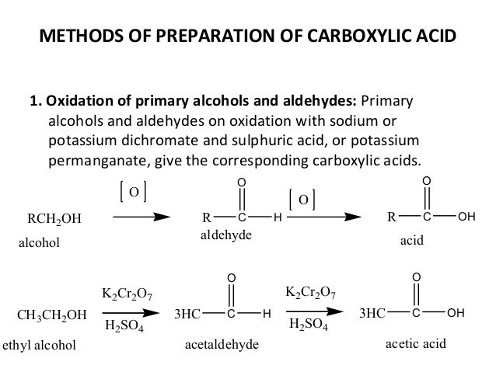

Slide 3
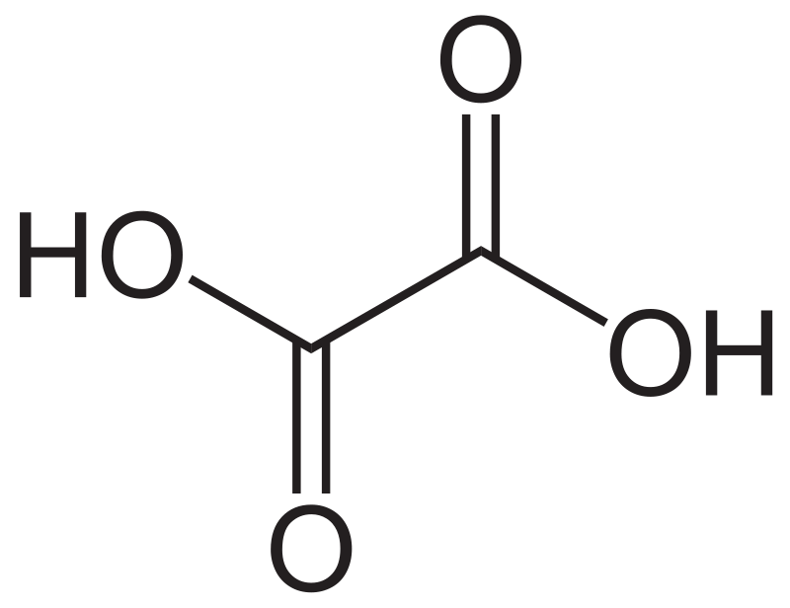
A dicarboxylic acid is an organic compound containing two carboxyl functional groups (−COOH). The general molecular formula for dicarboxylic acids can be written as HO₂C−R−CO₂H, where R can be aliphatic or aromatic.
Oxalic acid is an organic compound with the formula C₂H₂O₄. It is a white crystalline solid that forms a colorless solution in water. Its condensed formula is HOOCCOOH, reflecting its classification as the simplest dicarboxylic acid.

Slide 4
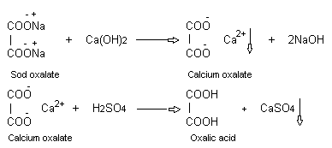
Preparation of oxalic acid

Slide 5
Oxalic acid is a dicarboxylic acid with the chemical formula C₂H₂O₄.
Physical properties of Oxalic acid and :
It's colorless
It's odorless
It's a powder or granular solid at room temperature
Its crystals can have a pyramidal shape to them
In addition, oxalic acid can react violently with things like alkali metals. It is also sensitive to heat, and it is potentially explosive when mixed with certain compounds.
Interestingly, a colorful oxidation reduction reaction occurs when potassium permanganate is mixed with oxalic acid. The reaction turns the purple potassium permanganate into a light brown color.

Slide 6
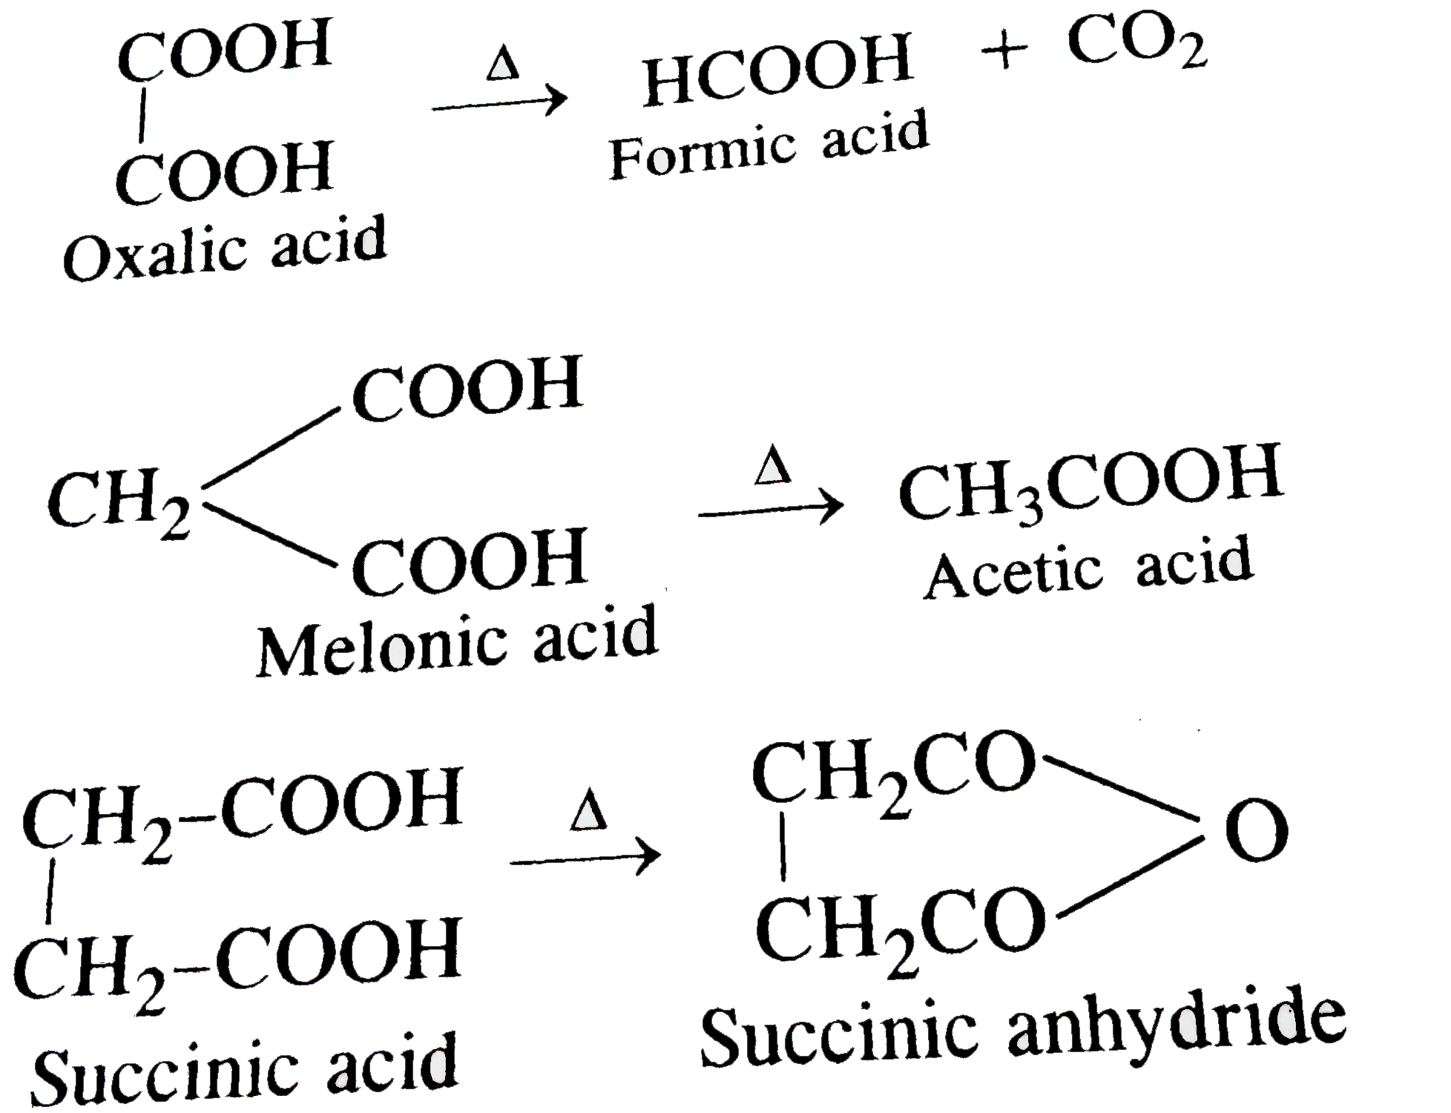
Chemical properties

Slide 7
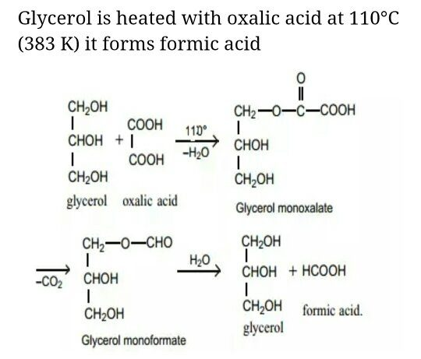

Slide 8
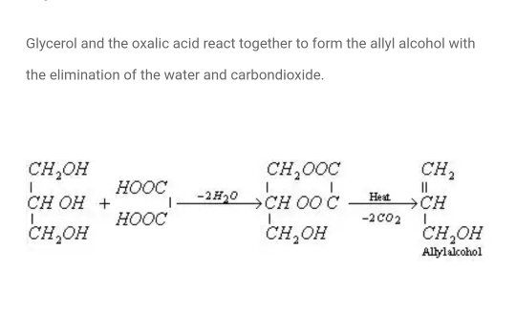

Slide 10
Talking about some uses of Oxalic acid, this chemical is basically an essential household product that is used mainly as a cleaner for various things. In any case, we will look at some applications of this acid below.
Cleaning Agent
Industrial Uses
Medicinal uses
Other Uses
Cleaning Agent
Oxalic acid as mentioned above is mainly used for the toughest cleaning duties. The acid features bleach-like qualities and can be used for things like removing rust and stains on objects and metals. This acid is found in some quantity in several cleaning products, detergents and bleaches. Oxalic acid is also ideal for polishing practically any stone and treating old wood.
Industrial Uses
In industries, this chemical is applied mostly for mineral processing mechanisms. Additionally, Oxalic acid can be used to sterilize equipments and people in the textile space use it for bleaching clothes.
Medicinal Uses of Oxalic Acid
In the medical field, companies make use of the acid to further purify certain chemicals or dilute them. However, there is very fewer data on the health benefits of this acid. Oxalic acid in organic and raw form is non-lethal. But sometimes it can have harmful effects in the body as well

