Slide 1
Malonic acid

Slide 2
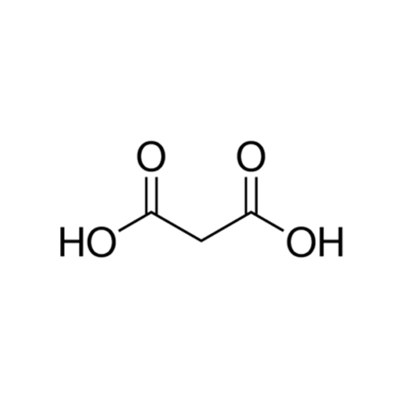
Malonic acid (IUPAC systematic name: propanedioic acid) is a dicarboxylic acid with structure CH2(COOH)2.
Malonic acid is also known as Propanedioic Acid or Dicarboxymethane.
Malonic acid was first prepared in the year, 1858 by the French chemist Victor Dessaignes by the oxidation of malic acid. Malonic acid is found in some fruit’s viz citrus fruits. The amount of malonic acid produced from fruits through organic farming is greater than the fruits grown through conventional agriculture. Malonic acid can be produced through the fermentation of glucose.

Slide 3
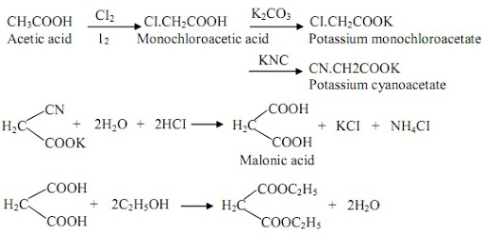
Preparation of malonic acid

Slide 4
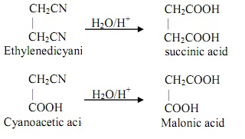
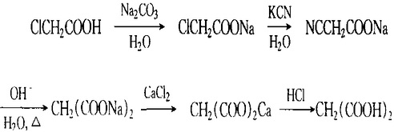

Slide 6
Properties of Malonic acid – C₃H₄O₄
C₃H₄O₄ | Malonic acid
Molecular Weight/ Molar Mass | 104.061 g/mol
Density | 1.619 g/cm³
Boiling Point | Decomposes
Melting Point | 135 to 137°C

Slide 7
Chemical properties of malonic acid

Slide 8
Uses of Malonic acid – (C₃H₄O₄)
The uses of malonic acid are listed below.
Malonic acid is used as a precursor in polymers and polyester.
It is used in flavours as well as the fragrance industry.
It is used to control the acidity.
It is used in pharmaceutical products.
It is used as a cross-linking agent between potato starch and cornstarch to enhance its mechanical properties.
It is used in the preparation of barbituric salt.
It is used in electroplating.
It is used to produce vitamin B1, vitamin B6, vitamin B2, and amino acids.
It is used in chemical synthesis as a building block.

