Slide 1
Succinic acid

Slide 2
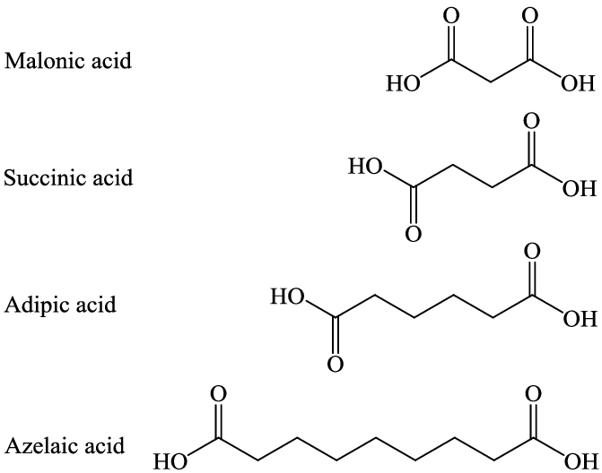

Slide 3
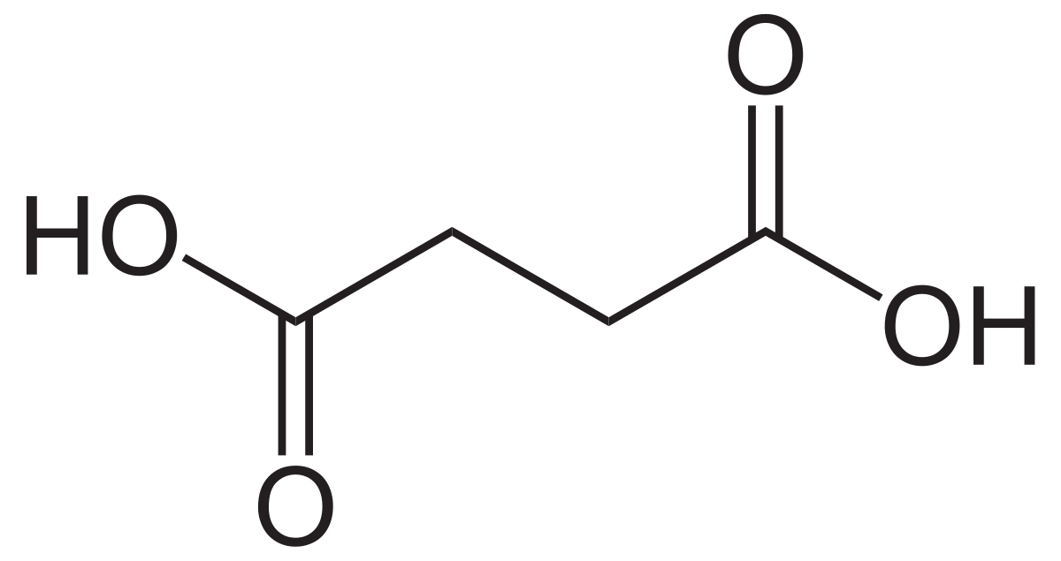
Succinic acid is a dicarboxylic acid with the chemical formula (CH₂)₂(CO₂H)₂.

Slide 4
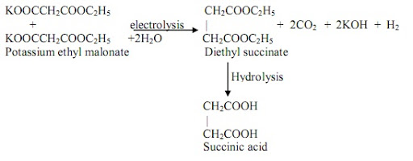
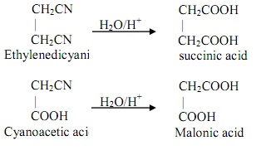
Preparation of Succinic acid

Slide 6
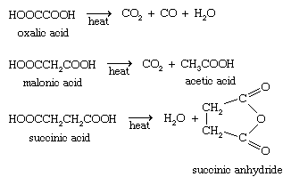
Physical properties
The yield of succinic acid is 80% theoretical. Colorless prisms; soluble in water, alcohol, and ether; insoluble in chloroform; sublime above 100° C without decomposition; m.p. 185° C; at 235° C decompose forming the anhydride.

Slide 7
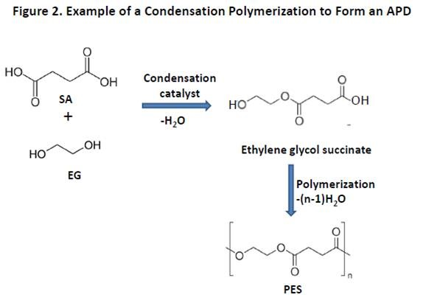

Slide 8
