Slide 1
Glutaric acid

Slide 2
Glutaric acid is the organic compound with the formula C₃H₆(COOH)₂ . Although the related "linear" dicarboxylic acids adipic and succinic acids are water-soluble only to a few percent at room temperature, the water-solubility of glutaric acid is over 50% (w/w).

Slide 4
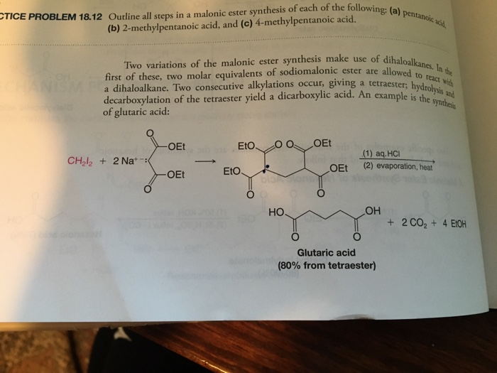

Slide 5
[(A) (from Trimethylene Cyanide)]
Trimethylene Cyanide

Slide 6
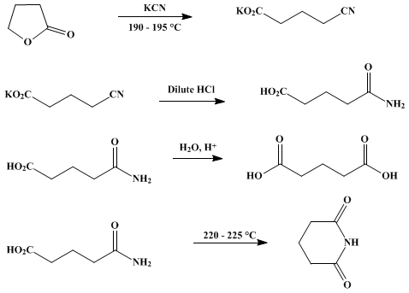
γ-butyrolactone
Formalin
Ethyl Malonate

Slide 7
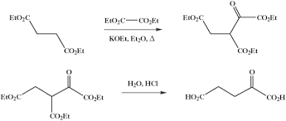
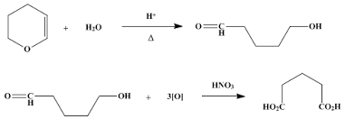
Diethyl malonate
1H Pyran

Slide 8
Properties Of Glutaric acid
Chemical formula | C₅H₈O₄
Molecular weight | 132.12 g/mol
Melting point | 95 to 98 °C
Boiling point | 200 °C

Slide 9
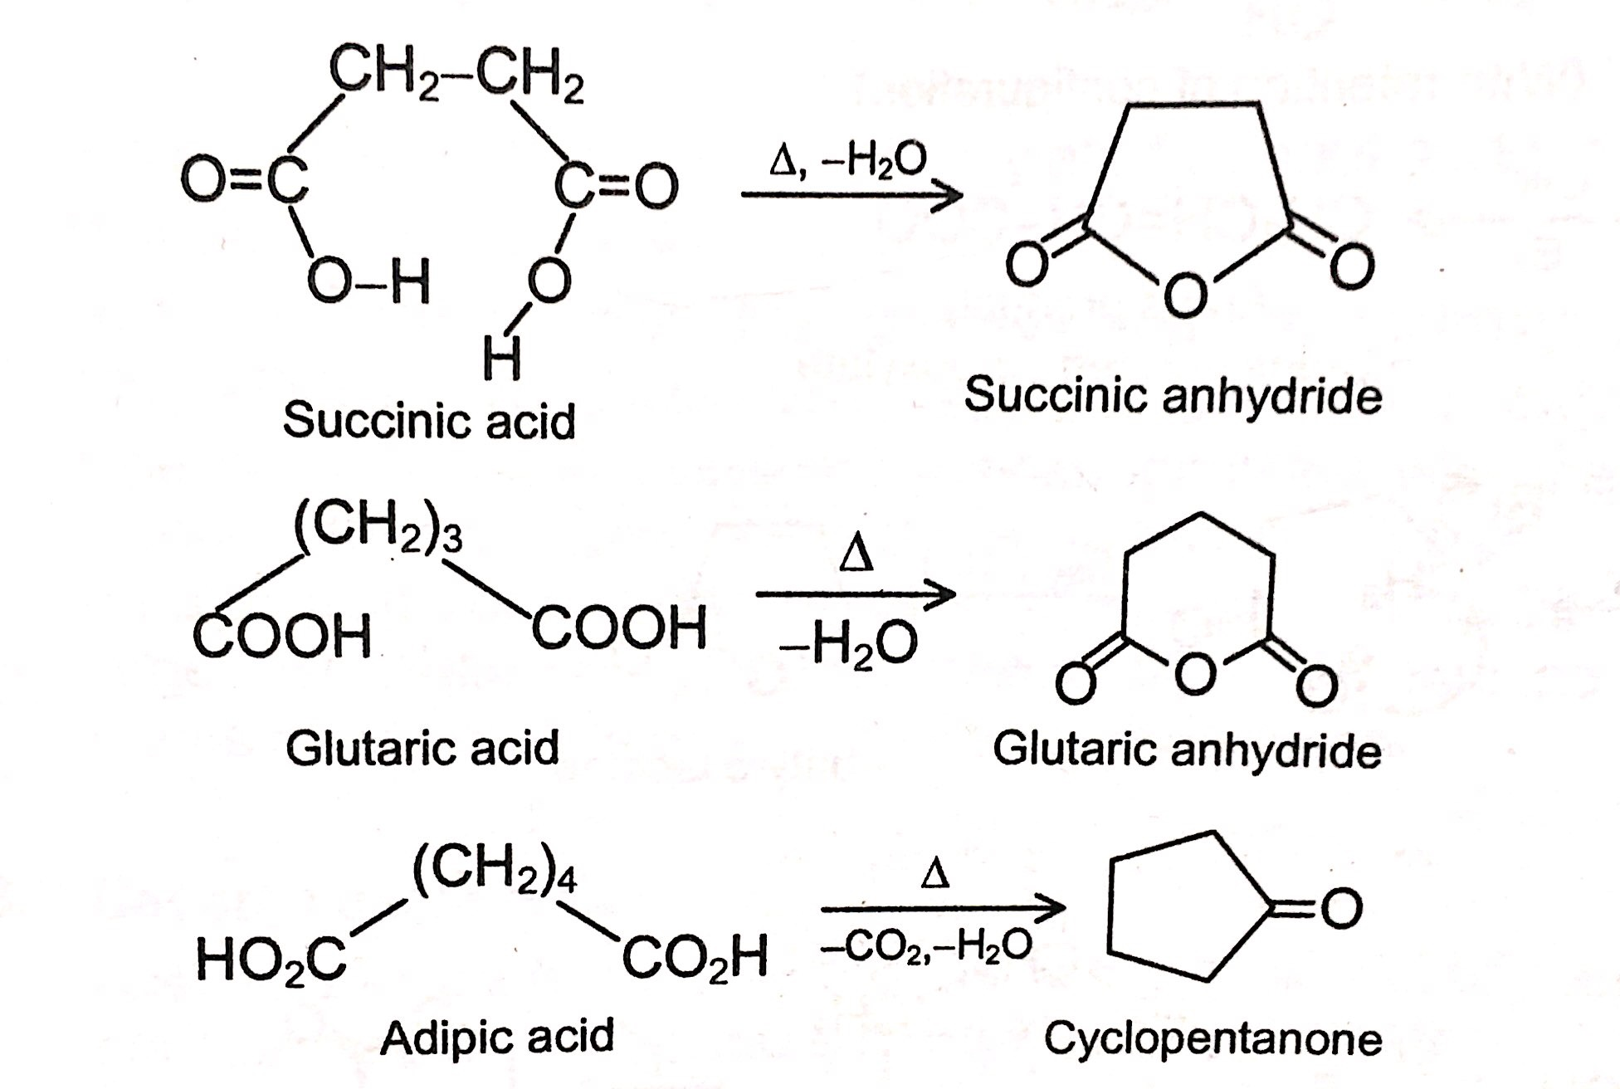

Slide 11
1,5-Pentanediol, a common plasticizer and precursor to polyesters is manufactured by hydrogenation of glutaric acid and its derivatives.
Glutaric acid itself has been used in the production of polymers such as polyester polyols, polyamides. The odd number of carbon atoms (i.e. 5) is useful in decreasing polymer elasticity.^{[citation needed]}
Uvitonic acid is obtained by the action of ammonia on glutaric acid.

