Slide 1
Adipic acid

Slide 2
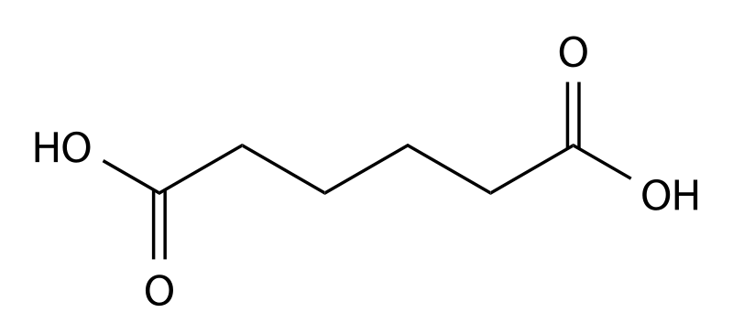
Adipic acid is an important inudstrial dicarboxylic acid with about 2. 5 billion kilograms produced per year. It is used mainly in the production of nylon. It occurs relatively rarely in nature. It has a tart taste and is also used as an additive and gelling agent in jello or gelatins.

Slide 3
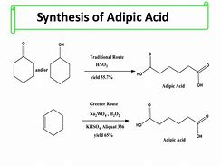
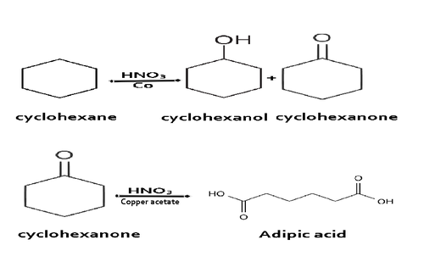

Slide 4
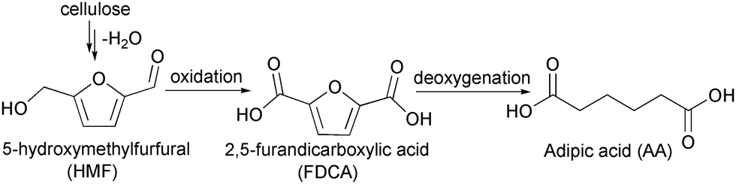

Slide 5
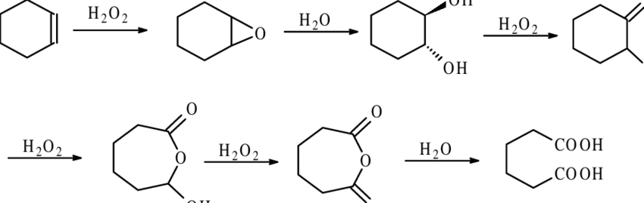

Slide 6
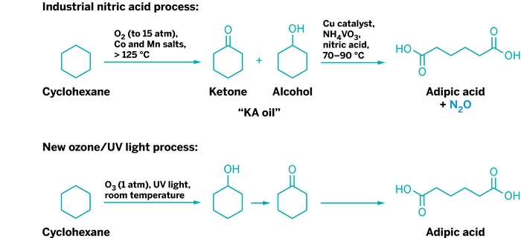

Slide 7
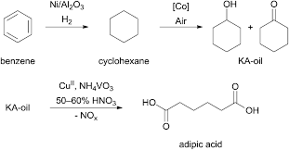

Slide 8
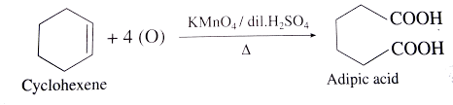
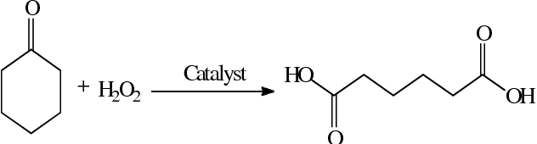

Slide 9
Physical properties
Chemical formula: C₆H₁₀O₄
Melting point: 152.1 °C (305.8 °F; 425.2 K)
Molar mass: 146.142 g·mol−1
Solubility in water: 14 g/L (10 °C), 24 g/L (25 °C), 1600 g/L (100 °C)

Slide 10
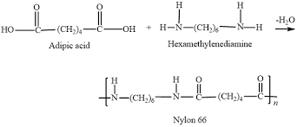
Chemical properties

Slide 11
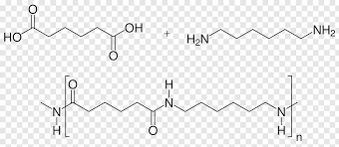

Slide 12
