Slide 1
Hydroxyl acids

Slide 3
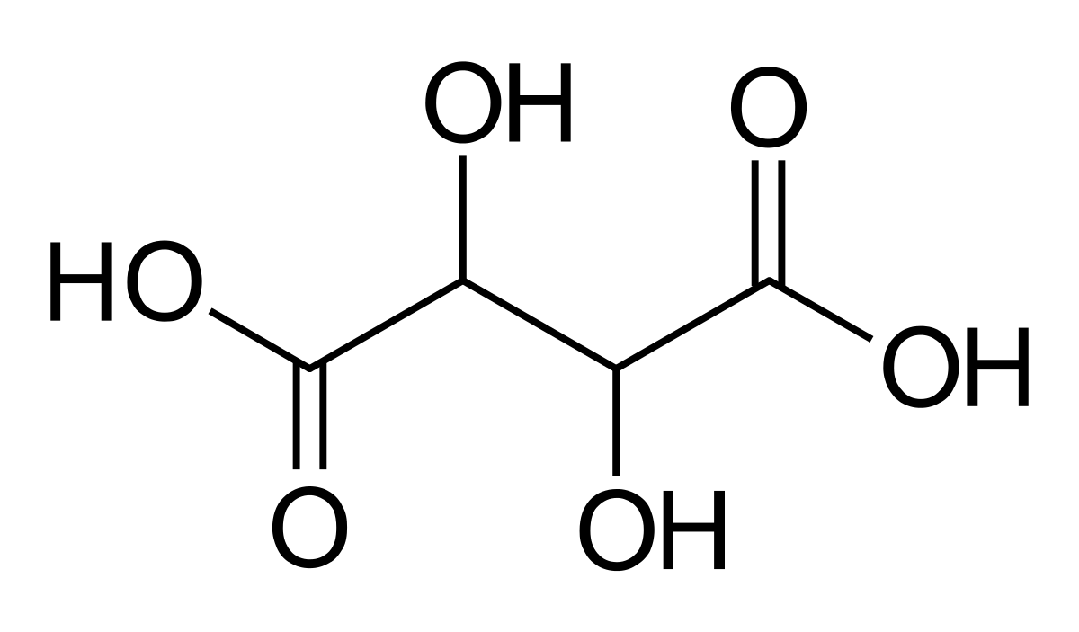

Slide 4
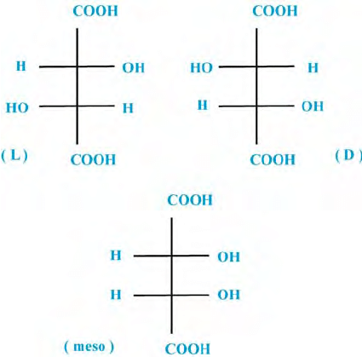

Slide 5
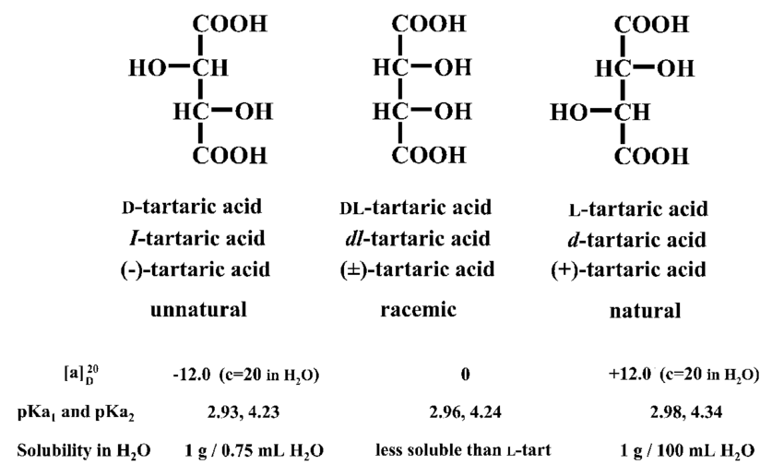

Slide 7
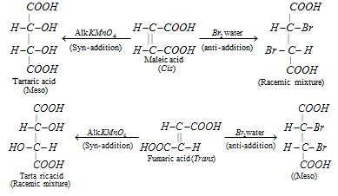

Slide 8
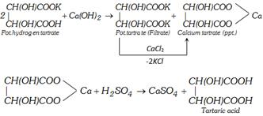

Slide 9
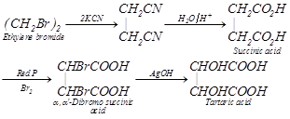

Slide 10
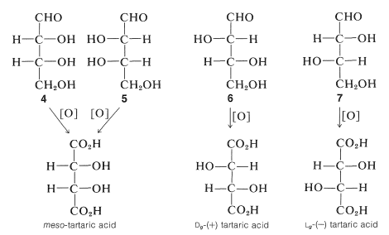

Slide 11
Physical Properties : It is a colourless crystalline compound. It is soluble in water and alcohol but insoluble in ether. It contains two asymmetric carbon atoms and thus shows optical isomerism (four forms). Natural tartaric acid is the dextro variety. It contains two secondary alcoholic groups and two carboxylic groups.

Slide 12
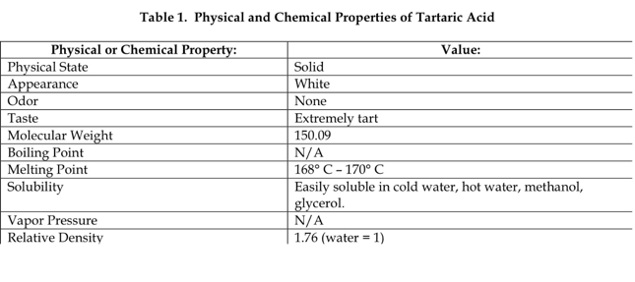

Slide 14
