Slide 1
Malonic ester

Slide 2
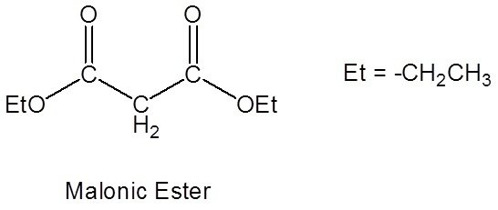

Slide 3
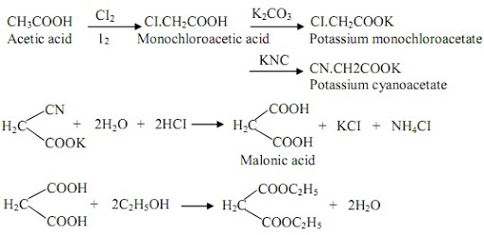
Synthesis of Malonic ester

Slide 4
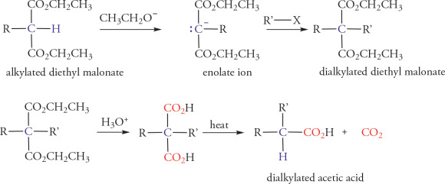
Characteristics of reactive methylene group

Slide 6
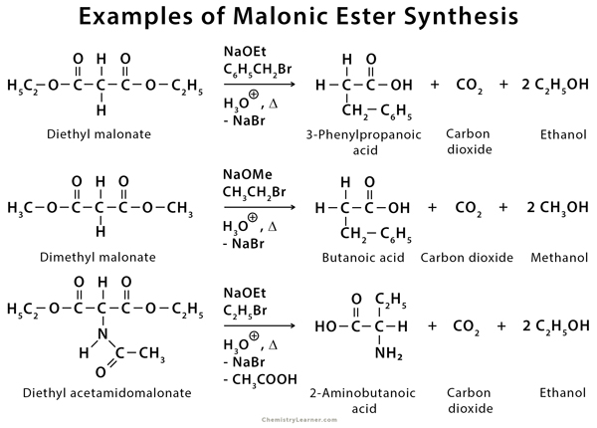

Slide 8
