Slide 1
Wave dualism

Slide 2
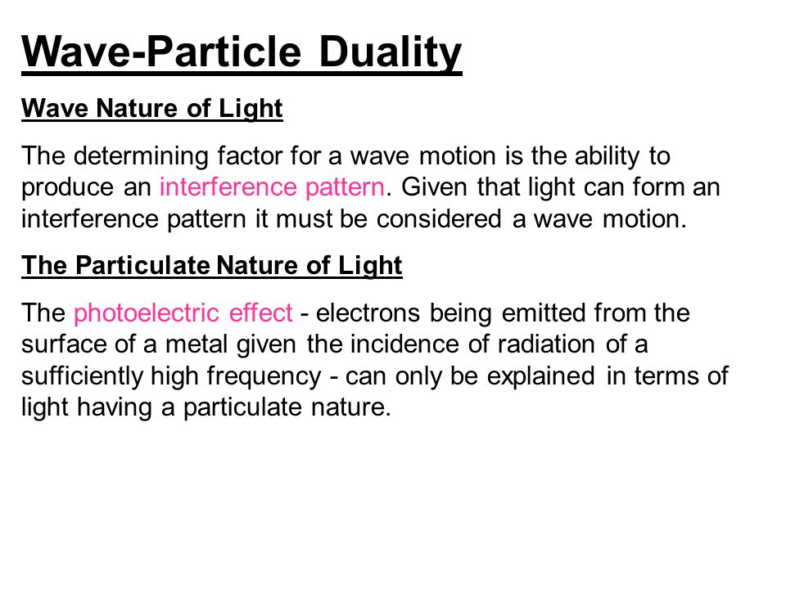

Slide 3
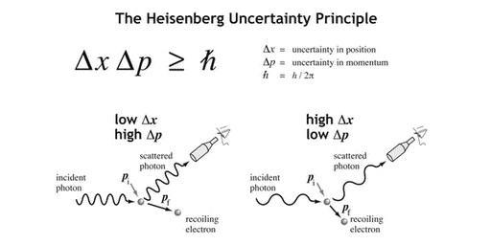

Slide 4
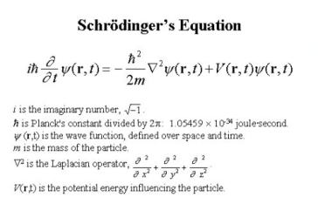

Slide 5
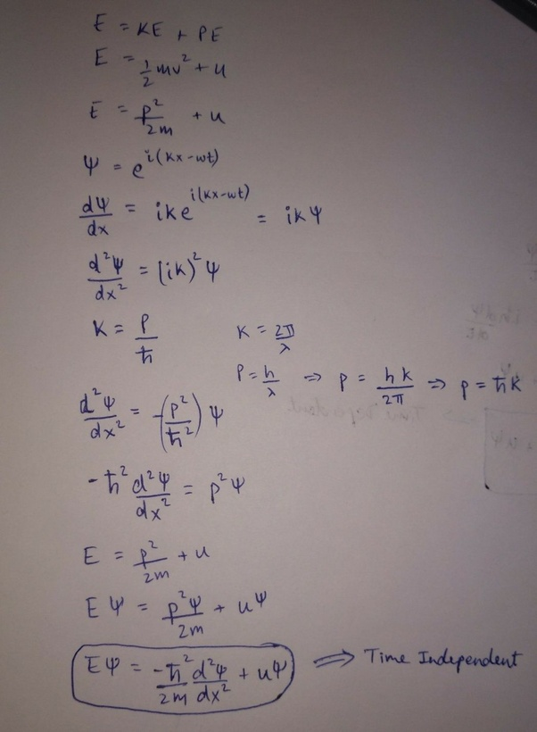

Slide 6
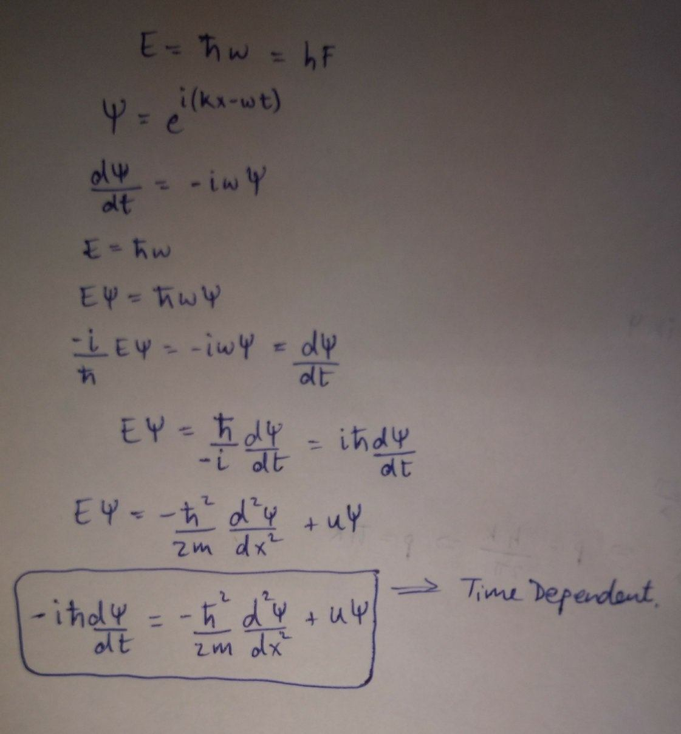

Slide 7
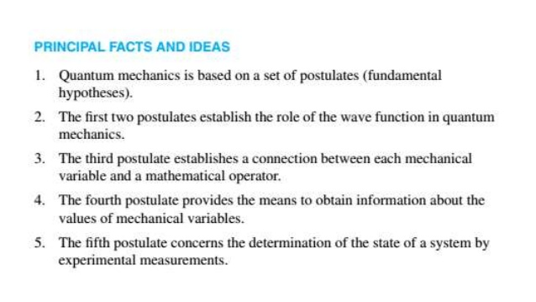

Slide 8
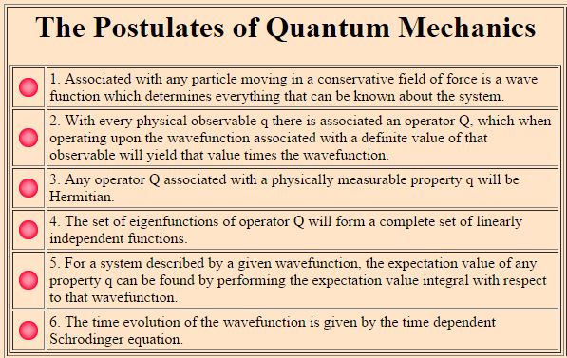

Slide 9
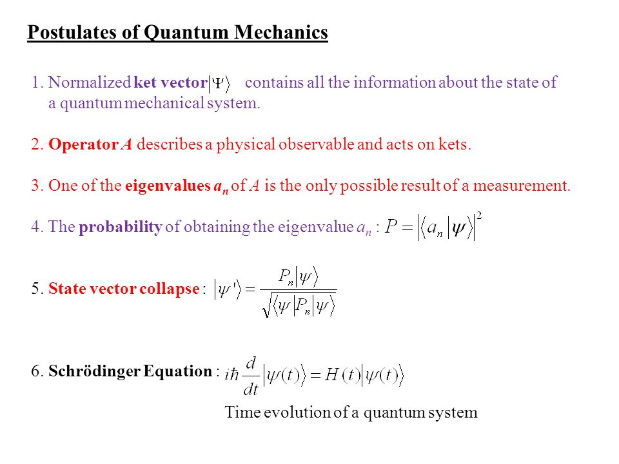

Slide 10
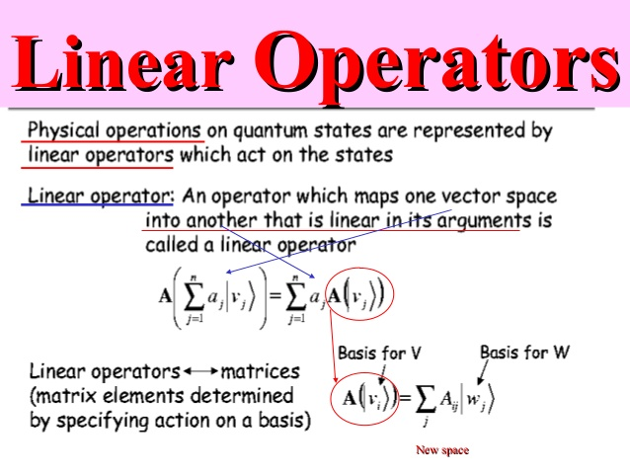

Slide 11
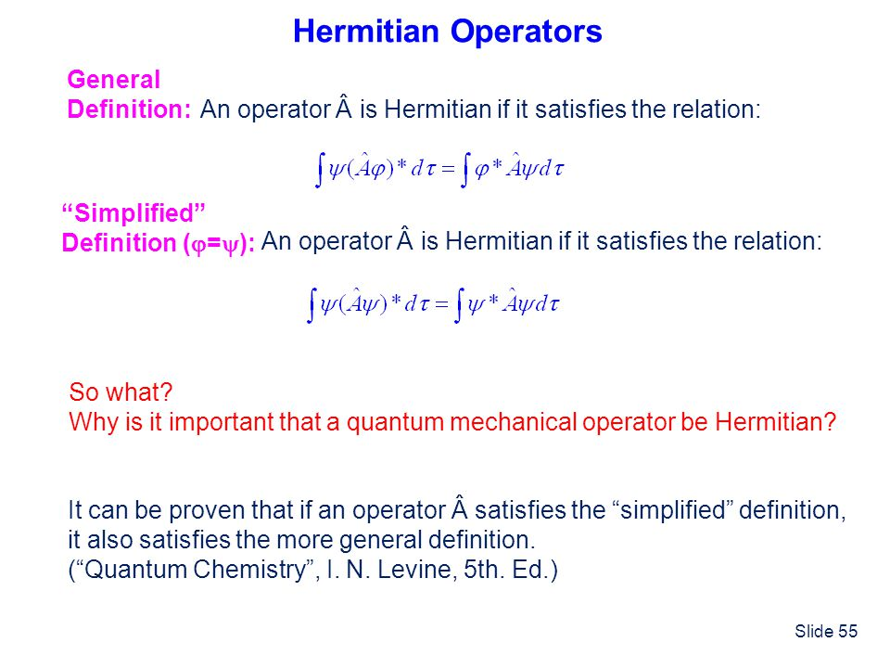

Slide 12
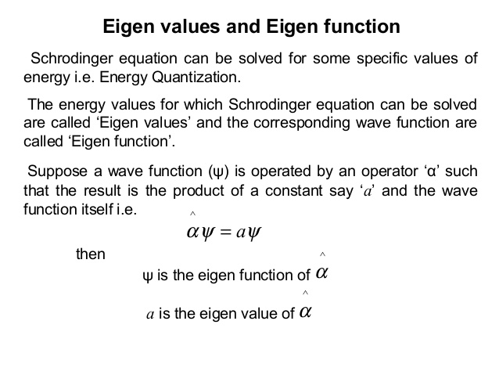

Slide 13
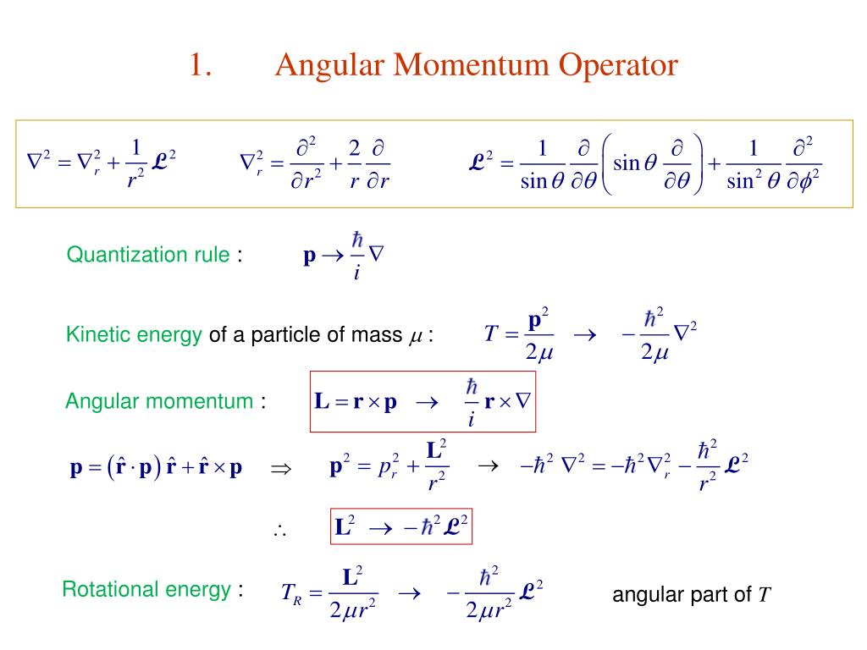

Slide 14
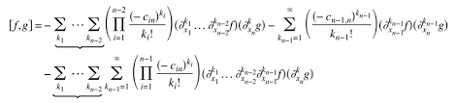
Commutation relations and related theorems

Slide 15


Orthogonality Principle
As discussed previously, any vector in a vector space can be expressed as a linear combination of the basis vectors that span the space. Here we will consider how the vector can be optimally approximated in a subspace spanned by a subset of the basis vectors. Specifically we assume a given function in the function space is approximated in a subspace by

Slide 16


