Slide 1
Carbonyl compounds

Slide 2
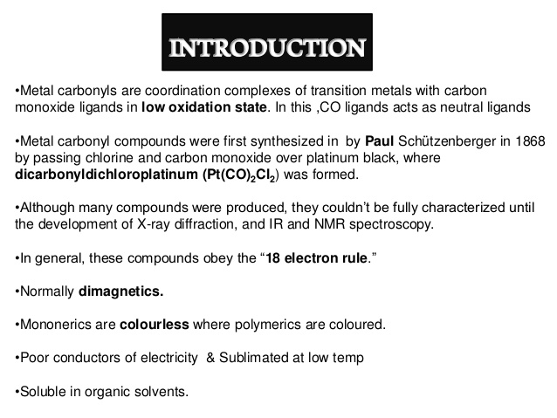

Slide 3
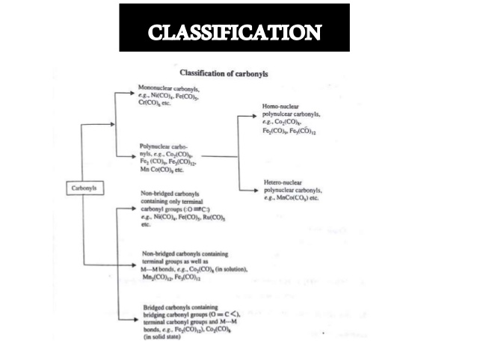

Slide 4
Metal Carbonyl are the compounds the CO group is attached to a metallic element.
Classified into 2 group
(a)Mononuclear carbonyls M(CO)x
(B)Polynuclear carbonyls M2(CO)y
MNC are formed by metals with even atomic number
Dia magnetic in nature

Slide 5
Nickel carbonyl-mononuclear carbonyl
Synthesis
1.Nickel carbonyl can be obtained by passing CO over nickel at 60 degree
Ni + 4CO----- Ni(CO)₄
2.When nickel iodide is heated with CO
NiI₂ + 4CO-----Ni(CO)₄ +I₂
3.CO react with alkaline suspension of nickel sulphate or nickel cyanide give NiCO

Slide 6
NiS +4CO-----Ni(CO)₄ + S
Ni(CN)₂ + 4CO----Ni(CO)₄ +(CN)₂
Reactions
1.Action of heat-nickel carbonyl decomposed when heated
Ni(CO)₄ ----- Ni + 4CO
2.Action of acids : Ni(CO)₄ +H₂SO4----- NiSO₄+H₂+4CO
3. With bases : Ni(CO)₄ + Ba(OH)₂---H₂Ni(CO)₃+BaCO₃
4.With halogens: Ni(CO)₄ + Cl2--- NiCl2 +4CO
5. Displacement reaction: Ni(CO)₄ +PCl₃---Ni(CO)₂(PCl₃)₂ +2CO
6.With HI: 2HI + Ni(CO)₄ ----NiI₂ + H₂+4CO

Slide 7
Action of nitric acid: It reacts with nitric acid and give a compound of intense blue colour Ni(NO)(OH)
Physical properties :
It is extremely toxic.
colourless liquid on heating suddenly it may explode mildly.
It is miscible with benzene and is almost insoluble in water.

Slide 8
Structure
The electron diffraction studies shows that the configuration is tetrahedral and Ni-C-O group is linear.
Raman spectral studies have revealed that the oxygen atom is triply bonded to C atom in the CO group.
It is assumed that the Ni atom has the configuration is 1s²2s² 2p⁴ 3s² 3p⁶3d⁸4s²

Slide 9
Stucture of nickel tetra catbonyl
n nickel tetracarbonyl, the oxidation state for nickel is assigned as zero.
The formula conforms to 18-electron rule. The molecule is tetrahedral, with four carbonyl (carbon monoxide) ligands. Electron diffraction studies have been performed on this molecule, and the Ni–C and C–O distances have been calculated to be 1.838(2) and 1.141(2) angstroms respectively.

Slide 10
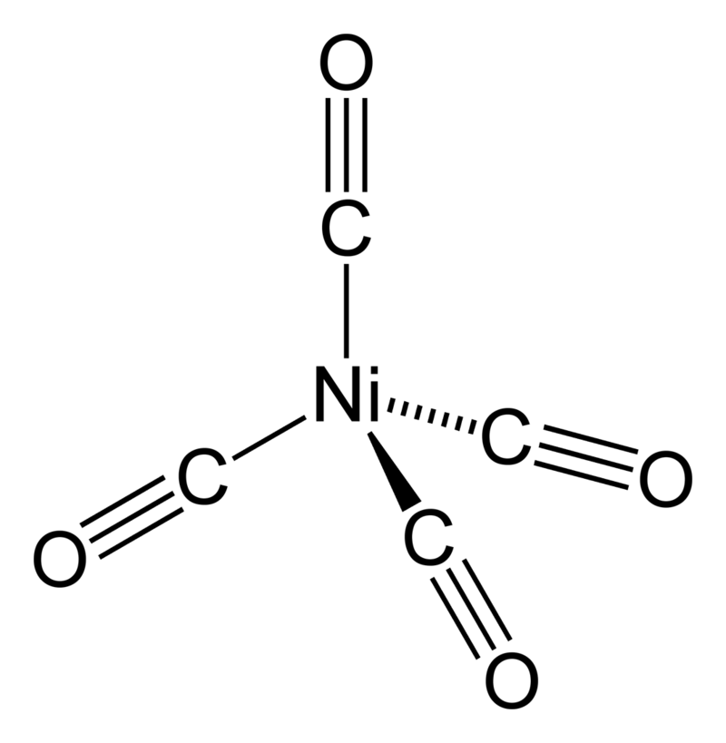

Slide 11
Uses of nickel carbonyl
Useful in the extraction of nickel by monds process
Utilized for purification of nickel
It is used for the preparation of metal mirrors and plates.
Used for glass plating
It is used as a catalyst.

Slide 12
Binuclear carbonyls of Ni
Binuclear carbonyls are formed by metal with odd atomic numbers. The atomic no of Ni is 28. So it does not form a binuclear complex.

